Slide 1
Meet the Teacher
2018-2019
Mrs Bailey

Slide 2
Welcome to Year 3

Slide 3
Topics!
Autumn – The Romans – Trip to Chester
Spring – Anglo Saxons – Workshop/trip
Summer – The Vikings – Viking invasion

Slide 4
General Information/Routines
Water bottles
P.E Kits in every day
  Labelled
Safety
  Earrings taken out or covered
  Long hair tied back
Home time
Pencil cases

Slide 5
Updating information
Updating contact details
Inhalers
Medical information

Slide 6
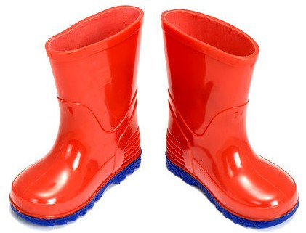
Wellies!
Welly sheds
Field will be available to the children all year round
Children to bring in a set of wellies, old trainers or walking shoes suitable for playing/working on the field in all weathers
Please make sure they are named!

Slide 7

Expectations
My hopes for your children:
  Enjoyment of school and learning – a child learns best and achieves more when they are happy! ☺
  A smooth transition into KS2
  Prepared to make mistakes – they help us learn
  Independence
  A motivation to learn
  Trying their best at all times to be the best they can be
  A good partnership between the child, their parents and the school

Slide 8
Rewards
House points
Star of the week
VIP
Super writer

Slide 9
Transition to ks2
Main changes:
  No fruit break in the afternoon
  Spellings sent home and tested
  Guided reading
  Planners
  Homework days
  Lockers
  Swimming

Slide 10

Reading
Promote a love for reading
Read at home with your child – ideally 3-4 times a week
Ideally children to read a little each day

Slide 11
Accelerated reader
Whole-school scheme
In addition to Guided Reading
Children will choose a book suited to their reading level
Once finished – quiz on the hybrids
Star reader assessment each half term

Slide 12
Homework
Guided Reading & Planners:
  Homework is given on your child’s Guided Reading day to be returned on the same day the following week
  Your child will need to bring their homework book in on their Guided Reading day for the homework to be marked and the new homework to be set
  Planners will also be taken in on the Guided Reading day

Slide 13
Homework
Spellings:
  Spellings will be given on a Monday – they will be stuck inside their homework book as part of their EMA alongside a suggested activity to help them practise the words
  Test will be on Friday
  Children will also bring home a list of statutory spelling words to practise – tested half termly

Slide 14
Homework
Maths:
  MyMaths online homework – goes live on Friday to be completed by the following Friday
  Log on will be in planner

Slide 15
How you can help
Reading at home with your child
Providing an environment where they can complete their homework with appropriate support if necessary
Practising spellings and times tables – Times table rock stars!
Raising any concerns as soon as possible - no matter how small!

Slide 16

Concerns
If you do have any worries or concerns then please do come and see me as soon as possible.
You are welcome to come and see me before or after school
If you would like to see me before school then please make sure it is before 8.50am and come through the main entrance
If you are unable to come in please do write a note in your child’s planner (Please make sure your child gives me their planner!) or phone the school office who will relay the message to me.

Slide 17
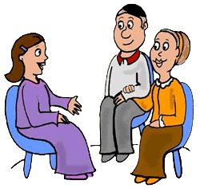
Communication between home and school is very important and can have a positive impact on children’s learning and experiences at school.

Slide 18


Helpers
I would welcome any help with topic books, hearing readers and working with groups. You might have a special skill such as sewing, baking, building or art, to name but a few!
Please do let me know if you can help regularly, or on occasions, as help is always warmly welcomed and greatly appreciated.

Slide 19
Thank you
Thank you for coming
Any questions?

