Slide 1
Welcome

Slide 2
“Reading feeds the imagination, it expands
horizons and offers new and exciting ways of seeing and making sense of our lives and of the world around us.”
Michael Morpurgo

Slide 3
Who is Read Write Inc. for?
Phonics is for children in Reception, Y1 and Y2 who are learning to read.
Phonics is also for children in Y3 and Y4 who haven’t met the KS1 reading expectations

Slide 4
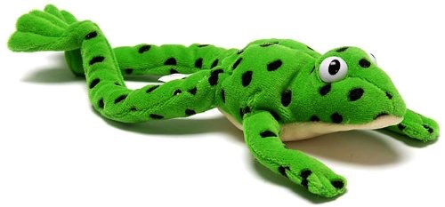
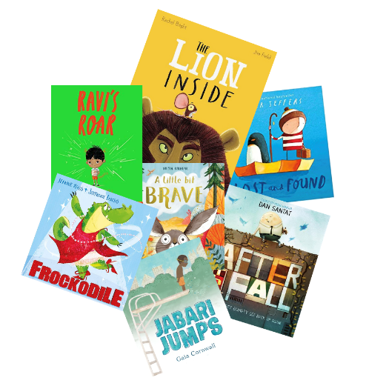

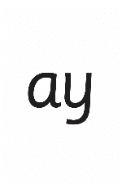



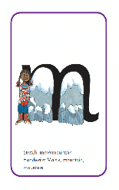
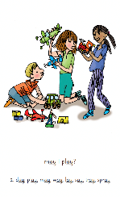
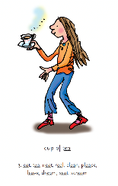
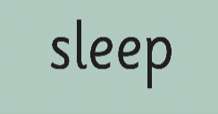
Read Write Inc. Phonics daily lessons
We teach children to read and write sounds, children practise reading and spelling words containing these sounds, then we give children decodable books containing sounds and words they can read.
They read each Storybook three times at school and again with you at home. On each reading, children’s fluency increases and the more they can focus on what the story is about.
Children also learn to spell the words they have been reading and develop their ideas into sentences.
Alongside this we read stories to children: stories they cannot yet read for themselves

Slide 5
Progress groups
Group children by phonic stages.
Teach to the group’s challenge level.
Re-assess all children every half term.
In the same way as children learning to swim, play the violin or learn tai kwondo, while your children are learning to read, they work in progress groups to master each level of phonics and reading.
Children work in these progress group for one 40 minutes each day. This means they are learning at their ‘challenge’ level for 3.5 hours a week. (Reception children build up to this throughout the year).
As the reading leader, I assess and re-group the children every half-term. This allows us to whisk children through the phonic stages as quickly as possible.

Slide 6
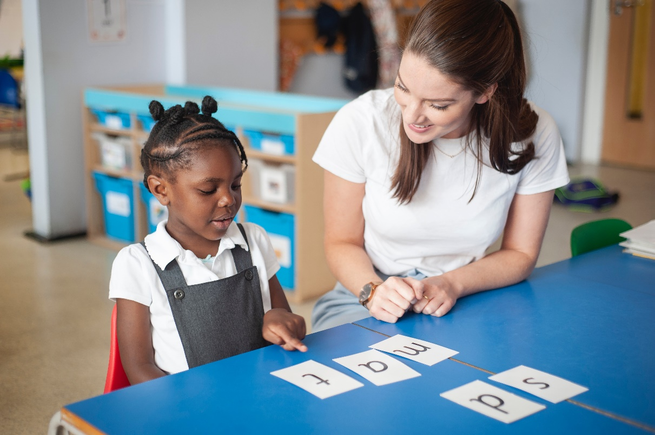
One-to-one tutoring – ‘keep up, not catch up!’
We want to make sure every child learns to read in our school.
Some children need extra practice when learning to read so we teach these children one-to-one for a few minutes every day – on top of their group lesson.
We make sure they ‘keep up’ from the beginning and don’t need ‘catch up’ later on.

Slide 7


What is phonics?
All words are made up of individual sounds. These sounds are blended together to form words. e.g. in ‘mat’ we have the sounds ‘m’, ‘a’, ‘t’, ship – ‘sh’, ‘i’, ‘p’.
A grapheme is another name for the letters we use to write the sound. It’s spelling of a sound on the page.
Using phonics, children learn to read by saying each sound and blending them to read a word. Children learn to spell by segmenting a word into sounds and writing the matching graphemes.
The National Curriculum ensures that all children are taught Phonics systematically. This gives your children the tools to read any word, for example demonstrate, containing, roamed, trivial, injured, whimper.

Slide 8
English alphabetic code
44 sounds
26 letters
Over 150+ graphemes (letter combinations)
One of the most complex alphabetic codes in the world.
We use 44 sounds to make all the words in the English language. This means we’ve got a problem. We’ve got 44 sounds and only 26 letters!
The 26 letters work singly, in pairs and sometimes in threes to represent one sound.
We have to group letters together to write some sounds e.g. ‘igh’, ‘air’.
In English we have more than 150 ways to represent 44 sounds, using the 26 letters in the alphabet.
This makes our language one of the most complex in the world!

Slide 9
Speed Sounds Set 1 and Set 2

Slide 11
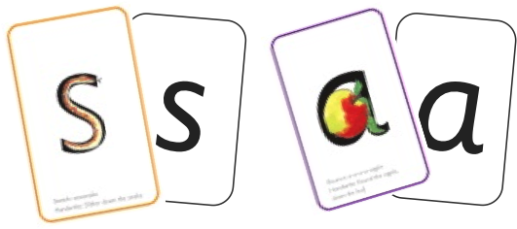

Sounds + blending = word reading
+
=
Alongside teaching children sounds, we teach them to blend sounds to read words e.g. s-a-t, sat.
Once children can read sounds speedily and understand Fred (m-a-t...mat), they can decode words.

Slide 12

Teach spelling using Fred Fingers

Slide 13
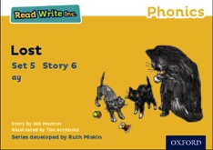
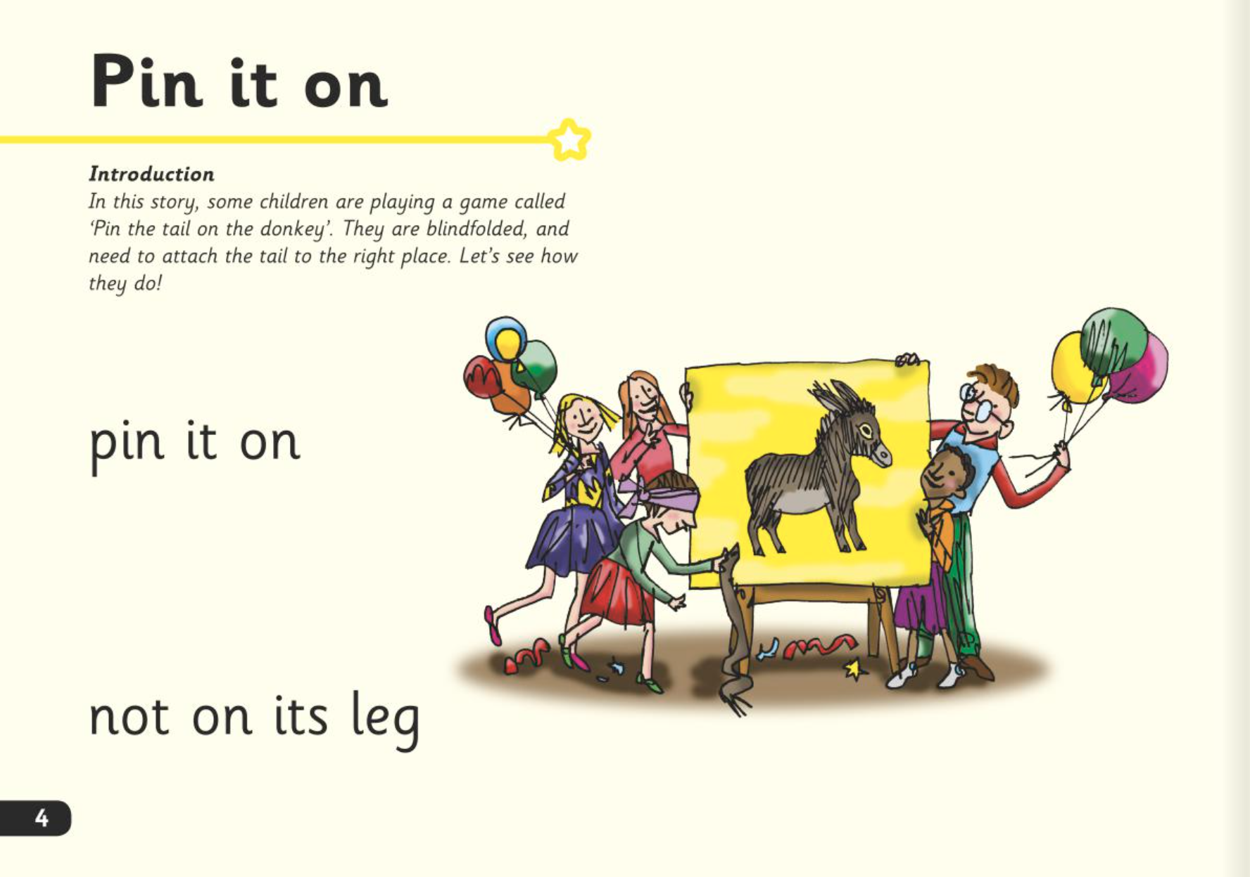
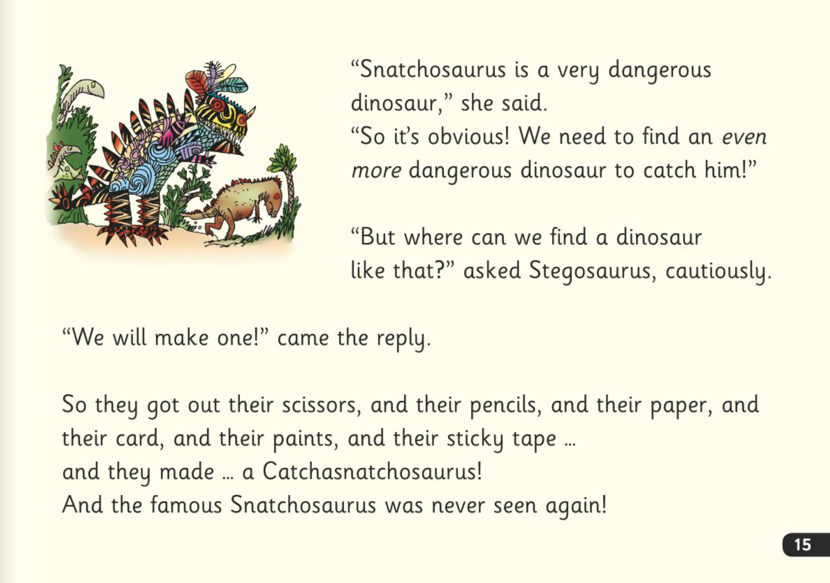
Three reads
In our school, children read Read Write Inc. Storybooks that match the sounds they can read.
They read each Read Write Inc. Storybook three times in class with their partner.
Re-reading the same book helps children to become confident readers. Each time they re-read, they build their fluency/speed and comprehension. They love reading and want to read because they can read all of the words in the Storybook.

Slide 14

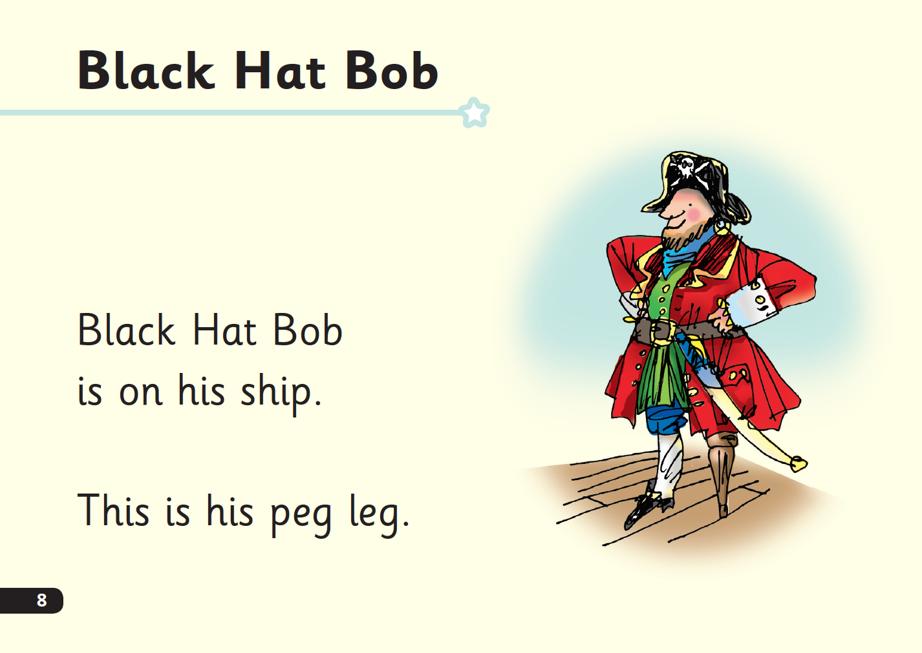
‘Special Friends’, ‘Fred Talk’
Children will be able to read all of the words in the Storybook.
If they hesitate, remind them to read the word using ‘Special Friends, Fred Talk,’.
For example, this means they spot the ‘sh’, then Fred Talk and blend to read the word e.g. sh, sh-i-p, ship.

Slide 15

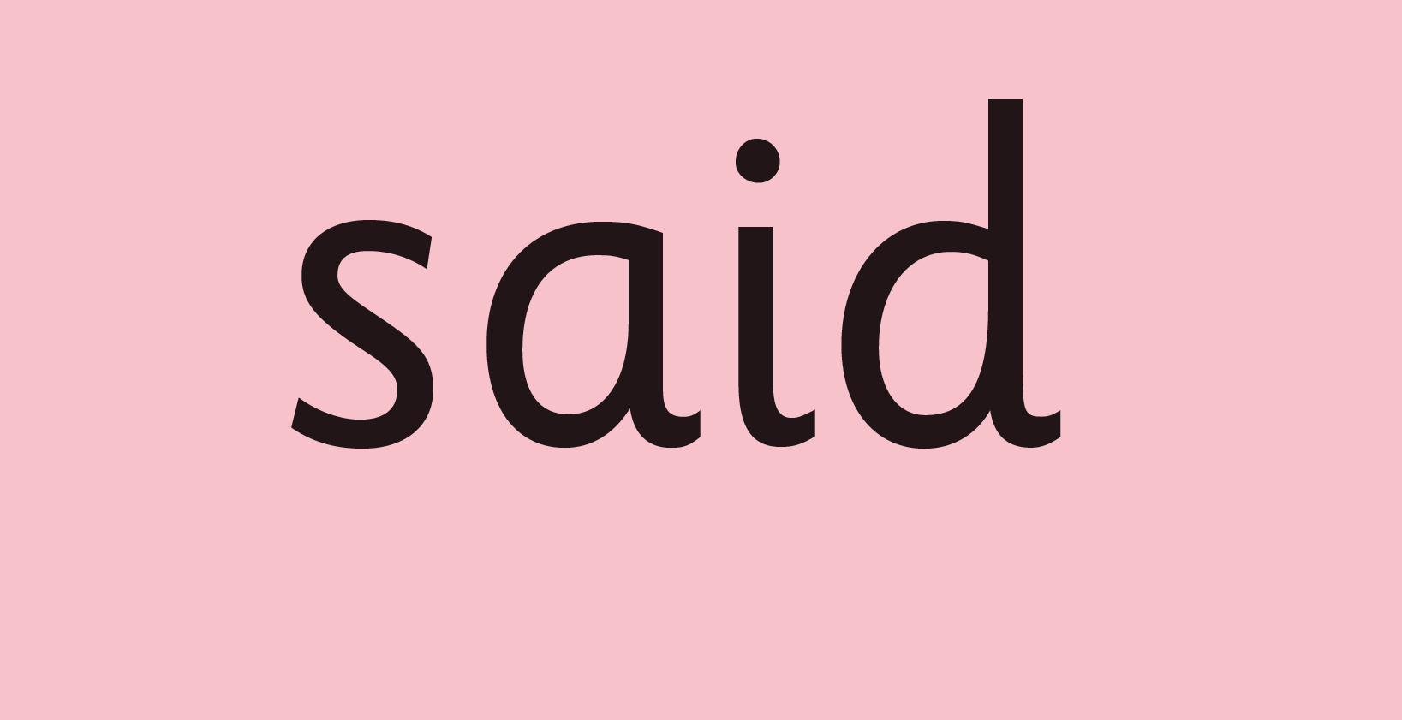
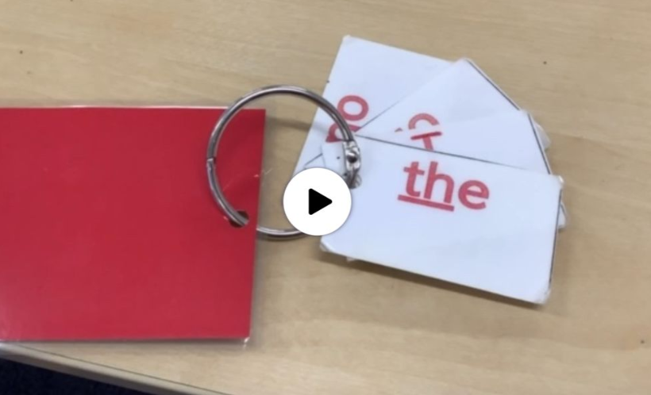
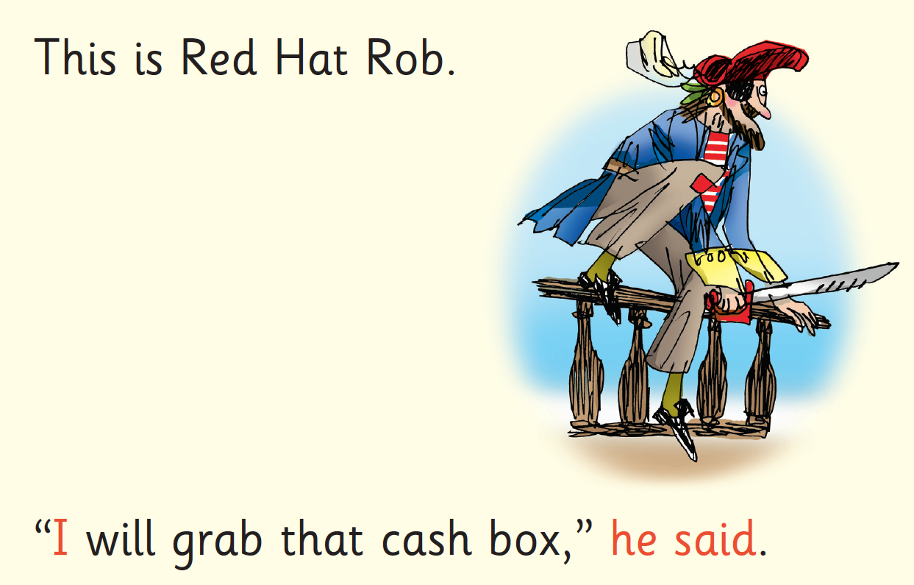
Red Words
Some words are ‘tricky’ because they contain letters that don’t match the sounds the child has been taught.
For example, ‘said’ has ‘ai’ making an ‘e’ sound.
We teach these common exception words as Red words.
In the early Storybooks, these words are printed in red text.
Remind your child not to use Fred Talk to read Red words but instead to stop and think if they know the word. Tell them the word if needed.

Slide 16

Which books will children bring home?
+
+
The more they read, the faster progress they will make.
Please avoid saying, “This book is too easy for you!” but instead say “I love how well you can read this book!”

Slide 17
What can I do?
Use pure sounds rather than letter names.
Use Fred Talk to help your child to read and spell words.
Listen to your child read their Storybook every day.
Watch the Virtual Classroom films together.
Read stories to your child every day.
Practice their key ring with them every day.

Slide 18
Remember…you all have the power to change outcomes for your children

Slide 19
Maths
What is subitising and why is it so important for young children?
This short, 7 minute film from the early years maths consultant Karen Wilding is worth watching
https://www.youtube.com/watch?v=4KtifCNlYy4
At its simplest, subitising is being able to visually see a number of objects instantly without needing to count them out one at a time.
Subitising actually comes from the Latin word for suddenly; it may not be a word we hear very often but it’s actually a crucial skill that many of us use on a daily basis without even realising it.
Have you ever played a board game with your child and noticed that they are able to tell you how many dots are on the die without needing to count? That’s subitising.

Slide 20
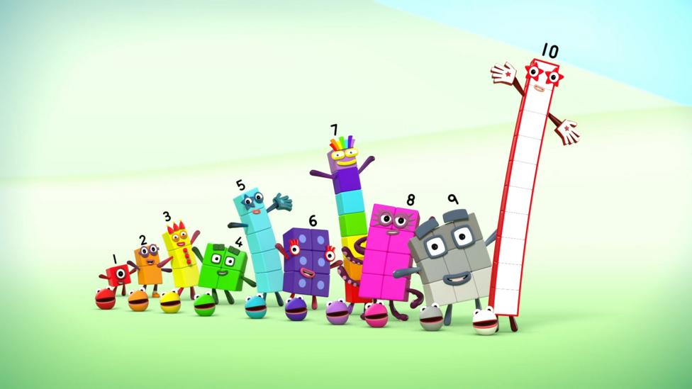
In the same way, children who love to watch Numberblocks soon become aware that certain arrangements of blocks are a particular amount – or character.
Subitising helps children to see, solve, and manipulate numbers in their head. This develops their number sense and helps them master key calculation strategies at an early stage.
Often young children learn to count but don’t fully understand the relationship between numbers and amounts.

Slide 21
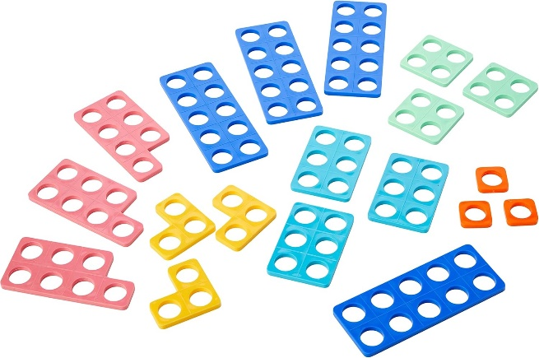
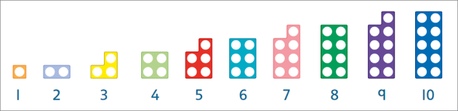
Numicon
Numicon is a system of flat plastic shapes with holes in them. Each shape represents a number from one to 10 and each number has its own colour.
The holes in the Numicon Shapes represent the numbers 1 to 10. When they're arranged in order, as in the picture below, children can easily see connections between numbers, such as ‘one more’ or ‘one less’.
We use Numicon to see more complex mathematical ideas, like how two fours make eight, three twos make six, and so on. This lays the foundation for their understanding of numbers all the way through school. We can easily see which numbers are odd and which are even too.

Slide 22


5 and 10 frames
We use 5 frames first and then 10 frames during our maths learning and as part of our everyday maths in the environment.
This is a great subisitising game. You could try it with an egg box
https://www.youtube.com/watch?v=zhHUj4yhkLc&t=4s
https://www.youtube.com/watch?v=MzFtJh_abhM

Slide 23

Thanks for coming

