Slide 1
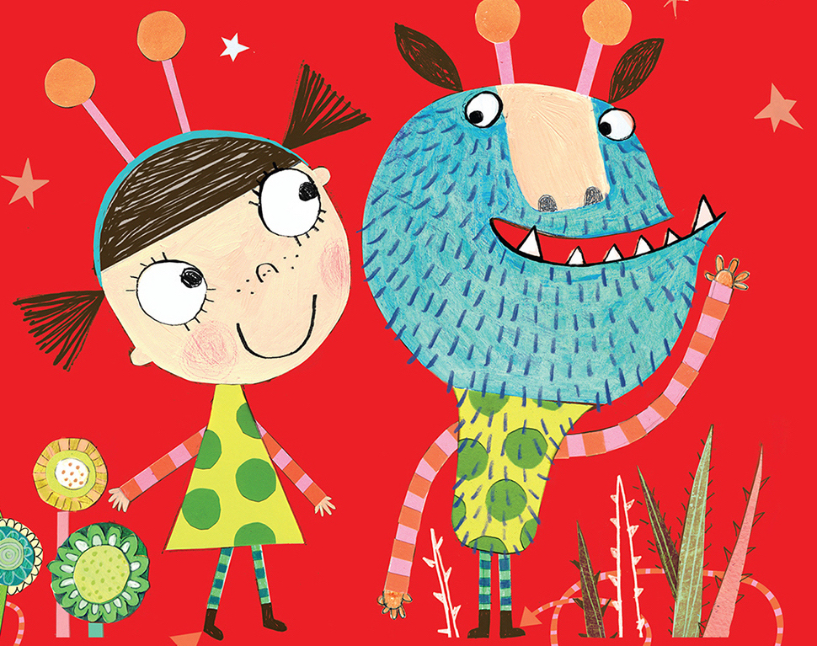
Spectacular Starter – We will find some clues from our story – Who do they belong to? What clues do they give us?
As theologians, we will begin our learning by exploring how people of faith celebrate harvest. We will then move onto explore why Jesus was special.
As scientists, we will be learning about animals including humans focusing on what animals need to survive. We will also begin to explore the seasonal changes at this time of year.
As musicians, we will take our inspiration from a piece of music called: In the Hall of the Mountain King. We will use our ideas to create a troll rap and a graphic score.
As artists, we will explore the work of Joan Miro and take inspiration from her work to create our own troll pictures.
Land, Sea and Sky
Hedgehogs Autumn 1 2026
For our RSHE:
British Values: Individual Liberty
No Outsiders – To like the way I am - Elmer
As computer scientists, we will be creating own algorithms in ‘2Go’ to move objects across a screen.
As geographers, we will be exploring the United Kingdom using maps, atlases and globes.
As sports people, we will be developing our throwing and catching skills. We will then be using out skills in invasion games.
Fantastic Finish - We will go on a walk of our local area to find bridges. Who lives underneath them?
As designers, we will be designing and making our own free standing bridges.

