Slide 1
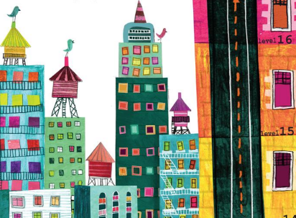
Spectacular Starter –a little cottage has appeared in the woodland. Who lives there? Does this remind
us of a fairy tale?
As scientists, we will be continuing to develop our knowledge of plants. We will be planting our own seeds and exploring what plants need to grow and stay healthy.
As historians, we will be learning about the lives of Neil Armstrong, Ernest Shackleton and Christopher Columbus.
As musicians, we will be engaging in fairytale themed music. This will link to our trip to see the Philharmonic Orchestra.
As designers, we will design and prepare food for a teddy bear’s picnic.
As computer scientists, we will be developing our knowledge of coding using the programme ‘2Code’.
Where Would You Travel To?
Hedgehogs Class
Summer 2 2026
For our RSHE:
British Values: Mutual Respect
and Tolerance
Articles: 16, 17, 19, 24 & 27
Heartsmart – No way Through Isn’t True!
Christopher Winters SRE
As geographers, we will be learning to identify the seven continents and five oceans of the world.
As sports people, we will be developing our understanding of attacking and defending when playing team games.
As theologians, we will be exploring stories from the gospels in the New Testament.
As artists, we will create our own animal masks by mixing colours and experimenting with different textures.
Fantastic Finish –
We will have a Teddy Bear’s Picnic where we will taste our fruity creations!

