Slide 1
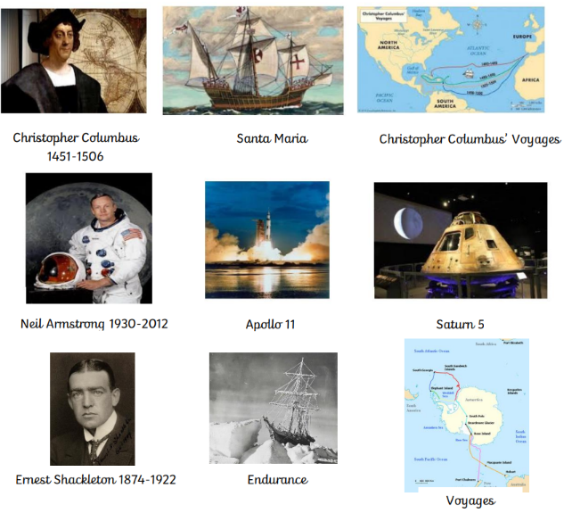
Into the Unknown Knowledge Organiser
Key people:
Key vocabulary
Exploration | The act of exploring or finding an unfamiliar area.
Courageous | Not put off by danger.
Fleet | A group of ships which sail together.
Apollo 11 | The command module that was carried by the rocket Saturn 5, and landed on the moon.
Colonizer | Someone who sends people to a place who then settle there and take over control of the place.
Slavery | Being forced to work for someone against their will without payment.
Saturn 5 | The rocket which carried the crew and command module Apollo 11 to the Moon.
Voyage | A long journey involving travel by sea or in space.
Key Facts:
• Christopher Columbus and Neil Armstrong were significant individuals who contributed to international achievements.
• Christopher Columbus discovered America.
• Neil Armstrong was the first person to walk on the moon.
• Their contributions to exploration affected the lives of people at the time and today.
• Columbus and Armstrong were courageous and skilled explorers.
• The history of exploration is a major human achievement that develops human knowledge and progress.

