Slide 1
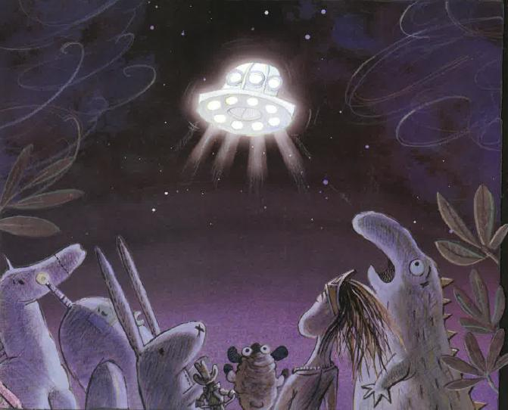
Spectacular starter – we will start our study theme by discovering a pile of toys. Where have they come from? Who do they belong to?
As sports people, we will be developing our understanding of jumping effectively and efficiently. We will also be developing our knowledge of rackets, bats and balls.
For our RSHE:
British Values: Mutual Respect
and Tolerance
Articles: 16, 17, 19, 24 & 27
Heartsmart – Fake is a Mistake!
Christopher Winters SRE
As computer scientists, we will be creating our own animated stories inspired by ‘Toys in Space’.
As geographers, we will be learning to identify the seven continents and five oceans of the world and describe our locality in relation to these.
As scientists, we will be learning to identify a variety of plants and trees. We will also be learning to describe the basic structure of plants and trees.
As artists, we will be developing our painting skills, and taking inspiration from Van Gogh’s Starry Night.
Into the Unknown
Hedgehogs Class
Summer 1 2026
As theologians, we will be exploring what life was like when Jesus, God the Son, was alive on earth.
As historians, we will be learning about the lives of Neil Armstrong, Ernest Shackleton and Christopher Columbus.
Fantastic Finish – we will finish out study theme by having an alien tea party.
As musicians, we will be exploring the unit ‘Blast Off’. We will be singing and performing a range of space songs.

