Slide 1
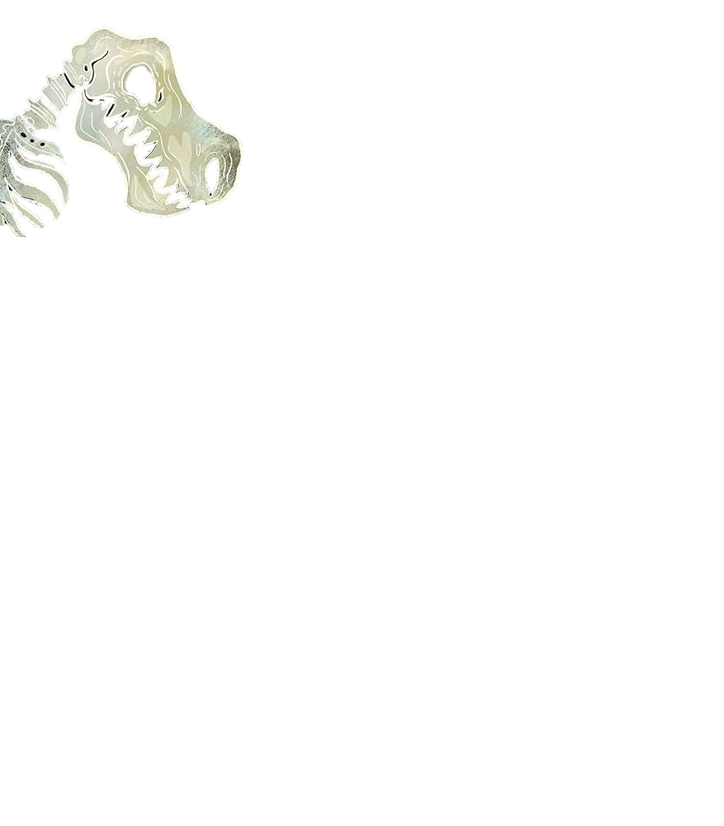

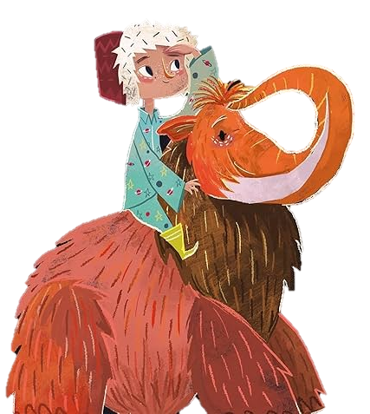
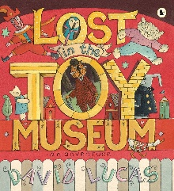


Super Starter
We will start our study theme by engaging in a stone age workshop on our residential.
As theologians, we will be finishing our learning about holy places before exploring the Easter Story.
As Sports people, we will be learning to add movements together through dance and develop our ball skills.
As writers, we will be writing stories based on ‘The Curious Case of the Missing Mammoth’ with a change of character
As scientists, we will continue our learning on everyday materials.
As geographers, we will explore the countries and cities that make up the UK and use this knowledge to help use identify the locations of fossils
As musicians, we will explore simple accompaniments on percussion instruments to show our awareness of pulse.
As computer scientists, we will be using Purple Mash to engage in the unit Speadsheets.
As readers we will be enjoying the book ‘The Curious Case of the Missing Mammoth’ by Ellie Hattie
We will also be exploring Lost in the Toy Museum by David Lucas, and Woolly Mammoth by Mick Manning.
For our RSHE:
British Values: Democracy
Articles: 28,29,31
Heartsmart –Too Much Selfie Isn’t Healthy!
No Outsiders enhanced with P4C
Hedgehogs’ Class
Spring 2 2026
Fantastic Finish
We will be visiting Knowsley Safari Park to reflect on our learning about animals..

