Slide 1








Meet the Teacher
Hedgehogs Class
Year 1 & 2

Slide 2


Hello! I am Miss Garratt

Slide 3
- Timetable
- Reminders
- End of Year Expectations

Slide 4
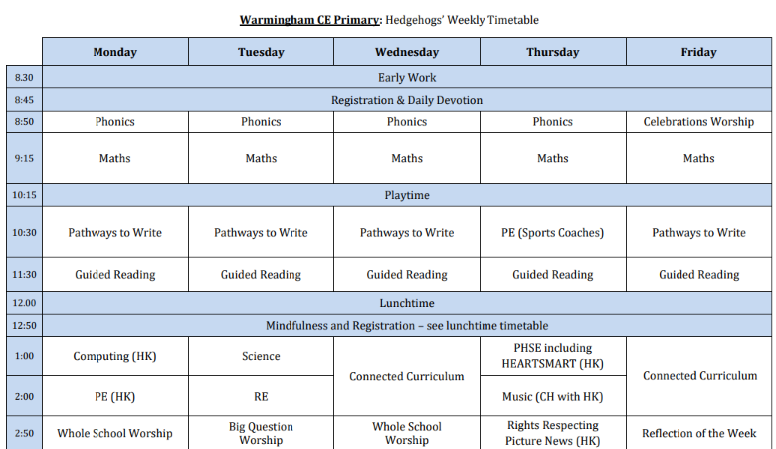

Slide 5
Reading
Children should read at home five times a week. They will need to record each time they read in their reading records. They must read to an adult at least once a week. It is important for adults to sign the reading record each time they read with their child so that we can ensure the children are having the opportunity to read with an adult at home. The children who have read five times a week at home will receive a raffle ticket. This will then go into a whole class draw at the end of the half term and the winning raffle ticket will receive a prize. The more times the children read five times a week, the more raffle tickets they will have in the draw and the more chance of winning their class prize!

Slide 6
Homework
Spelling and Phonics– You will find a list of the spellings the children need to learn in this book.
Magma Maths (Y1 Onwards) – Each week the children will be set a task to complete. This is something you should do with them. Talking through the task is an important aspect.
TT Rockstars (Y2 Onwards) – At least five times a week for 5 minutes. It is vital that your child knows their tables inside out and back to front. By the end of Year 4, it is expected that every child will know their times tables. Like Reading, times tables are often better practiced a little and often rather than in once a week.
Study Theme Work – Each half term your child will be given a list of possible tasks they need to complete linked to their study theme.

Slide 7
PE Kits
Please ensure that your child comes into school in their full PE kit.
No jewelry to be worn during PE sessions.
Hair must be tied up for P.E.
PE days – Monday and Thursday

Slide 8
Additional Clothing
Due to diverse British weather please ensure that your child always comes to school with a sensible waterproof coat. Wellingtons are also required so that learning can take place outdoors all year round. Hat, scarves and gloves are encouraged during the colder months (all labelled).

Slide 9
Water and Snacks
Children need to bring a water bottle into school every day. These too need to be clearly labelled. Children have access to clean, chilled filtered water to top up their bottles when needed. Healthy snacks are encouraged for the morning break.

Slide 10
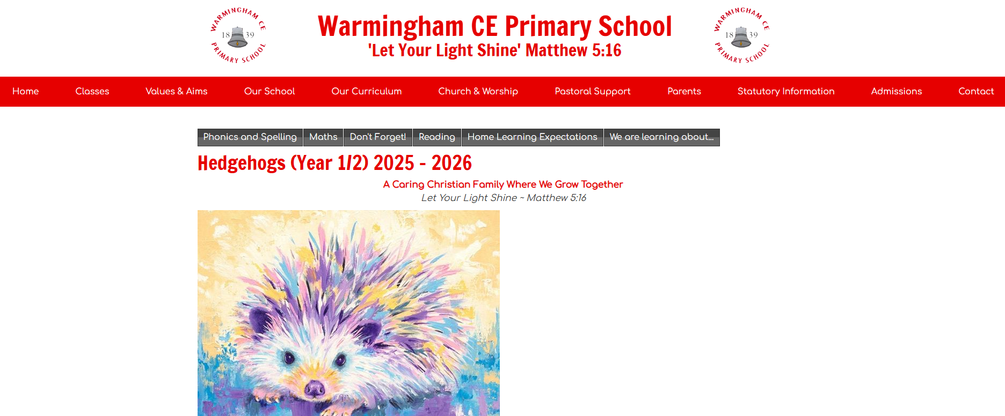

Slide 11
Thank you for coming
End of Year Expectations are on the side should you want them

