Slide 1
Welcome to
Year 3 / 4 Squirrels’ Class
Meet the Teacher
September 2025

Slide 2
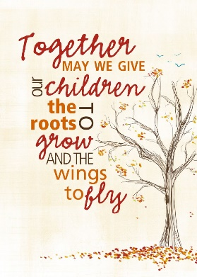

Slide 3
Hello, I am Mrs Bugliarello (Mrs B)

Slide 4
Timetable
Reminders / updates
End of Year Expectations

Slide 5
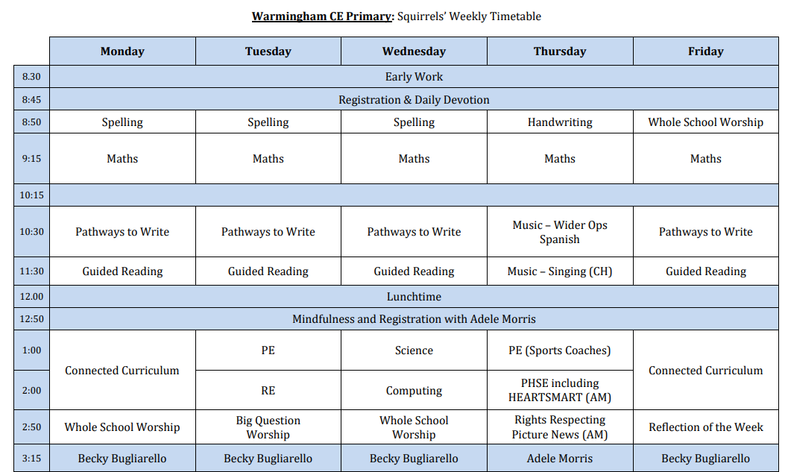

Slide 6
Reading – Children should read at home five times a week. They will need to record each time they read in this reading record. They must read to an adult at least once a week. It is important for adults to sign the reading record each time they read with their child so that we can ensure the children are having the opportunity to read with an adult at home. The children who have read five times a week at home will receive a raffle ticket. This will then go into a whole class draw at the end of the half term and the winning raffle ticket will receive a prize. The more times the children read five times a week, the more raffle tickets they will have in the draw and more chance of winning their class prize!

Slide 7
PE Kits
Please ensure that your child has a full (labelled) PE kit – Black PE shorts, Red PE t-shirt with school logo and black pumps / trainers (including a warm plain black tracksuit and trainers in colder weather). Children are to come dressed in their PE kits on a Tuesday and Thursday.
No jewelry to be worn during PE sessions and hair must be tied up.

Slide 8
Additional Clothing
Due to diverse British weather please ensure that your child always comes to school with a sensible waterproof coat. Wellingtons are also required so that learning can take place outdoors all year round. Hat, scarves and gloves are encouraged during the colder months (all labelled).

Slide 9
Water and Snacks
Children need to bring a water bottle into school every day. These too need to be clearly labelled. Children have access to clean, chilled filtered water to top up their bottles when needed. Healthy snacks are encouraged for the morning break.

Slide 10
Homework
Spelling and Phonics– Your child will be given a list of the spellings for each week.
Maths - Firstly, we would like you to have fun playing games, baking and do practical things with your children that involve some element of Maths. Maths is everywhere. As the children move up through the school, they should also complete the following tasks:
Magma Maths (Y1 Onwards) – Each week the children will be set a task to complete. This is something you should do with them. Talking through the task is an important aspect.
TT Rockstars (Y2 Onwards) – At least five times a week for 5 minutes. It is vital that your child knows their tables inside out and back to front. By the end of Year 4, it is expected that every child will know their times tables. Like Reading, times tables are often better practised a little and often rather than in once a week.
Study Theme Work – Each half term your child will be given a list of possible tasks they need to complete linked to their study theme. There will always be a wide selection of tasks to provide the children with some choice. The children should choice one or two which particularly interest them. It's important that the children focus on something they are passionate about. There is no expectation that they will complete all of them. Please don’t do these tasks for the children – it’s pointless, a waste of your time and your child won’t gain anything from it. Instead work together, supporting and helping your child if needed. As the children move up through the school, you should encourage your child to complete these tasks on their own in preparation for High School. These should then be brought into school on the last Monday of each half term.

Slide 11
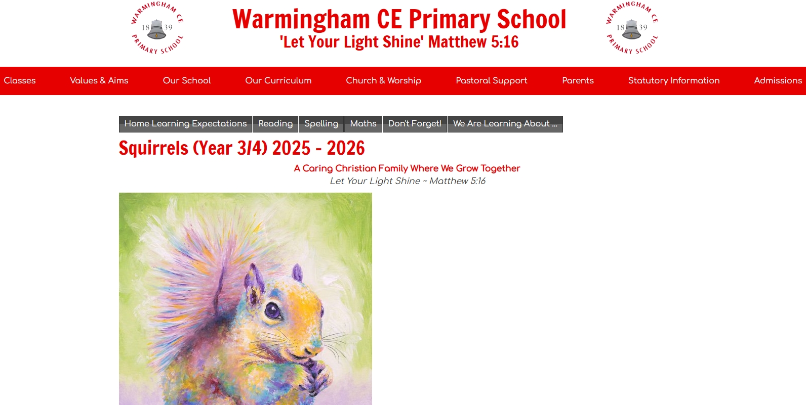

Slide 12
End of year expectations

Slide 13
Thank you

