Slide 1

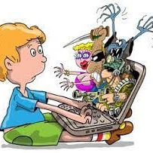
Keeping children safe online
Dawn Sharples

Slide 2

At the end of this session you will:
Be able to identify the ways in which children and young people communicate and interact online
1
Identify some of the key risks and harm that children and harm that children and young people can be exposed to online
2
Understand how the online world can impact children and young people positively and negatively
3
Identify ways in which you as an individual can help keep children and young people safer online
4

Slide 3
According to the NSPCC:
Key parental concerns include:
not knowing which apps their children are using or what they are doing on them
not knowing how to use the apps and feeling out of their depth to support their children
their children see something inappropriate, sexual or illegal
their children may be contacted by someone who wishes to harm them
if their child is using apps meant for older children or adults
their children may be bullied or even bully another child

Slide 4

Introduction

Slide 5

Children’s use of social media, apps and games
According to Ofcom 2021:
14% of 5-7 year olds own a smart phone, compared with 49% of 8-11s and 91% of 12 – 15s
30% of 5-7 year olds use social media apps, compared with 44% of 8-11s and 87% of 12-15
33% of 5-7 year olds use messaging apps, compared with 64% of 8-11s and 91% of 12-15s

Slide 6

What are social media apps?
Social media apps and sites allow us to create and share content with others
Children and young people may use multiple social media accounts to share content with their friends and followers, and express their individuality.
Many young people will also use social media to communicate with family and friends. FOMO (Fear Of Missing Out) can also be a factor in young people’s use of social media.

Slide 7

How many social media apps are you aware of, or do you actually use?

Slide 8
Advantages and disadvantages of social media
Potential Risks
Potential Benefits
Potential Risks
Feel connected with family and friends
Communicate with others, especially when they face speech and language difficulties
Share posts, images and videos about their lives with people close to them
Gives them a platform to share their voice about issues that matter to them, such as environmental impact, racism and equality.
Express themselves and experiment with different identities in a way that offline space can limit
Access support networks and share experiences with like-minded people
Be creative and share their talents through posts, images, videos and specific accounts
Keep a virtual scrapbook of key moments in their lives
Learn about the world around them and keep up with current affairs
Being targeted by offenders
Online grooming
Online bullying
View inappropriate content
Being influenced by what they see
Damage to self-esteem
Oversharing information
Potential employers can judge you on what you post.

Slide 9
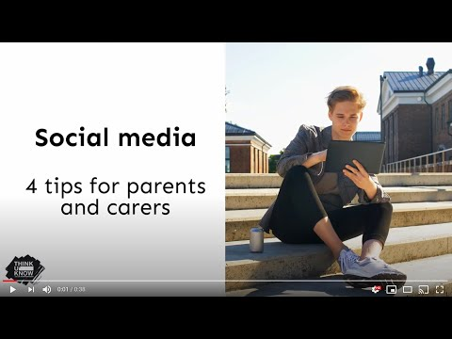
Social Media – Tips for Parents and Carers

Slide 10
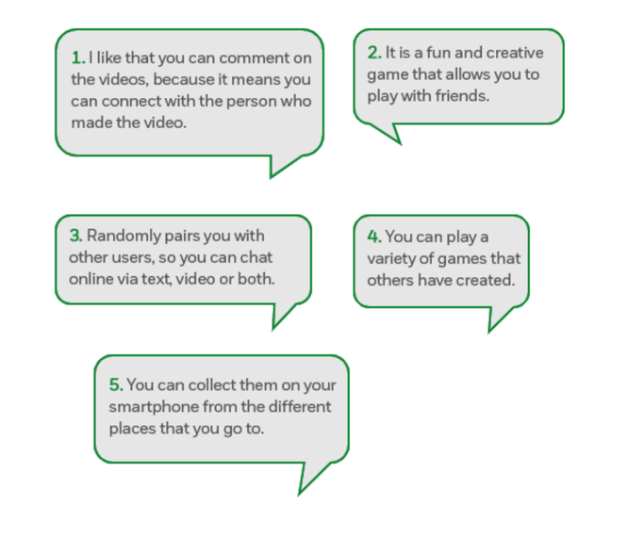
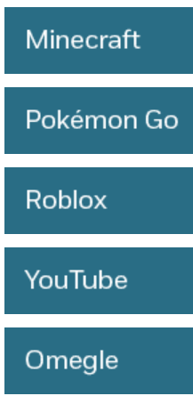
Quiz – Do you know your Apps?
Match each of the apps to the quote

Slide 11

Online Gaming
Children like to play online games for fun, to be creative, communicate with friends and learn new skills.
However, many popular games are multiplayer and allow children to play and communicate with others.
This could include people known to them as well as people they don’t know.

Slide 12
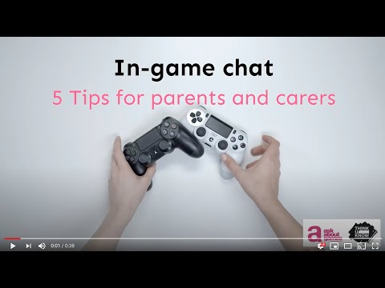
Online Gaming -Tips for Parents & Carers

Slide 13
Adult or violent content within games
Some games, especially massively multi-player online role-playing games (MMORPG) can expose children to scenes that:
Feature extreme violence, warfare and criminal activity
Show explicit sexual acts, which may glamourise rape, assault and prostitution
Use racist, homophobic or sexist language and feature swearing
Depict certain groups such as women in derogatory ways

Slide 14

Age Ratings for online games
The PEGI (Pan European Game Information) organisation classifies whether the content of a game is appropriate for players of a certain age by showing the game’s age-rating in years and one or more icons that depict the types of content
Notes:
This rating system does not take into account of risks posed to children by other players in chat rooms

Slide 15

Problematic or compulsive gaming
Games are designed to be an immersive experience and can be challenging to take breaks from.
It’s important to talk to children and young people about healthy gaming habits, including:
Taking breaks
Having a balance of online and offline activities
Playing in person with others like friends and family

Slide 16
Online Grooming

Slide 17
Sex and relationships online
How to protect children from inappropriate contact:
Look out for your child moving to new platforms to chat
As young people develop, they often seek more privacy and autonomy in both their online and offline world. However, it’s important to consider whether your child is developmentally ready to be left unsupervised whilst gaming or chatting.
In particular, younger children can struggle to identify risks they may face whilst online and require supervision to learn these skills.
Encourage young people to use their devices in spaces where some level of supervision is possible, for example, a family room or living room.

Slide 18
'Sexting’
(youth-produced sexual imagery)
If you are worried about your child sending nude images or videos (sometimes referred to as ‘youth-produced sexual imagery’ or sexting), NSPCC provides advice to help you understand the risks and support your child.
If your child has shared nude images, Thinkuknow by NCA-CEOP provides advice on talking to your child and where to get help.
So You Got Naked Online created by South West Grid for Learning, has advice for young people and parents affected by sexting, also available in a SEND (Special Educational Need and Disability) version.

Slide 19
Practical advice
Speak to the person it is shared with and ask them to delete it.
You can challenge content about you that has been published by others using the site’s “report abuse” option
The law is on your side and was not designed to punish young people for making mistakes while experimenting with their sexuality.
The law is aimed firmly at those who choose to trade or profit from sexual pictures of children. The law was also written in 1978, a time when mobile phones hadn’t been invented and the idea of a camera phone was probably mind-blowing! The law wasn’t designed to consider sexting and self-generated content. But police and law makers today understand this
The Internet Watch Foundation is an organisation in the UK who have the ability to remove child sexual abuse imagery, hosted in the UK. https://report.iwf.org. uk/en

Slide 20

How to identify online bullying
Look out for the signs. If your child is anxious or upset after being online this may be a sign they are being cyberbullied
Talk to them about what cyberbullying is (people deliberately hurting you) and encourage your child not to retaliate. This may mean leaving conversations or taking a short break before going back online.
Reassure, record and report. Reassure your child that everything will be OK, and you will sort it out together. Try not to get angry if your child has posted or shared something that has led to the bullying. We all make mistakes, and this is an opportunity to reinforce how important it is to think carefully before sharing. If the cyberbullies are children from your child’s school, then it’s important to keep a record of events and share with the school

Slide 21
Top tips to deal with Cyberbullying
Encourage your child to save the evidence and show you
They can do this by taking a screenshot of what has happened or by keeping the messages they have received.
Don’t deny access to technology
Although it can be very tempting to remove a device from a child if they are being bullied online, it may prevent your child from coming to you about online worries again. We have been told by pupils that the main reason they wouldn’t speak to their parents about cyberbullying is because they were worried their technology would be taken away from them.
Don’t reply
Most of the time a bully is looking for a reaction when they are being mean online. Tell your child not to reply. Instead, they should tell a trusted adult what has happened.
Use the tools available
Report, block and take a screenshot. You can report a person or profile, as well as content, e.g. a post, video or comment. This will then be flagged to the service who will review it against their terms and conditions.
Speak to the school
It is always worth having a conversation with your child’s school about their experience of cyberbullying. Schools can offer support and advice to you and your child. Consider contacting their class teacher, form tutor, Head of Year, or a pastoral lead.

Slide 22

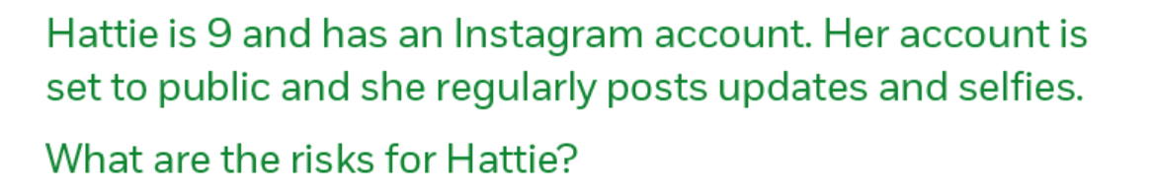
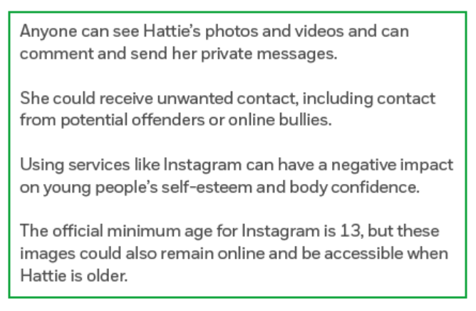
Discussion

Slide 23
Supporting young people to manage their digital footprint
You can support young people to manage their own digital footprint including how to:
Use privacy settings to manage who they are sharing with
Use additional settings where available to approve posts and name tags before they are public
Block people they are not comfortable sharing
Report content that other people have posted in order to get it taken down
Encourage them have conversations with you, to discuss want they want to share online.
Educate them about the importance of asking before sharing things about them online

Slide 24
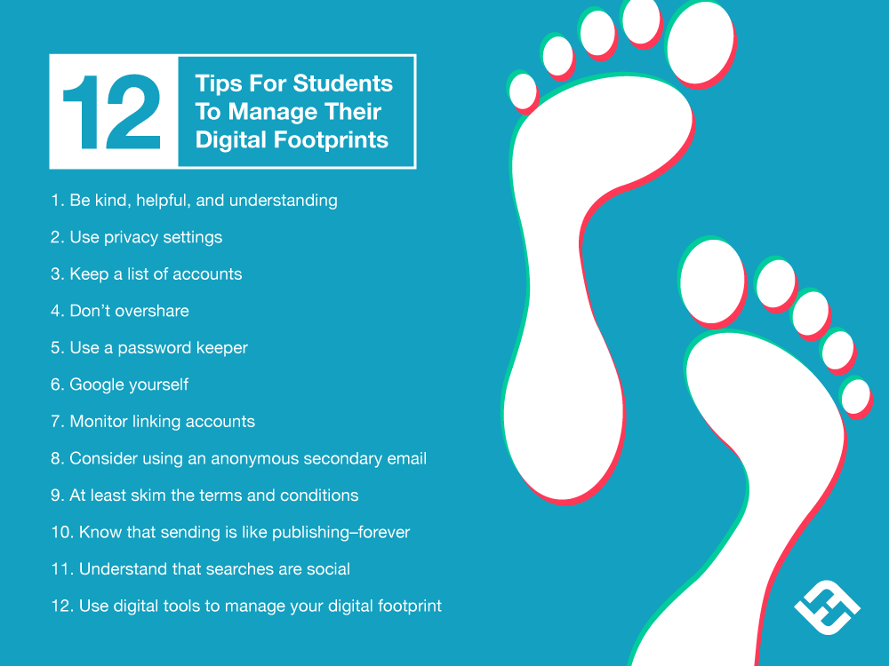

Slide 25

Be aware of, and manage your digital footprint

Slide 26

Set up kids’ tech devices
E-safety Checklist
Set parental Controls on your broadband to prevent your children seeing things they shouldn’t
For smart phones check parental controls are also set up on the mobile network
Use the device settings so you can only download age appropriate apps and games
Set up password control or disable in-app purchasing
Disable location sharing
Only download age appropriate apps you’re happy for your child to use.

Slide 27

Setting up Parental Controls
Parental Controls & Privacy Settings Guides - Internet Matters
Notes:
Use the QR code and find the instructions for your device

Slide 28
I hope you have more confidence in:
Being able to identify the ways in which children and young people communicate and interact online
1
Identifying some of the key risks and harm that children and harm that children and young people can be exposed to online
2
Understanding how the online world can impact children and young people positively and negatively
3
Identifying ways in which you as an individual can help keep children and young people safer online
4

Slide 29


Resources:
NSPCC
Free helpline for adults worried about a child and needing help, advice and support
Childline
Free service for children and young people

Slide 30
Further Resources
https://www.internetmatters.org/
Kidscape
Digital Footprint - BulliesOut
Childnet — Online safety for young people

