Slide 1
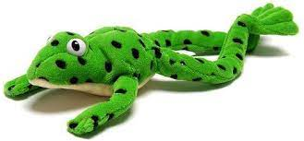
Phonics Screening Information -2026
Welcome!

Slide 2
Reading Changes Everything
“Teach a child to read and keep that child reading and we will change everything… and I mean everything.”
Jeanette Winterson

Slide 3
What is the Phonics Screening Check?
A word-reading check taken during the week commencing 8th June 2026.
Children read 40 words – 20 real words and 20 nonsense words, either by sight or using RWI strategies.
The check is done on a 1:1 basis.
The threshold is usually 32 words read correctly.
If they do not manage to read 32 of the words, they are given extra support, and repeat the check at the end of Year 2.
The aim is that all children will be able to read accurately before they begin Year 3.
All children are individuals, and all develop at different rates. The screening check ensures that teachers understand which children need extra help with phonic decoding.
They have not failed!

Slide 4

Green Words and Nonsense
(Alien) Words
Green Words
Nonsense Words
Words that can be read through decoding and blending.
Children are taught to ‘spot the special friend’, ‘Fred talk’ and then ‘read’.
These are real words that have meaning.
Examples of green words:
ch-o-p g-r-ee-n s-p-oi-l
c-o-b-w-e-b i-n-c-l-u-d-e
Words that can be read through decoding and blending.
Children are taught to ‘spot the special friend’, ‘Fred talk’ and then ‘read’.
These are not real words and have no meaning.
Examples of nonsense words:
j-o-ch r-ee-nk l-i-p-e
b-r-ai-n-t s-r-i-nk-er

Slide 5
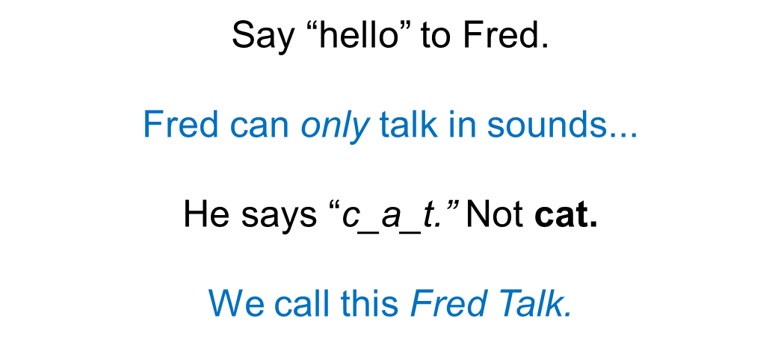
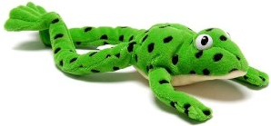

Slide 6
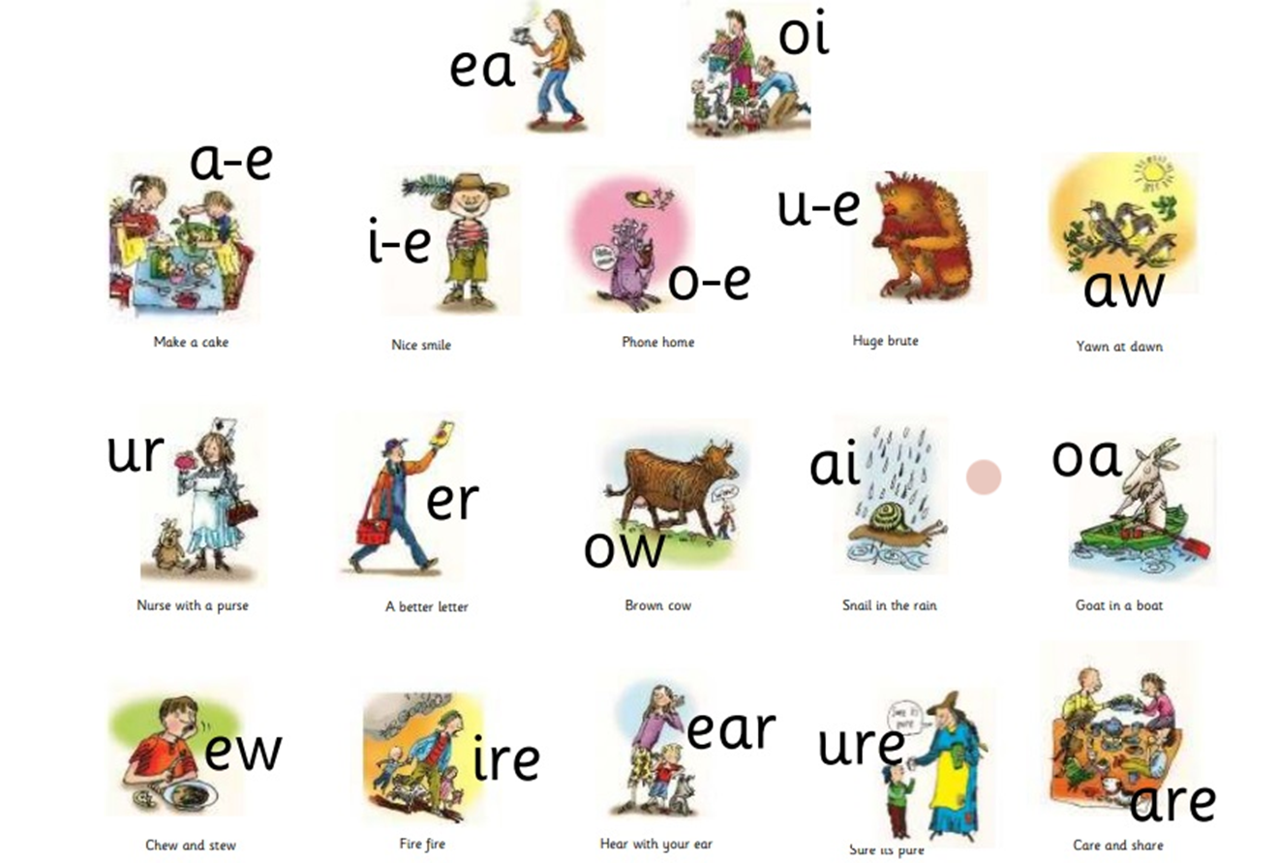

Slide 7

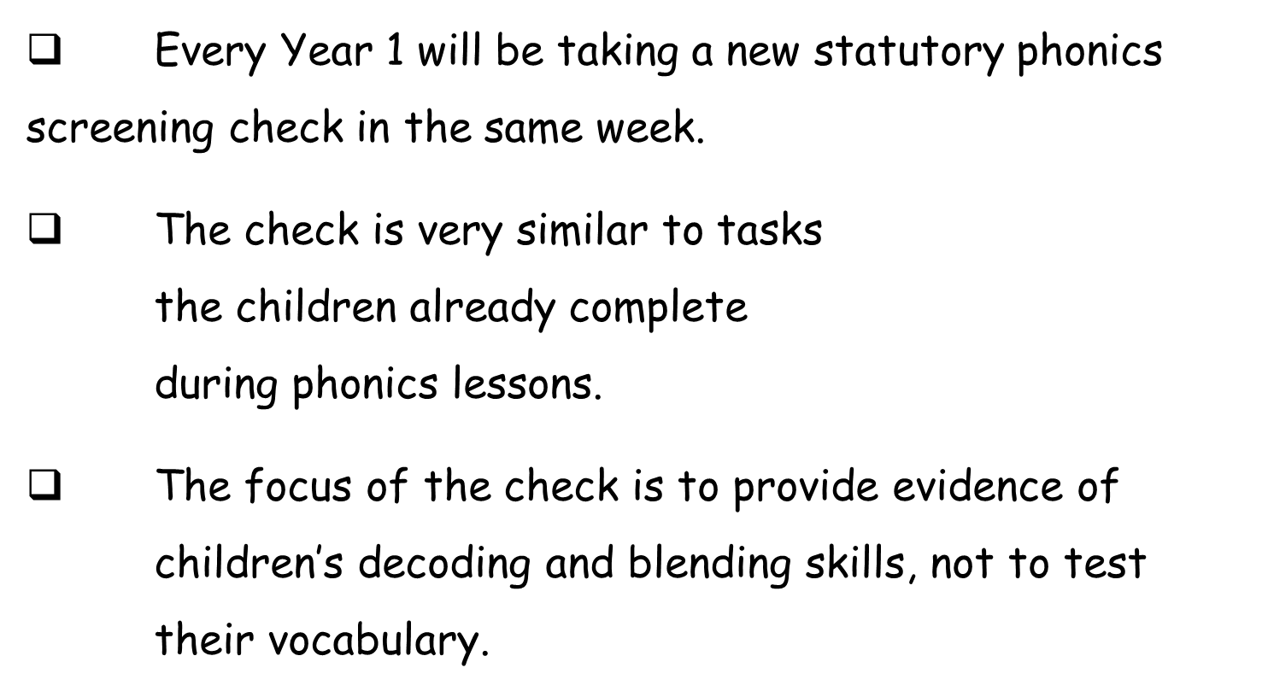

Slide 8
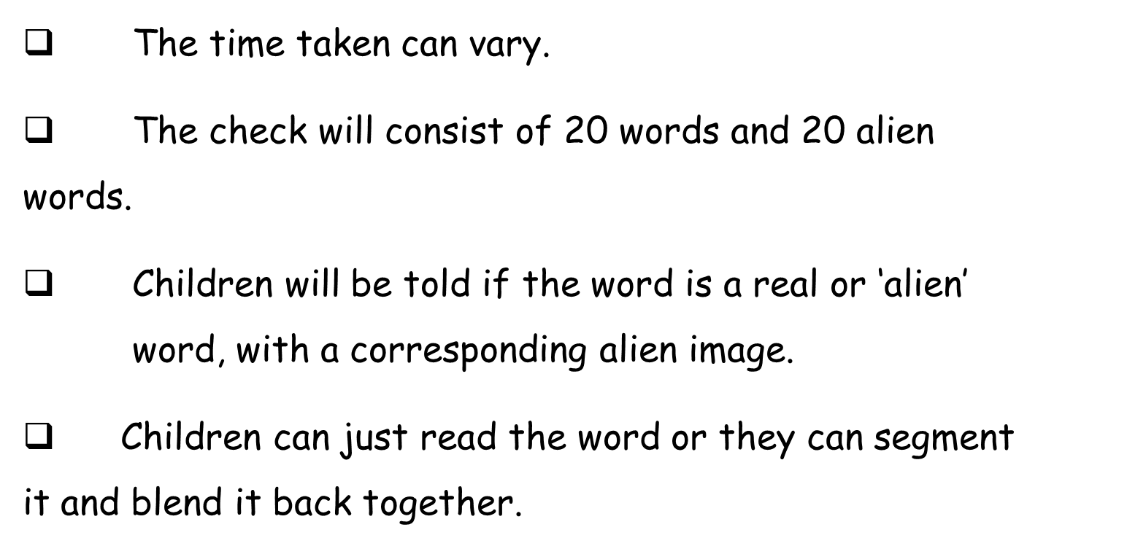

Slide 9

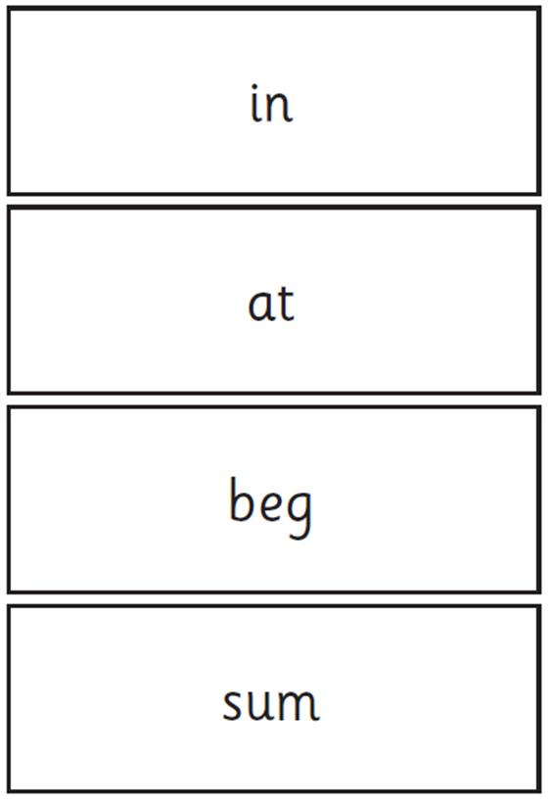
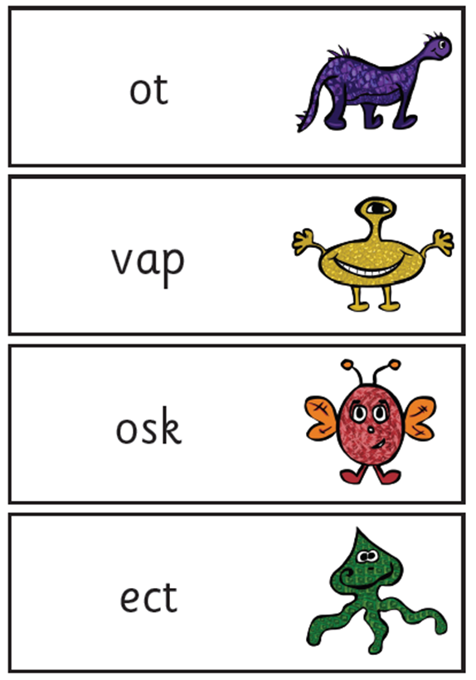

Slide 10
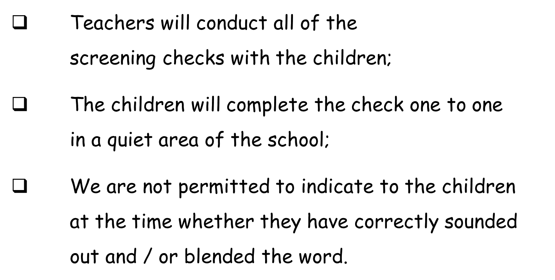

Slide 11

How are the results used?
Teachers will gain a better understanding of who needs support with decoding/blending.
Parents will have an understanding of whether their child is on track with their reading skills (results will be shared with parents in end of year reports).
Passing the Check does not automatically mean they finish the RWI scheme. If we feel they need some more time to embed their RWI skills and reading speed, children will be kept on the scheme.

Slide 12
When will it happen?
The Phonics Screening Check will take place throughout the week beginning
Monday 8th June

Slide 13
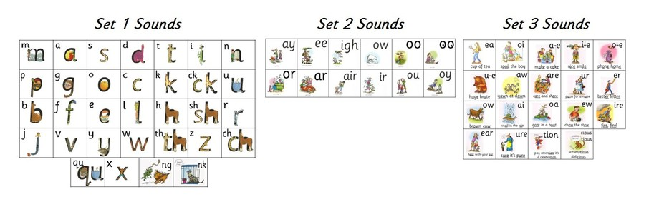
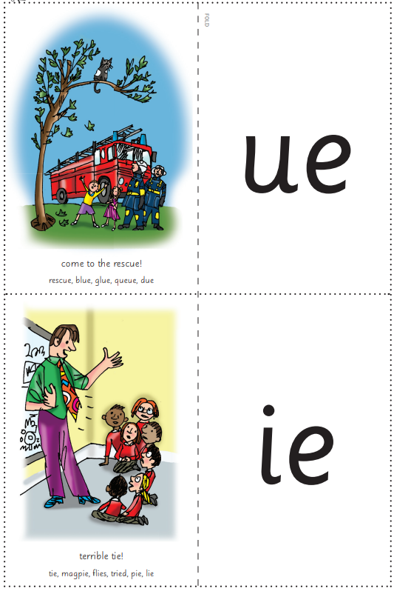
What Can You Do To Help?
Listen to your child read everyday. This can be a book of their choice, but the more they read, the more exposure they are gaining!
Regularly practise set 1, 2, 3 and the additional sounds, in a different order each time.
When homework comes home, encourage your child to read the words (this can be done in any order!).
Encourage your child to read their Read Write Inc books with confidence and pace.
When reading any words/books, encourage your child to use ‘Special Friends’, ‘Fred Talk’, read the word’ to read.

Slide 14

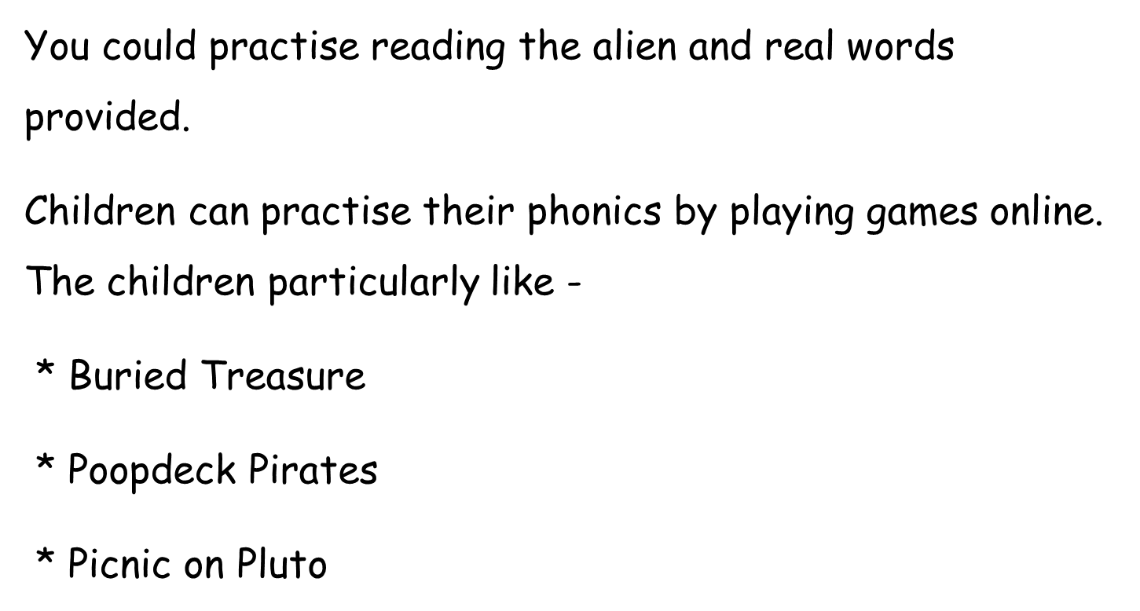

Slide 15
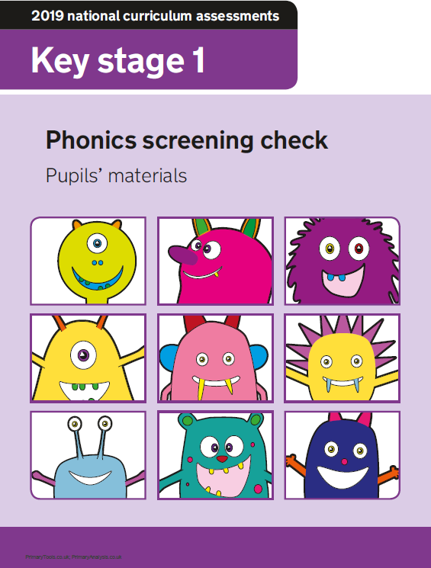

Questions?

