Slide 1

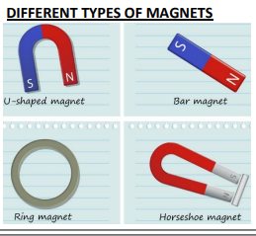






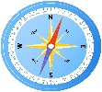
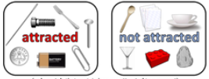
YEAR 3 KNOWLEDGE ORGANISER
Forces and Magnets
Spring 2
Key Knowledge
Forces can make things change shape.
Forces can make things change speed.
Forces can make things change direction
It is easier to push or pull things along smooth surfaces than rough ones.
Like poles repel. Opposite poles attract.
A compass needle is a magnet. A compass always points north-south.
Not all metals are magnetic. Iron, nickel and cobalt are magnetic.
What should I already know?
That everyday materials have different physical properties
The shapes of solid objects made from some materials can be changed by squashing, bending, twisting and stretching.
Key Vocabulary
force | A push or a pull on an object that causes it to change speed or direction
contact force | Forces that act when two or more objects touch each other, e.g. friction
friction | The force that act when two objects touch each other. It is a contact force.
magnet | An object that produces a magnetic force
magnetic | Objects which are attracted to magnets, even without touching
poles | North and south poles are found on any magnet
repel | A force that pushes objects away
attract | A force that pulls objects together

