Slide 1



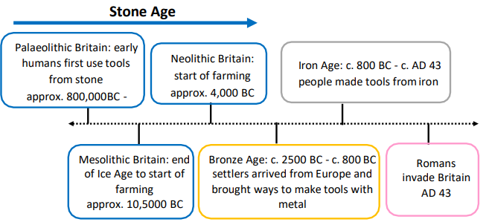

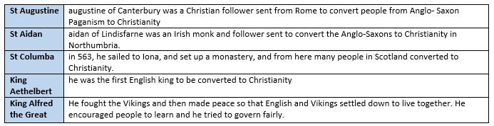
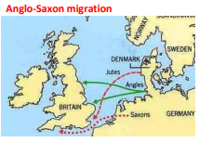

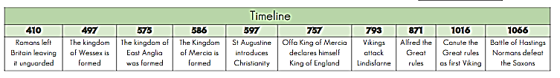

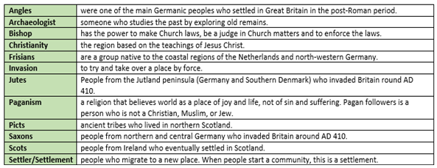
What I should already know?
•The Stone Age was when early humans used tools from stone. This lasted until the Bronze Age. •The Bronze Age began when settlers arrived from Europe to Britain. These settlers brought with them ways of making tools from metal (bronze). •The Iron Age lasted from 800 BC till the Roman invasion (AD 43) - this was when people used tools made from iron. •In AD 43, the Romans under the order of Emperor Claudius, first invaded Britain and Roman rule lasted until AD 410
KEY KNOWLEDGE
Understand how Britain became under threat after the Romans left and why tribes wanted to settle in Britain. Understand the struggles for control and how Anglo-Saxon Britain was converted to Christianity. The Romans left Britain around 400AD so Britain was now unprotected from invasion. New invaders arrived and began to settle in Britain. The Scots and Picts invaded from the North. Invaders from Germany, Denmark and Holland came from the east. These new settlers became known as the Anglo-Saxons after the biggest tribes: the Angles & the Saxons. There were seven Anglo-Saxons kingdoms: Northumbria, Mercia, Wessex, Essex, Sussex, Kent and East Anglia. Some of the place names today are Anglo-Saxon names. St Augustine, St Columba and St Aiden who were influential in converting the Anglo-Saxons to Christianity. Lindisfarne was an important island monastery. The archaeological discovery at Sutton Hoo was a significant event in finding out about life in Britain during Anglo-Saxon Times.

