Slide 1
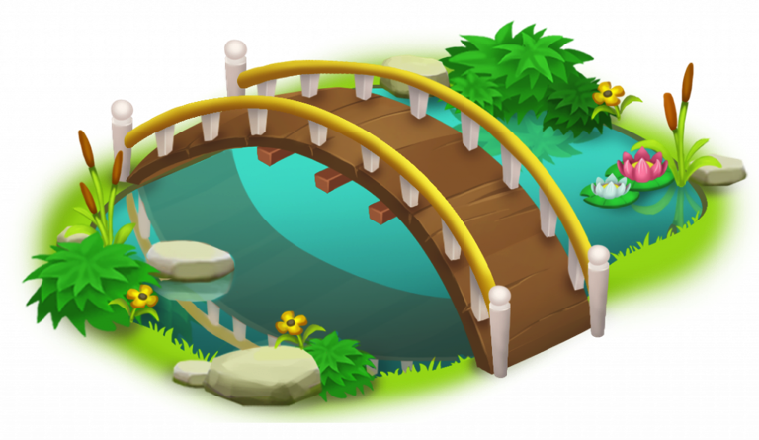
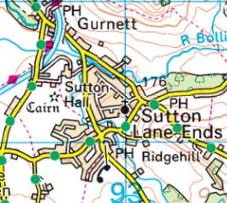
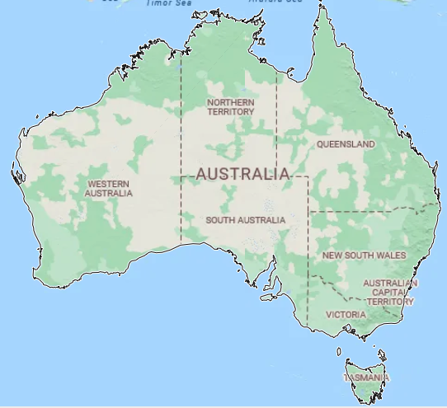
Year 2 – Down Under (Geography)
KEY KNOWLEDGE
The world has seven continents: North America, South America, Europe, Asia, Africa, Australia and Antarctica.
The world has five oceans: Atlantic, Pacific, Indian, Arctic and Southern.
Australia is located in the Southern Hemisphere. Nearby countries to Australia include New Zealand and the Philippines.
Key physical features of Botany Bay are: large, shallow estuary for 2 rivers.
Key human features of Botany Bay are: Sydney Airport, a busy cargo seaport, Botany Bay National Park.
Key physical features of Sutton are: Rossendale Brook, Croker Hill, The Hollins, nearby to Teggs Nose and Macclesfield Forest. Sutton is in the continent of Europe.
Key human features of Sutton are: Hollinhey Primary School, Sutton St James Church, Sutton Common BT Tower, Macclesfield Canal, The Pleasance, Village Shop and Post Office, Cop Meadow Playground and Church House Pub.
What I should already know:
• Know the countries of the UK.
• Know the main geographical characteristics of Sutton.
• Know and describe some key features of England, Scotland, Wales and Northern Ireland.
• Know the difference between village, town and city.
• Name some of the human and physical features of Sutton.
• Know the compass points are North, South, East and West.
• Know that a plan is a bird’s-eye view.
• Be able to label a field sketch and a photograph.
KEY VOCABULARY
Business | A company or organisation that sells goods or services.
Continent | A large area of land, such as Europe or Asia.
Harbour | A place on the coast where ships and boats can stay safe.
Industry | The production of goods or services in an economy.
Landscape | The visible features of an area of land, like hills, rivers, and trees.
Ocean | A large body of salt water that covers most of the Earth.
Port | A place where ships load and unload goods.
Vegetation | Plants in a particular area.
KEY MAPS

