Slide 1
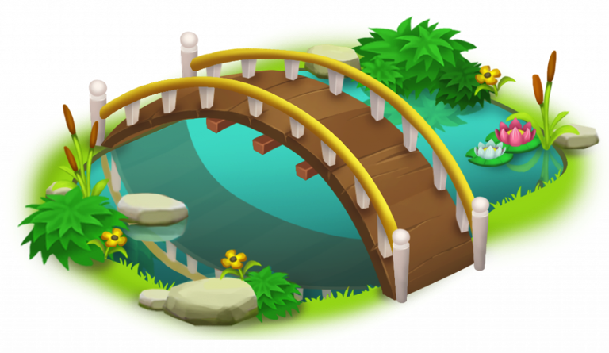

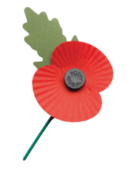
Year 2 – Down Under (History - Remembrance)
KEY KNOWLEDGE
We celebrate Remembrance Day because of the people who died in war.
Remembrance Day is the 11th November every year. Armistice Day was in 1918.
War memorials are for remembering those who lost their lives.
Remember the name of one of our local soldiers on the war memorial.
Recognise some of the things we do to remember eg Remembrance Sunday, poppy, words, last post etc.
What I should already know:
I can use time words to talk about events.
I can order familiar events on a simple timeline.
I can talk about events in my own experience that are important to me.
I can recognise the difference between past and present in my own life.
I can ask questions such as: What was it like for people? What happened? How long ago?
KEY IMAGES
Soldier silhouette | Poppy Appeal
KEY VOCABULARY
Armistice | An agreement to stop fighting in a war.
Memory | Something you remember from the past.
Memorial | A special place or object that helps us remember people who died in wars.
Past | The period before now.
Poppy | A red flower that people wear to remember those who died.
Remember | To keep something or someone in your mind.
Remembrance | Thinking about and honouring people who have died.

