Slide 1

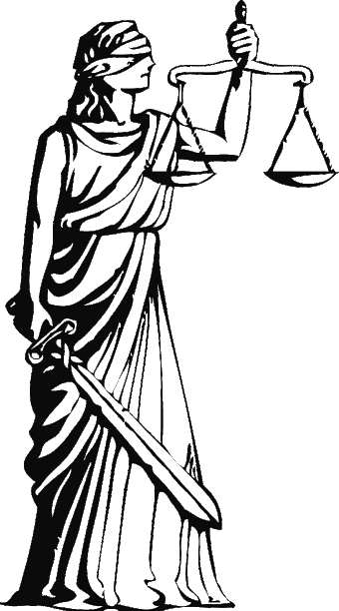
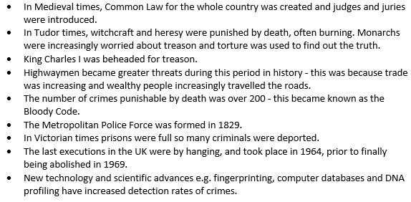
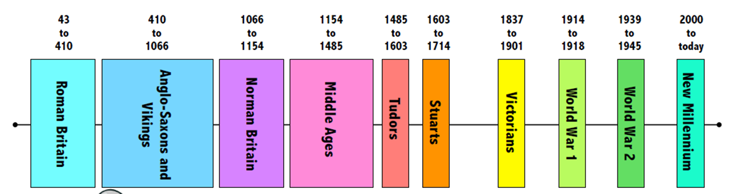
Y6 Crime & Punishment
Key Vocabulary
Jury | A group of people who listen to all the evidence and decide if someone is guilty.
Judge | A person who is in charge of a serious trial and decides what punishment a criminal gets.
Trial | A meeting where all the evidence about whether someone is guilty of a crime is read out and a decision is made.
Lawyer | A person who tries to persuade the jury that a person did or didn’t commit a crime.
Magistrate | A person who is in charge of a trial that’s not as serious.
Transportation | A punishment that meant being sent to live in America or Australia and work really hard.
Pillory | A punishment that meant being put in stocks so people could throw things at you.
Deterrence | The action of discouraging crime through installing doubt or a fear of consequences.
DNA profiling | From 1984, it identified someone from a crime scene through body fluids.
Gallows | A wooden structure with steps leading to a platform where criminals would be hung in front of an audience.
Justice | For someone to have fair treatment for their behaviour.
What I should already know:
•The chronology of British history (pre 1066) including the Stone, Bronze and Iron Ages, and the Roman, Anglo- Saxon and Viking invasions and settlements.
•The Normans invaded Britain in 1066 and at the Battle of Hastings, William I defeats King Harold, bringing an end to the Anglo-Saxon era.
•The Romans believed that if you punished crimes harshly, people would be deterred from committing crimes in the first place. However, how you were punished depended on how important you were.
•In Anglo-Saxon Times, instead of punishment, most crimes demanded that the criminal pay the injured party compensation, known as weregild.
Key Knowledge

Slide 2
