Slide 1
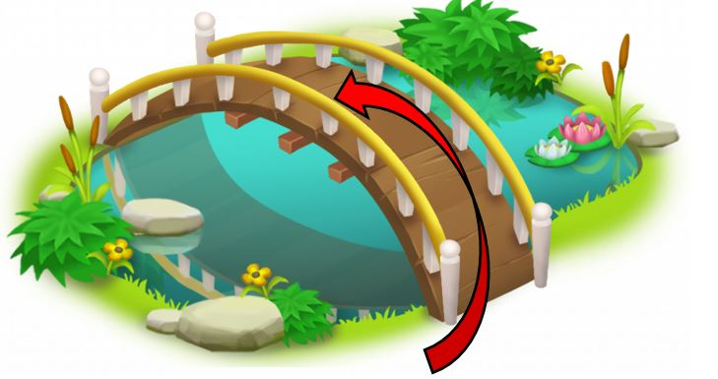


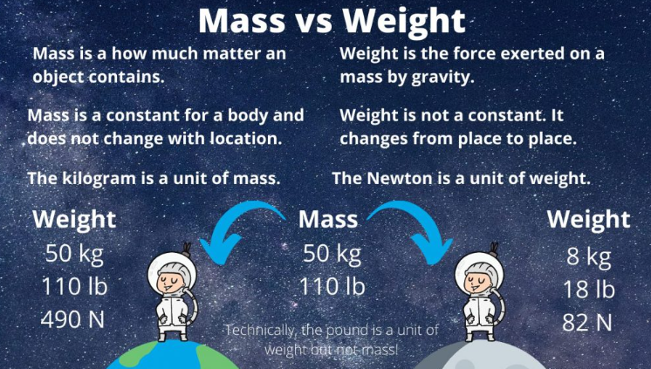
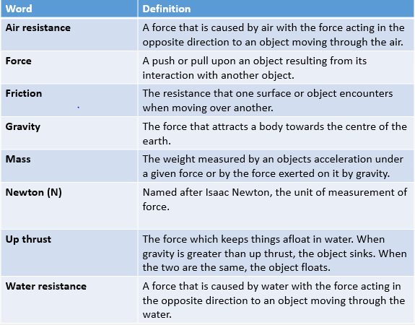
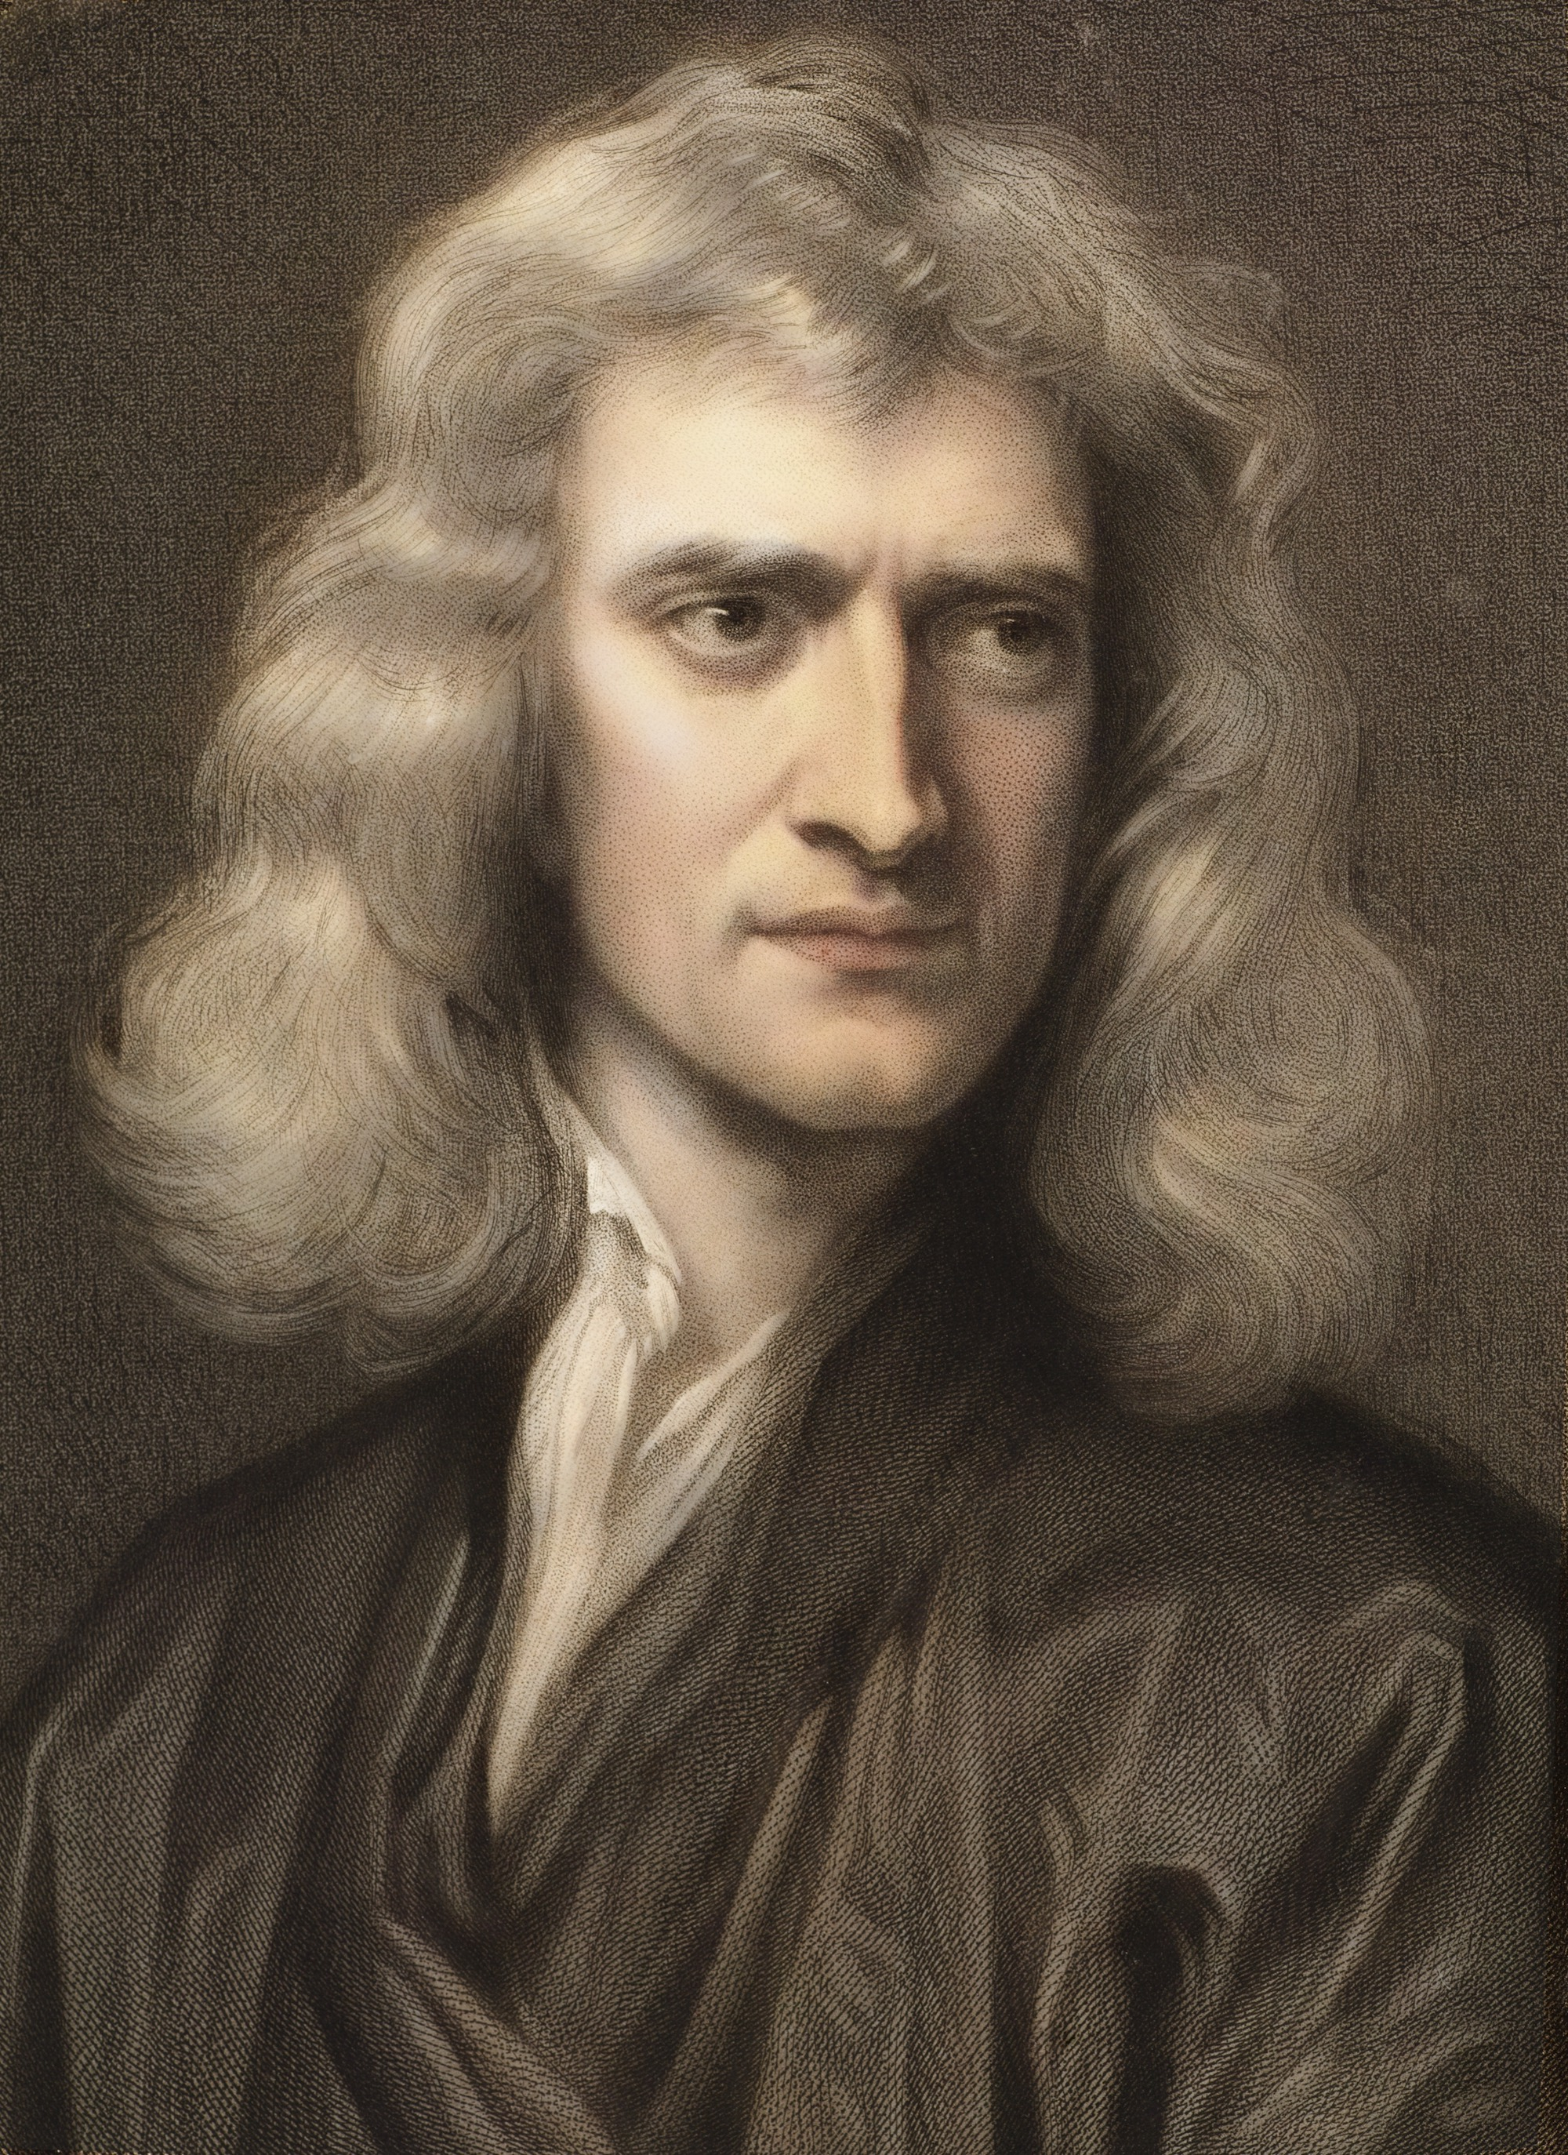
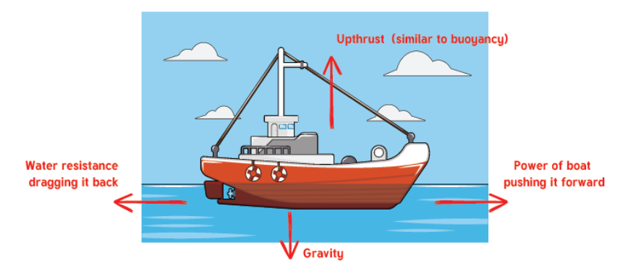
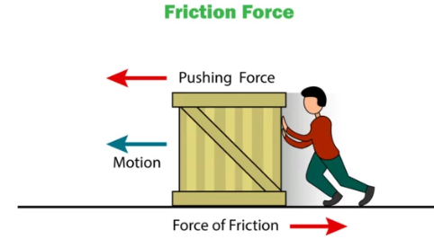
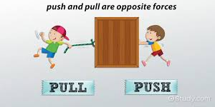
What Should I already know?
To know examples of forces in everyday life. To understand that objects can move differently on different surfaces. To know that magnets have two poles which attract and repel To understand that not all metals are magnetic/attracted to a magnet.
Key Knowledge
To know that there are different types of forces and understand their different effects. • To understand that air resistance and water resistance are forces against motion caused by objects having to move air and water out of their way. • To know that friction is a force against motion caused by two surfaces rubbing against each other. • To know that some objects/animals are streamlined to minimise the effects of air/water resistance.
Isaac Newton
Occupation: Scientist, mathematician, and astronomer 1643- 1727
Scientific Discoveries
Gravity - helped to explain the movements of the planets and the Sun.
Laws of Motion - Newton's laws of motion were three fundamental laws of physics that laid the foundation for classical mechanics.
Calculus - important type of math used in advanced engineering and science.
Reflecting Telescope - In 1668 Newton invented the reflecting telescope. This type of telescope uses mirrors to reflect light and form an image.

