Slide 1
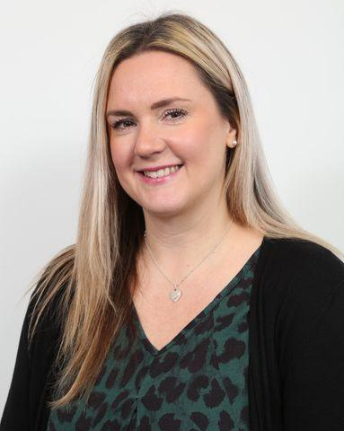
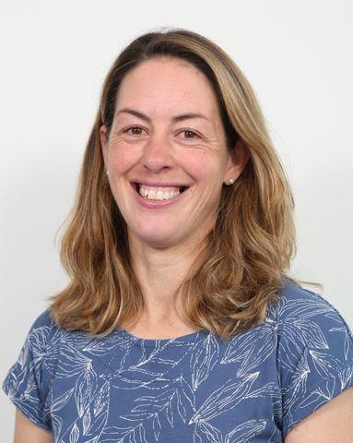
Year 1 2025 & 2024
Miss Whitehead & Mrs Harle

Slide 2
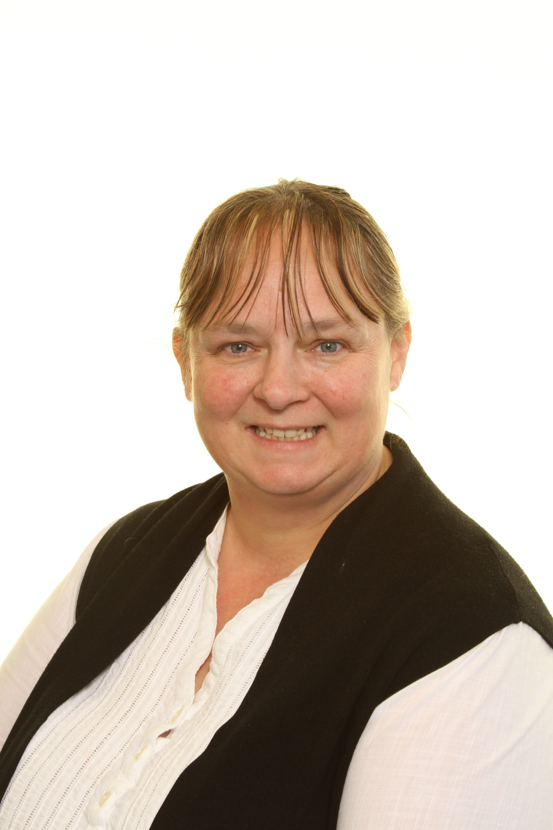
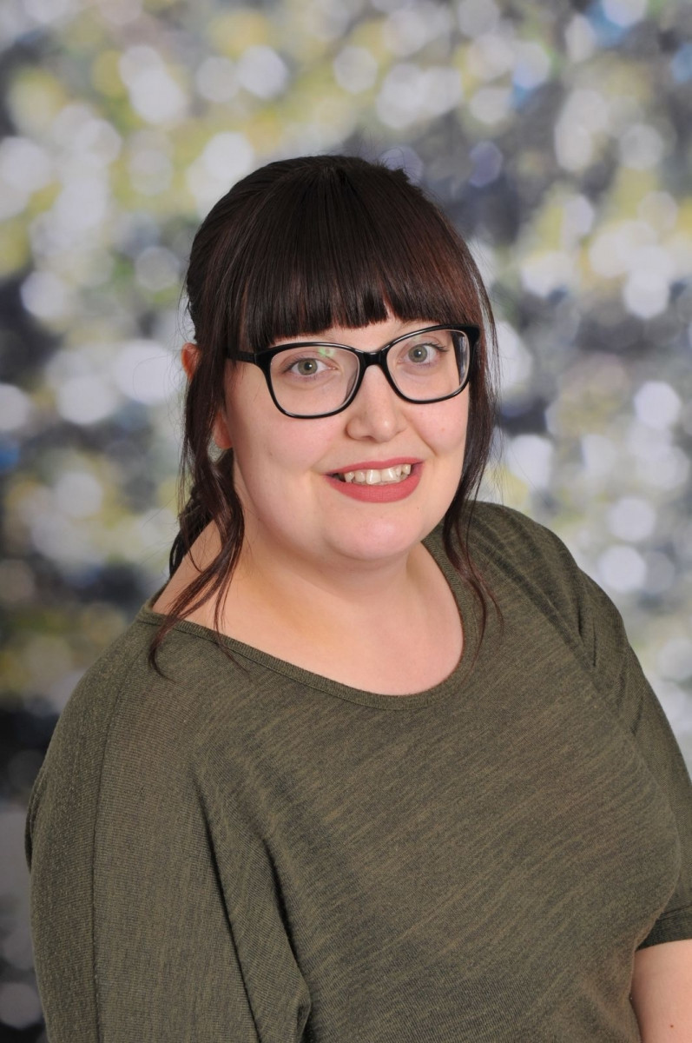
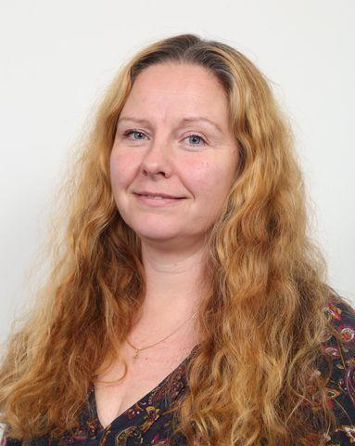
Year 1 Team
Teaching assistants -
Mrs Rowley – Teacher on Tuesday afternoon

Slide 3
Info
Lunchtime routines –They all have free school dinners. Details of this are on our website. Lunchtime is from 11.45pm till 1.00pm. The children have their lunch in the hall and then have playtime in the playground with the other children.
Morning routine – please drop your child at the garden gate between 8.40 am and 9.00 am (register time). The children then put away their coat, book bag and snack and have a coloring activity.
Afternoon pick up – please wait for your child in the play ground by the gate to the garden gate at 3.20 pm. The teacher will release the children one by one, when she has seen that there is someone to collect your child. Please let us know if someone different is picking them up.
A day at school for a Year 1 can include – lessons in the classroom, self initiated play activities, outdoor play, assembly, History, art, PE as well as lunch, break etc.

Slide 4

Info
Children should wear school uniform. Details of the uniform supplier are on the website. Uniforms should be worn on the days your children don’t have PE.
PE kit- on the day your child has PE (Tuesday and Thursday) your child should come to school dressed in clothes suitable for sports. Ideally it should be shorts or tracksuit bottoms, trainers and a PE t-shirt.
Put names in all articles of clothing.
A named water bottle. This is for the children to have regular drinks of water.
Snacks: Your child should bring a healthy snack/money for the morning snacktime. Children will receive a piece of fruit/vegetable in the afternoon.
School book bag. Please send them in each day.

Slide 5

Rewards
Star day
Table of week
Rocket- golden time
Stickers/ certificates

Slide 6

Reading
Reading books will be changed on a Tuesday and a Friday.
Please sign reading records and we will do the same in school.
Guided reading- children will read in small group once a week.
Reading Buddies- Year 5 will be our reading buddies.

Slide 7

Playtimes -
Show and Tell-
Forest School- Summer term

Slide 8
Homework
Weekly homework – written sheet in folder and assignments on EdShed phonics/spelling.
Half Term Topic Enrichment Tasks- optional.
Website list of maths and phonics games.
Set on Wednesday to be returned the following Monday.

Slide 9
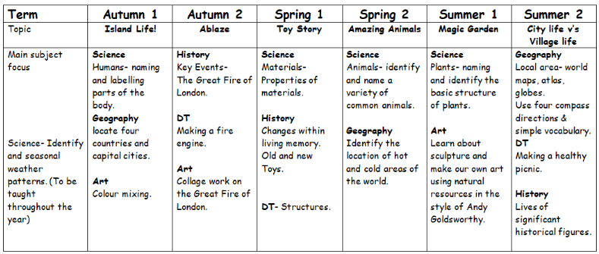
Topics
Each half term detailed info will be updated on the class webpage.

Slide 10


