Slide 1
Year 2 2025-2026
Mrs Mottershead

Slide 2
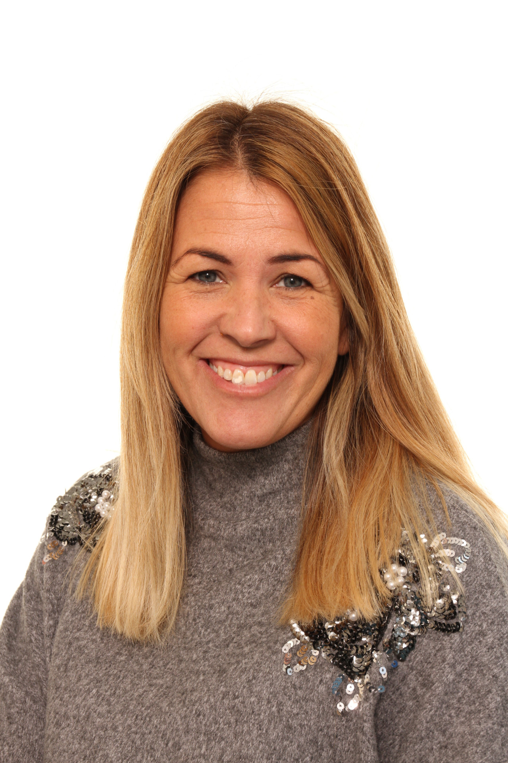
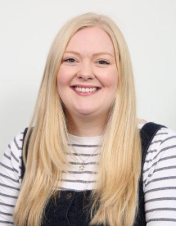
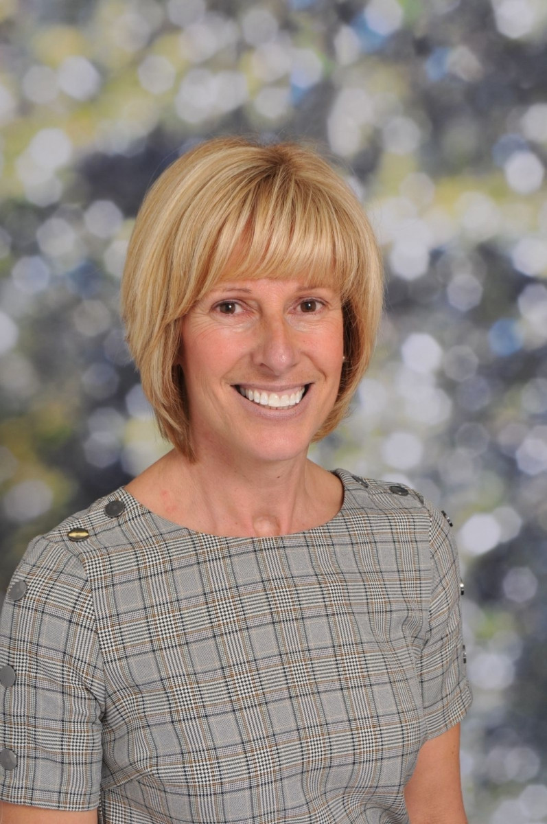
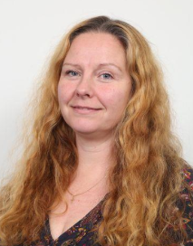
Year 2 Team
Teaching assistants - Miss Hagar,
Mrs Wood
Mrs Clowes
Mrs Rowley (Thursday afternoon)

Slide 3
Lunchtime routines –All children can choose to have a free school dinner. You may send a packed lunch instead if you wish. Menus for school dinners are available on the website. Lunchtime is from 11.45am -1pm. The children have their lunch in the hall and then have playtime in the playground with the other children.
Morning routine – please drop your child at the Year 2 external door between 8.40 am and 8.50am (register time). The children then put away their coat, book bag and snack and have a morning coloring activity before starting the day.
Afternoon pick up – please wait for your child in the play ground outside Year 2 at 3.20 pm. The teacher will release the children one by one, when she has seen that there is someone to collect your child. Please let us know if someone different is picking them up. This could be via email or call to the office.

Slide 4

Children should wear school uniform. Details of the uniform supplier are on the website. Uniforms should be worn on the days your children don’t have PE.
PE kit- on the day your child has PE (Monday and Friday) your child should come to school dressed in clothes suitable for sports. Ideally it should be shorts or tracksuit bottoms, trainers and a PE t-shirt with their school jumper.
Put names in all articles of clothing including PE kit and wellies.
A named water bottle. This is for the children to have regular drinks of water.
Snacks: Your child should bring a healthy snack for the morning snack time. Children will receive a free piece of fruit in the afternoon.
School book bag. Please send them in each day with reading book and record.

Slide 5

Reading
Reading books will be changed on a Tuesday and a Friday.
Please sign reading records and we will do the same in school.

Slide 6
Homework
Weekly homework – written sheet in folder and assignments on EdShed, one maths and one phonics.
Half Term Topic Enrichment Tasks.
Set on Wednesday to be returned the following Monday.

Slide 7
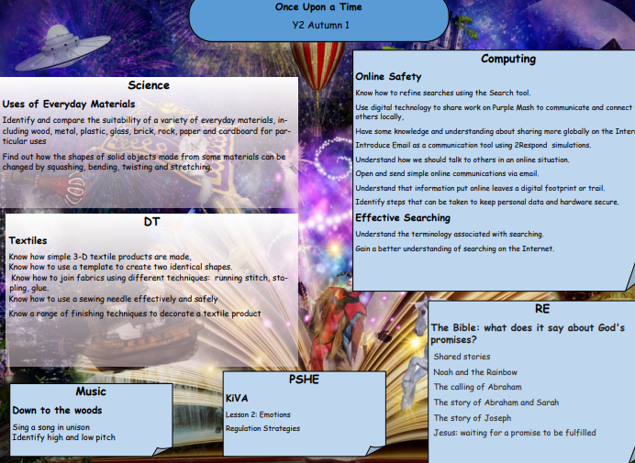
Topics
Each half term detailed info will be updated on the class webpage.

Slide 8
year2@hollinhey.cheshire.sch.uk

