Slide 1

Lets remember our sounds! I’m going to say them out of order.
Can you point to the sounds when you hear them?
ea oi aw
ur er

Slide 2
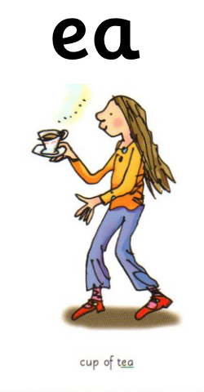
ea ea ea ea
Special friends:
Rhyme: “Cup of tea”
Can you write ‘ea’.

Slide 3

ea
Sound out and blend these words that contain ‘ea’.
Listen to the example:
p ea, p ea, pea
n ea t, n ea t, neat
t r ea t, t r ea t, treat
Can you write these words out? See if you can do so without looking at the words.

Slide 4
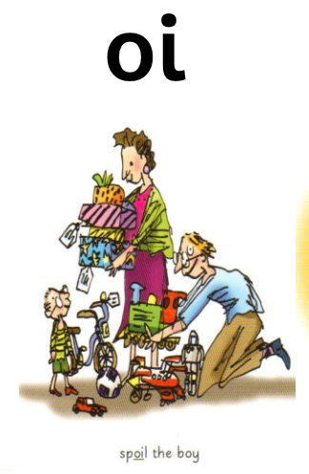
oi oi oi oi
Special Friends!
Rhyme: “ Spoil the boy? ”.
Can you write ‘oy’ .

Slide 5
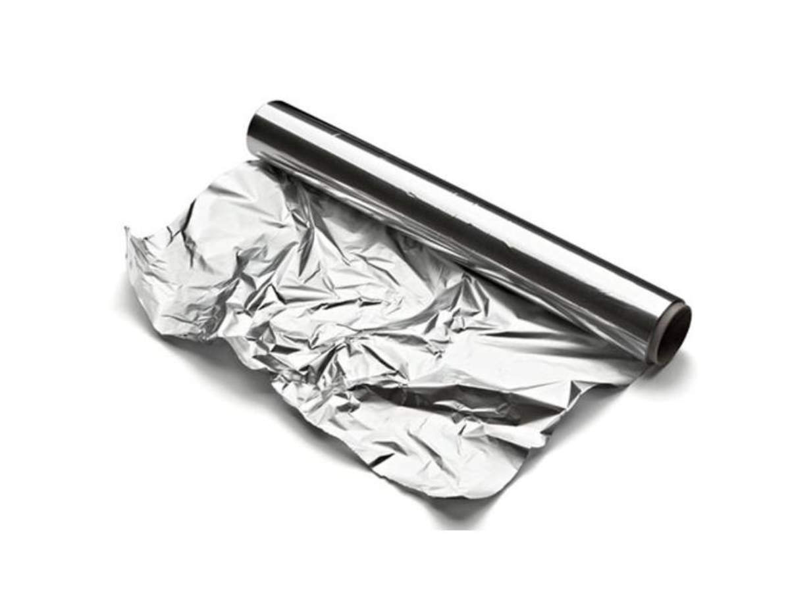
oi
Sound out and blend these words that contain ‘oy’.
Listen to the example:
b oi l, b oi l , boil
c oi n, c oi n, coin
s p oi l, s p oi l, spoil
Can you write these words out? See if you can do so without looking at the words.

Slide 6
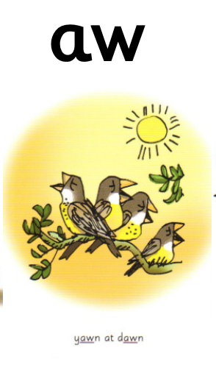
aw aw aw aw
Special friends!
Rhyme: “ Yawn at dawn! ”
Can you write ‘aw’ .

Slide 7

aw
Sound out and blend these words that contain ‘aw’.
Listen to the example:
l aw n, l aw n, lawn
d r aw, d r aw, draw
c l aw s, c l aw s, claws
Can you write these words out? See if you can do so without looking at the words.

Slide 8
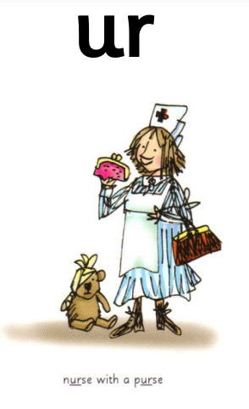
ur ur ur ur
Special friends!
Rhyme: “ Nurse with a purse!”
Can you write ‘ur’ .

Slide 9
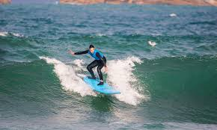
ur
Sound out and blend these words that contain ‘ur’.
Listen to the example:
c ur l, c ur l, curl
b ur n, b ur n, burn
t ur n, t ur n turn
Can you write these words out? See if you can do so without looking at the words.

Slide 10
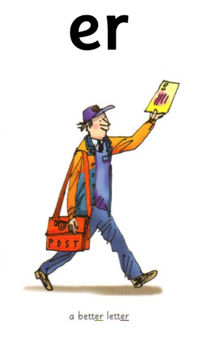
er er er er
Special friends!
Rhyme: “A better letter!”
Can you write ‘er’.

Slide 11
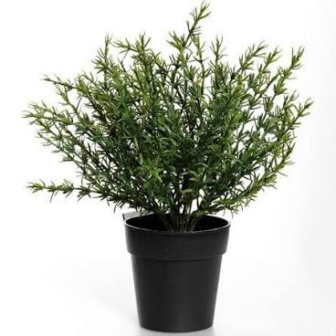
Sound out and blend these words that contain ‘er’.
Listen to the example:
er
h er, h er, her
s l ow er, s l ow er, slower
w i n t er, w i n t er, winter
Can you write these words out? See if you can do so without looking at the words.

