Slide 1


Lets remember our sounds! I’m going to say them out of order.
Can you point to the sounds when you hear them?
c k u b
e l h

Slide 2
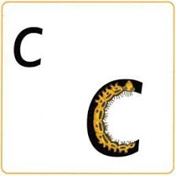
c c c c c
Rhyme: “ Up we go. Curl around the caterpillar”.
Can you write ‘c’ .

Slide 3
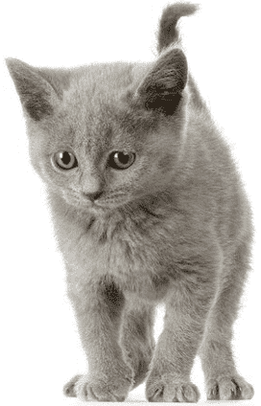
c
Sound out an blend these words.
Listen to the example:
c o t, c o t, cot
c a p, c a p, cap
c u t, c u t, cut
Can you write these words out? See if you can do so without looking at the words.

Slide 4

k k k k k
Rhyme: “ Up we go. Down the kangaroos body, curly tail and leg.Flick.”
Can you write ‘k’ .

Slide 5
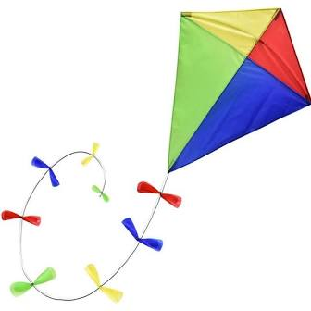
k
Sound out an blend these words:
Listen to the example.
k i t, k i t, kit
k i ck, k i ck, kick
k i p, k i p, kip
Can you write these words out? See if you can do so without looking at the words.

Slide 6
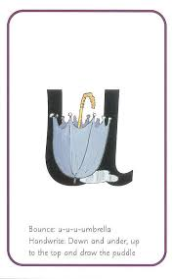
u u u u
Rhyme: “ Up we go. Down and under, up tothe top down and draw the puddle. Flick.”
Can you write ‘u’ .

Slide 7
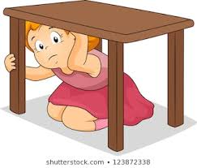
u
Sound out an blend these words. Do you notice that in these words the ‘u’ is in the middle?
Listen to the example.
u p, u p, up
c u t, c u t, cut
b u n, b u n, bun
Can you write these words out? See if you can do so without looking at the words.

Slide 8

b
Rhyme: “ Up we go. Down the laces to the heel and round the toe. Flick!”
Can you write ‘b’ .

Slide 9
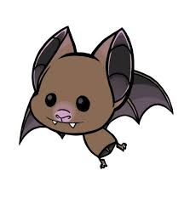
b
Sound out an blend these words:
Listen to the example.
b i t, b i t, bit
b a d, b a d, bad
b i n, b i n, bin
Can you write these words out? See if you can do so without looking at the words.

Slide 10
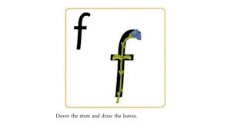
Rhyme: “ up we go, down the stem, loopity leaves . Flick!
Can you write ‘’ .

Slide 11
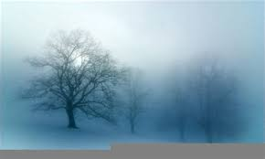
Sound out an blend these words:
Listen to the example.
f a t, f a t, fat
f i b, f i b, fib
f u n, f u n, fun
Can you write these words out? See if you can do so without looking at the words.

Slide 12
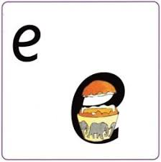
e
Rhyme: “up we go, lift off the top and scoop out the egg!”
Can you write ‘e’ .

Slide 13

e
Sound out an blend these words.
Listen to the example.
Do you notice that in some of these words the ‘e’ is in the middle?
t e n, t e n, ten
e n d, e n d, end
m e t, m e t, met
Can you write these words out? See if you can do so without looking at the words.

Slide 14
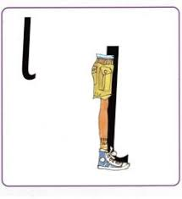
l
Rhyme: “ Up we go. Down the long leg. Flick.”
Can you write ‘l’ .

Slide 15

l
Sound out an blend these words:
Listen to the example.
l o t, l o t, lot
l a p, l a p, lap
l i p, l i p, lip
Can you write these words out? See if you can do so without looking at the words.

Slide 16
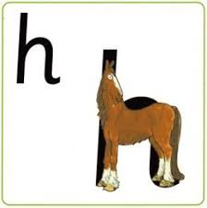
h
Rhyme: “ Up we go. Down the head to the hooves and over his back. Flick!”
Can you write ‘h’ .

Slide 17
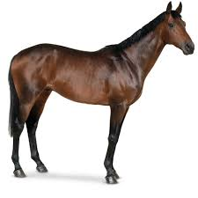
h
Sound out an blend these words:
Listen to the example.
h o p, h o p, hop
h i m, h i m, him
h a t, h a t, hat
Can you write these words out? See if you can do so without looking at the words.

