Slide 1
Lets remember our sounds! I’m going to say them out of order.
Can you point to the sounds when you hear them?
ar or air
ir ou oy

Slide 2
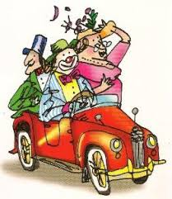
ar ar ar ar
Special friends:
Rhyme: “ Start the car? “
Can you write ‘ar’.

Slide 3


ar
Sound out and blend these words that contain ‘ar’.
Listen to the example:
f ar, f ar, far
p ar t, p ar t, part
s m ar t, s m ar t, smart
Can you write these words out? See if you can do so without looking at the words.

Slide 4
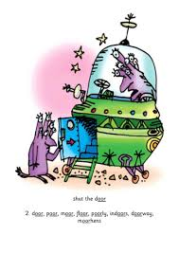
or or or or
Special Friends!
Rhyme: “ Shut the door? ”.
Can you write ‘or’ .

Slide 5

or
Sound out and blend these words that contain ‘or’.
Listen to the example:
f or, f or , for
s or t, s or t, sort
s p or t , s p or t, sport
Can you write these words out? See if you can do so without looking at the words.

Slide 6
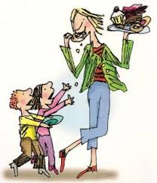
air air air
Special friends!
Rhyme: “ That’s not fair! ”
Can you write ‘air’ .

Slide 7

air
Sound out and blend these words that contain ‘air’.
Listen to the example:
h air, h air, hair
ch air, ch air, chair
l air, l air, lair
Can you write these words out? See if you can do so without looking at the words.

Slide 8

ir ir ir ir
Special friends!
Rhyme: “ Whirl and twirl!”
Can you write ‘ir’ .

Slide 9

ir
Sound out and blend these words that contain ‘ir’.
Listen to the example:
g ir l, g ir l, girl
b ir d, b ir d, bird
th ir d, th ir d third
Can you write these words out? See if you can do so without looking at the words.

Slide 10

ou ou ou ou
Special friends!
Rhyme: “Shout it out!”
Can you write ‘ou’.

Slide 11

Sound out and blend these words that contain oo.
Listen to the example:
ou
l ou d, l ou d, loud
r ou n d, r ou n d, round
m ou th, m ou th, mouth
Can you write these words out? See if you can do so without looking at the words.

Slide 12

oy oy oy oy
Special friends!
Rhyme: “Toy for a boy!”
Can you write ‘oy’ .

Slide 13

‘ oy.
Sound out and blend these words that contain ‘oy’.
Listen to the example:
b oy, b oy, boy
j oy, j oy, joy
t oy, t oy, toy
Can you write these words out? See if you can do so without looking at the words.

