Slide 1

Lets remember our sounds! I’m going to say them out of order.
Can you point to the sounds when you hear them?
qu sh th
ch ng nk

Slide 2

qu qu qu qu
Special friends:
Rhyme: “ qu -qu-qu- queen
Round her head, up past her earrings and down her hair:”
However, I like to teach ‘qu’ with this: The queen doesn’t go anywhere without her umbrella.
Can you write ‘qu’.

Slide 3

qu
Sound out and blend these words:
Listen to the example.
qu i t, qu i t, quit
qu i z, qu i z, quiz
qu i ck , qu i ck, quick
Can you write these words out? See if you can do so without looking at the words.

Slide 4
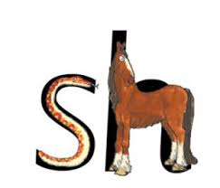
sh sh sh sh
Special Friends!
Rhyme: “Shhhhh says the horse to the hissing snake”.
Can you write ‘sh’ .

Slide 5

sh
Sound out and blend these words.
Listen to the example:
sh o p, sh o p, shop
sh i p, sh i p, ship
sh e d, sh e d, shed
Can you write these words out? See if you can do so without looking at the words.

Slide 6
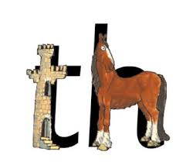
th th th th
Special friends!
Rhyme: “ The princes in the tower is rescued by the horse. She says: thhhhhank you.”
Can you write ‘th’ .

Slide 7

th
Sound out and blend these words:
Listen to the example.
th i s, th i s, this
th a t, th a t, that
th i n, th i n, thin
Can you write these words out? See if you can do so without looking at the words.

Slide 8
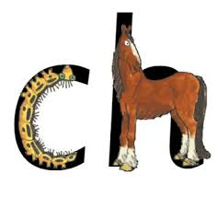
ch ch ch ch
Special friends!
Rhyme: “ Ch - ch- xh- choo! The horse sneezes when the caterpillar’s hairs get up is nose.”
Can you write ‘ch’ .

Slide 9
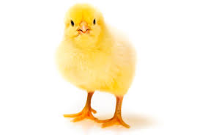
ch
Sound out and blend these words.
Listen to the example.
ch i p, ch i p, chip
ch o p, ch o p, chop
ch i n, ch i n chin
Can you write these words out? See if you can do so without looking at the words.

Slide 10
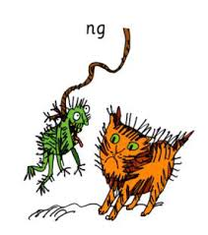
ng ng ng ng
Special friends!
Rhyme: “Thing on a string!”
Can you write ‘ng’.

Slide 11
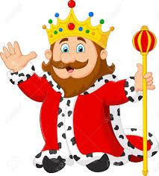
‘ng’ is in the middle or end of words.
Listen to the example.
Sound out and blend these words:
ng
s i ng, s i ng, sing
b a ng b a ng, bang
w i ng, w i ng, wing
Can you write these words out? See if you can do so without looking at the words.

Slide 12
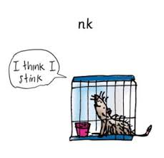
nk nk nk nk
Special friends!
Rhyme: “I think I stink!”
Can you write ‘nk’ .

Slide 13
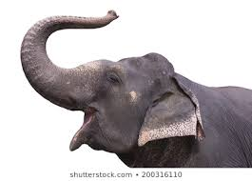
‘ nk.
‘ng’ is in the middle or end of words. Listen to the example:
Sound out and blend these words:
p i nk, p i nk, pink
l i nk, l i nk, link
s u nk, s u nk, sunk
Can you write these words out? See if you can do so without looking at the words.

