Slide 1

Lets remember our sounds! I’m going to say them out of order.
Can you point to the sounds when you hear them?
m a s d t
i n p g o

Slide 2
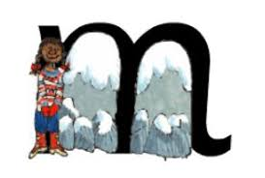
m m m m m
Rhyme: “ Maisy, mountain, mountain.
Can you write ‘m’ .

Slide 3
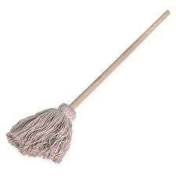
m
Sound out an blend these words.
Listen to the example:
m a n, m a n, man
m a d, m a d, mad
m a t, m a t, mat
Can you write these words out? See if you can do so without looking at the words.

Slide 4
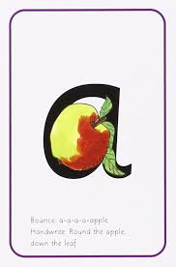
a a a a
Rhyme: “ around the apple and down the leaf”
Can you write ‘a’ .

Slide 5
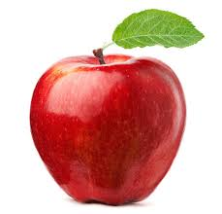
a
Sound out an blend these words: Listen to the example.
a t, a t, at
a m, a m, am
a n t, a n t, ant
Can you write these words out? See if you can do so without looking at the words.

Slide 6

s s s s s
Rhyme: “ Slither down the snake”
Can you write ‘s’ .

Slide 7
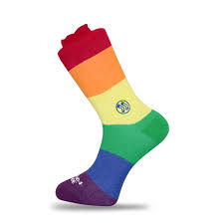
s
Sound out an blend these words: Listen to the example.
s a t, s a t, sat
s a m, s a m, sam
s a d, s a d, sad
Can you write these words out? See if you can do so without looking at the words.

Slide 8
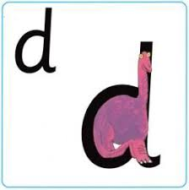
d d d d d
Rhyme: “ Round the dinosaurs bottom, up his tall neck and down to his toes.”
Can you write ‘d’ .

Slide 9
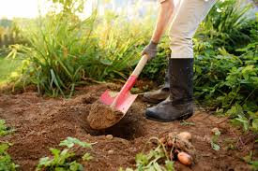
d
Sound out an blend these words:
Listen to the example.
d a d, d a d, dad
d a m, d a m, dam
d o t, d o t, dot
Can you write these words out? See if you can do so without looking at the words.

Slide 10

t t t t t
Rhyme: “ up we go, down the tower, flick. Across the tower.”
Can you write ‘t’ .

Slide 11
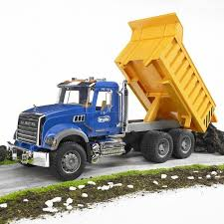
t
Sound out an blend these words:
Listen to the example.
t a p, t a p, tap
t a g, t a g, tag
t o p, t o p, top
Can you write these words out? See if you can do so without looking at the words.

Slide 12
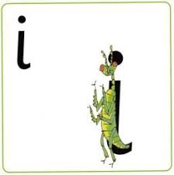
i i i i i
Rhyme: “up we go, down the insects body, flick. Dot for a head” .
Can you write ‘i’ .

Slide 13
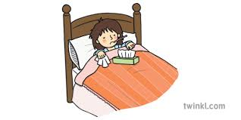
i
Sound out an blend these words:
Listen to the example.
i n, i n, in
i t, i t, it
i s, i s, is
Can you write these words out? See if you can do so without looking at the words.

Slide 14
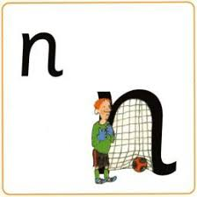
n n n n n
Rhyme: “ Up we go. Down and up Nobby and over the net.
Can you write ‘n’ .

Slide 15
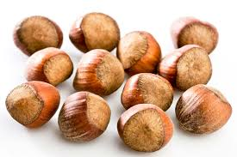
n
Sound out an blend these words:
Listen to the example.
n o t, n o t, not
n a p, n a p, nap
n i p, n i p, nip
Can you write these words out? See if you can do so without looking at the words.

Slide 16

p p p p p
Rhyme: “ Up we go. Down and up the pirates plait, round his face. Flick! ”
Can you write ‘p’ .

Slide 17
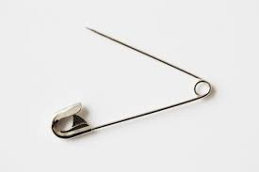
p
Sound out an blend these words:
Listen to the example.
p o p, p o p, pop
p a n, p a n, pan
p a t, p a t, pat
Can you write these words out? See if you can do so without looking at the words.

Slide 18
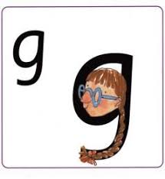
g g g g g
Rhyme: “ Up we go. Around the girls face, down her plait, giver her a curl.”
Can you write ‘g’ .

Slide 19
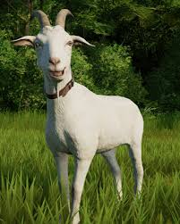
g
Sound out an blend these words:
Listen to the example.
g a p, g a p, gap
g o t, g o t, got
g a s, g a s, gas
Can you write these words out? See if you can do so without looking at the words.

Slide 20
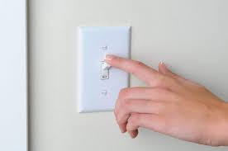
o
Sound out an blend these words: Can you see that sometimes the o is in the middle of these words?
Listen to the example.
p o t, p o t, pot
o n, o n, on
t o t, t o t, tot
Can you write these words out? See if you can do so without looking at the words.

Slide 21
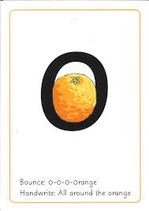
o o o o o
Rhyme: “ Up we go. All around the orange, flick.”
Can you write ‘o’ .

