Slide 1

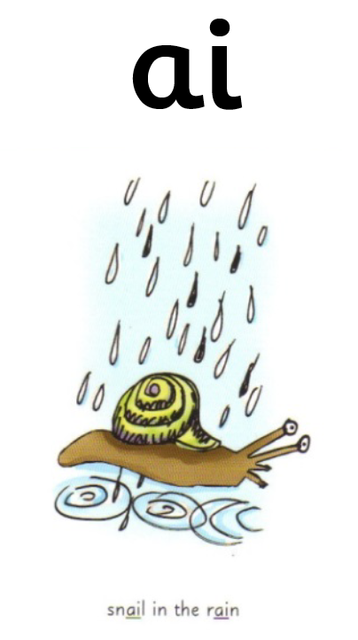
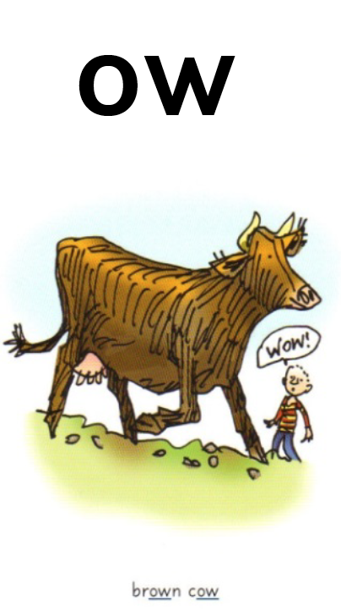
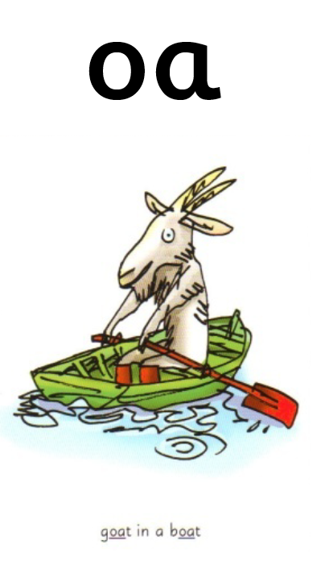
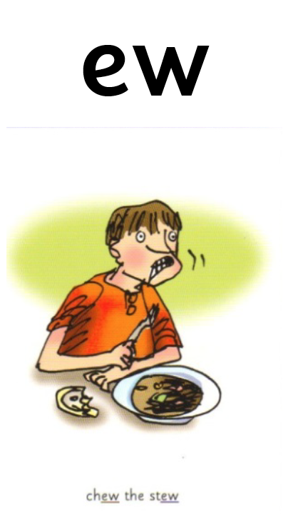
More special friends. These sounds ( digraphs) make the same sound as other digraphs we have learnt before. Have a listen.
Note: Digraph = Special friends ; two letters, one sound.
ow -
ai -
oa -
ew -

Slide 2
ow ow ow
Special friends:
Rhyme: “Brown cow”
Can you write ‘ow’.

Slide 3
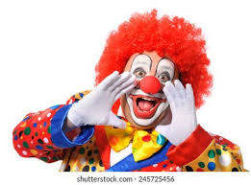
ow
Sound out and blend these words that contain ‘ow’.
Listen to the example:
d ow n d ow n down
f r ow n, f r ow n, frown
c r ow d, c r ow d, crowd
Can you write these words out? See if you can do so without looking at the words.

Slide 4
ai ai ai ai
Special friends!
Rhyme: “ Snail in the rain”.
Can you write ‘ai’ .

Slide 5

ai
Sound out and blend these words that contain ‘ai’’.
Listen to the example:
p ai n t, p ai n t , paint
t ai l, t ai l, tail
t r ai n, t r ai n, train
Can you write these words out? See if you can do so without looking at the words.

Slide 6
oa oa oa oa
Special friends!
Rhyme: “Goat in a boat! ”
Can you write ‘o a’ .

Slide 7

o a
Sound out and blend these words that contain ‘oa’.
Listen to the example:
t oa d, t o a d, toad
s t o n e, s t o n e, stone
th r oa t, th r oa t, throat
Can you write these words out? See if you can do so without looking at the words.

Slide 8
ew ew ew
Special friends!
Rhyme: “ Chew the stew!”
Can you write ‘ew’ .

Slide 9
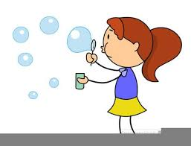
ew
Sound out and blend these words that contain ‘ew’.
Listen to the example:
n ew, n ew, new
f l ew, f l ew, flew
s c r ew, s c r ew screw
Can you write these words out? See if you can do so without looking at the words.

