Slide 1

Come Be With Me
Reading workshop

Slide 2
Reading is not just a good way to fill the time. It has important and far-reaching benefits which go beyond a love of a good book. When children and young people enjoy reading, they are more likely to create a habit and read more often which in turn will help to build vital reading skills and bring with it a wider range of benefits.
National Literacy Trust

Slide 3

Expanding Horizons
A book can provide a way to discover new worlds, find out about new people and learn about the past – fiction, non-fiction, poetry, autobiographies and diaries.
Other media which promote reading include: comics, magazines, song lyrics, digital media, cereal packets, road and shop signs, podcasts and audiobooks

Slide 4
Reading overview
Reading has two components:
Decoding or word recognition – Recognising words both in and out of context, (in a sentence or on a flash card for example), applying phonic rules by blending phonemes, e.g. c-a-t and through phonics work
Comprehension – the process used to interpret and understand word information, sentences and texts

Slide 5
Reading at Huxley
As a school we follow Read Write Inc. The Read Write Inc. phonics programme is carefully matched to the National Curriculum, giving your children the best chance of success. They show teachers, teaching assistants and parents step-by-step how to teach all children to become fluent readers, confident speakers and willing writers.
We use Read Write Inc. Phonics for our children in Foundation Stage to Year 2 and for our children in Key Stage 2 who need further support.
Children in Acorns also listen to, talk about, recount and re-enact traditional tales and rhymes

Slide 6

Using Read Write Inc…
When using RWI to read, the children will:
learn 44 sounds and the corresponding letter/letter groups using simple picture prompts
learn to read words using Fred Talk
read lively stories featuring words they have learned to sound out
show that they comprehend the stories by answering questions.

Slide 7

Following on from RWI
Building on the knowledge of reading gained in Early Years and Key Stage 1, the children begin to improve their fluency and comprehension skills. To be fluent, phonic knowledge is important and once fluent children can focus on understanding and comprehension. This happens because the brain doesn’t have to focus to work out what a word says and can concentrate on understanding the text and enjoying it.
At school, we share books from Literacy Tree for reading and writing, teachers read to the children in class and each child has a reading book, levelled to match their ability, using Star Assessments for reading.

Slide 8
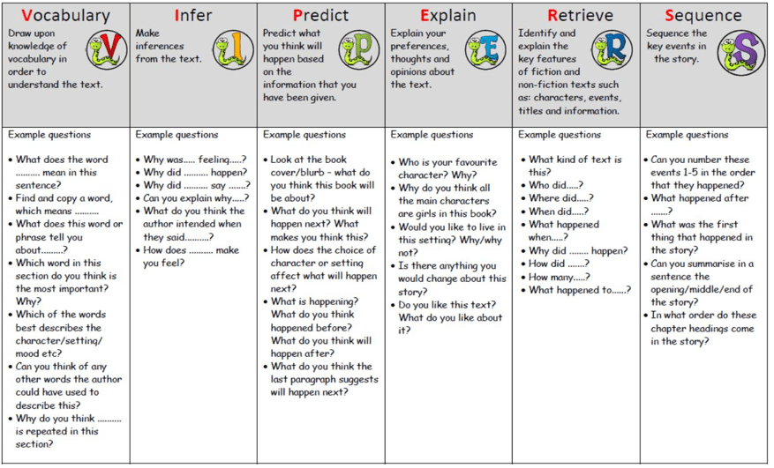
Reading Viper comprehension questions

Slide 9
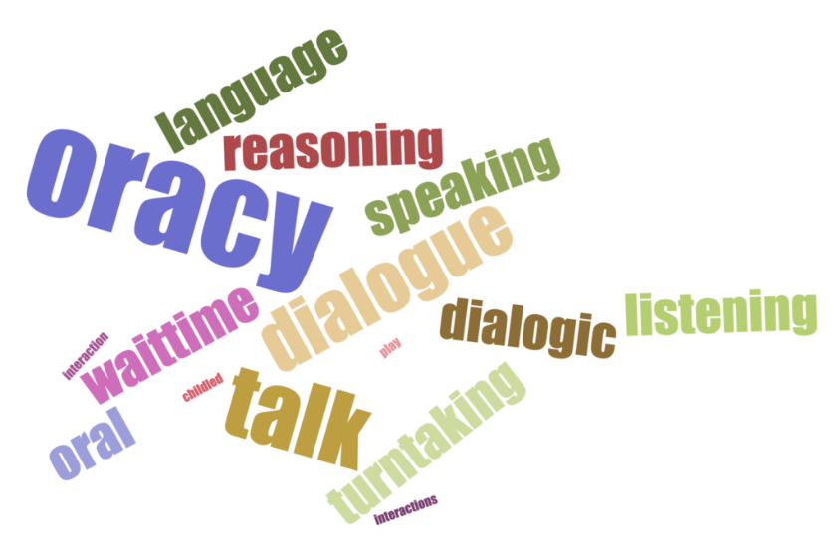
Reading and Oracy
Oracy is the ability to talk about ideas, develop an understanding of spoken language and use that to engage with others. Oracy allows children to become effective speakers and listeners, so they can better understand themselves, each other and the world around them.
Oracy is used in every aspect of the school day and can be used at home through reading, (by modelling and talking about a text) to help deepen knowledge about different subjects, to reason, to discuss choices in reading materials the children like/don’t like, to verbalise viewpoints, to organise, to focus and to improve fluency and expression.

Slide 10
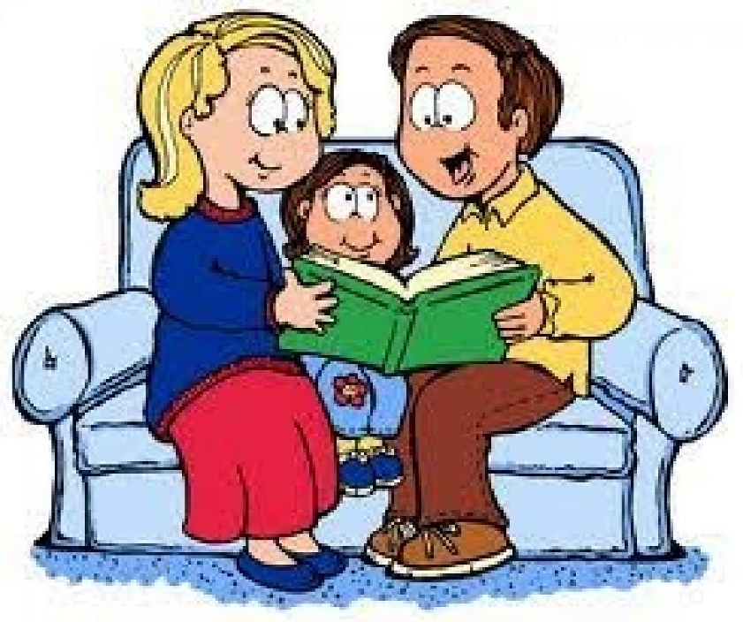
Reading with your child at home
Encourage reading by:
Having books at home, use the local library, have texts other than books, show that you love reading, (even if you don’t really!)
Before reading a book:
Talk about the book cover and the title
Share the blurb, if there is one
Flick through the book

Slide 11
Reading at home
Some ways to build fluency at home, include:
An adult/older sibling reading the text and the child follows with their finger. This helps with word recognition and models to the children how to read with fluency and expression
Taking turns to read a sentence or page each
Echoing – reading partner reads and child repeats in the same way
Be an active listener when your child reads
Read trickier books to your child for pleasure

Slide 12
What to do if a child gets stuck when reading
Use phonics – sound out the word
Read to the end of the sentence, what word would make sense?
Think about the text type, what might fit?
Does a word sound right?
Use the picture, if there is one
Is there a root word? E.g. helpless
Chunk the word – up-load-ed
Share the word

Slide 13
Impact of Reading
Amount of reading | 1 minute | 5 minutes | 20 minutes
Number of minutes per year | 180 | 900 | 3600
Number of words per year | 8000 | 282,000 | 1.8 million
Hours read by the end of primary school | 42 | 212 | 851
Performance in tests | Scores in the bottom 10% | Scores around average 50% | Scores in the top 10%

Slide 14
Activities to help with reading
I-spy
Wordsearch
Find a rhyme – what rhymes with ...?
Matching game
Snap game
Rhyming Jumps – Jumping Jack for odd one out
Make up a story, one sentence at a time
Letter grid game/Boggle

Slide 15

Reading for pleasure is very important
ENJOY!

