Slide 1

Year 2 Residential 14th May - 15th May

Slide 2
Children arrive in school at 8.45am.
Children to wear suitable clothes for outdoor activities on Thursday.
All belongings in a holdall that the child can recognise and carry.
Any medication to be handed to the class teacher. Medication forms to be completed to accompany the medication. (available from the office)
Coach will leave school for Trafford Hall after registration and all pupils/staff are ready.
We will inform school of our arrival, and school will inform parents.

Slide 3
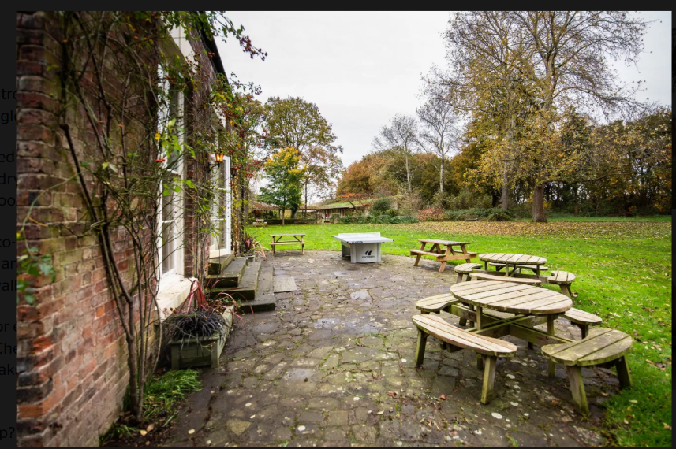

Slide 4
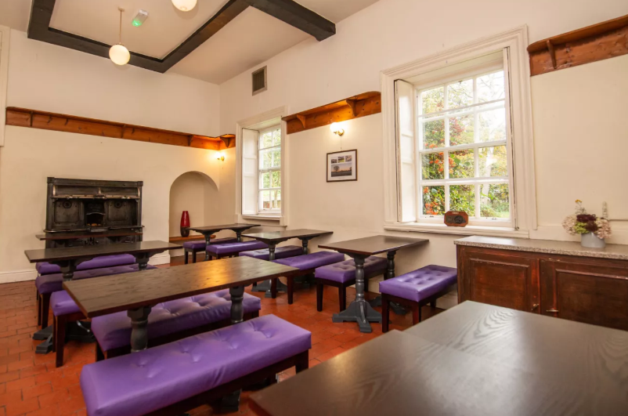

Slide 5
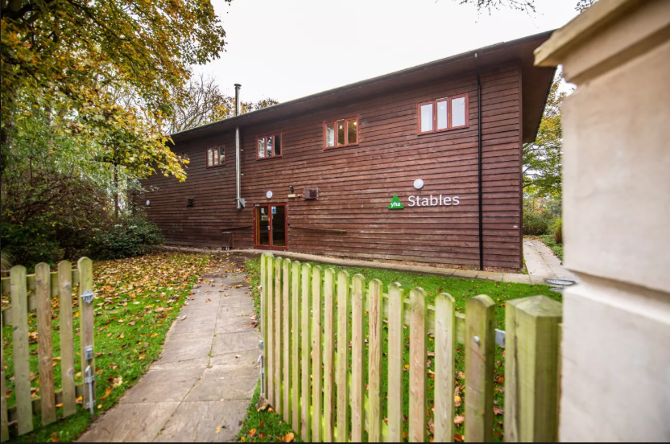

Slide 6
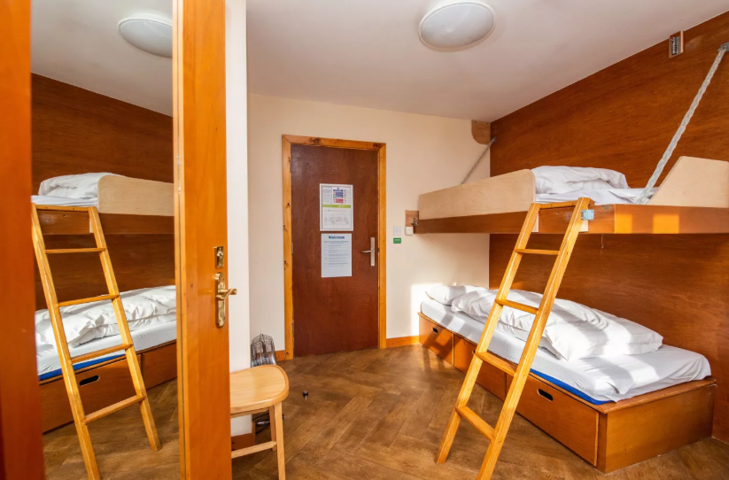

Slide 7
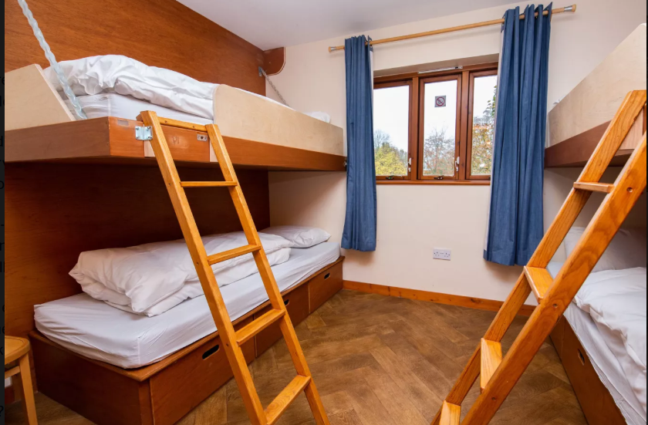

Slide 8
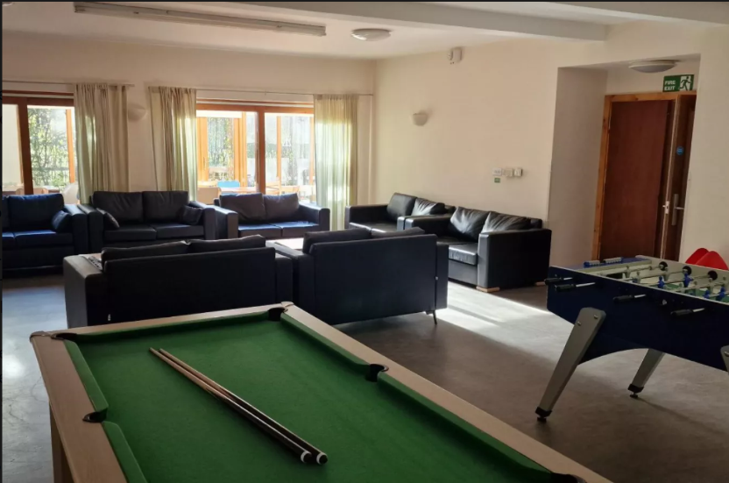

Slide 9
Meals
Thursday - Own Packed Lunch
Evening Meal - Choice of
Classic cheeseburger and fries
Crispy Bean Burger and Fries (v)
Jacket potato with cheese & beans (v)
Waffles with caramel sauce and cream (v)
fresh fruit

Slide 10
Breakfast Friday
Continental buffet, including cereal, fruit, yoghurt and flaky pastries.
Cooked full English breakfast
Fruit Juice
Friday YHA provide a packed lunch - huge range of sandwiches!!

Slide 11
Itinerary
Day | Am | Pm | Evening
Thursday | - 11am coach pick up Own Packed lunch | Welcome & Ground Rules Nature Scavenger Hunt Den Building Den Gallery Walk Teatime | Woodland / Grounds Walk Group Storytelling Circle Nature drawing
Friday | Breakfast Morning Stretch & Wake-Up Mini Beast Hunt Nature Art | Lunch - Provided Final closing circle Coach 2pm

Slide 12

What to bring … please don’t buy anything
Packed lunch for the first day.
1 pair of trainers
Slippers/ easy on/off indoor shoes (sliders)
Pyjamas (dressing gown if roomin bag)
Underwear x 2 (pants and socks)
Small towel (face washing and toothbrushing only)
2 x t-shirts
Wear a sweatshirt + pack one
Wash bag ( toothbrush, small toothpaste, soap flannel)
Coat (waterproof)
Small teddy (not their favourite one!)
PLEASE LABEL EVERYTHING!
Top Tip - Let your child pack their own bag with you.

Slide 13
Packed lunch - Thursday
If you require a packed lunch from school (remember its free) then please email class teacher by Friday 8th May.
Ham
Cheese
Tuna

