Slide 1
Tattenhall Residential
10th-12th November 2014

Slide 2
Arrival
Your child will be leaving school approximately 9:30am to arrive at Tattenhall residential centre at 10:00am.
Please arrive at school at the usual time 8:50am. You may enter via the main entrance where you can leave your suitcase in the hall and say goodbye to your child.
Upon arrival all children and staff will have a full fire and safety briefing by the residential centre members of staff.

Slide 3
Sleeping
arrangements
Boys and girls will sleep in separate dormitories.

Slide 4
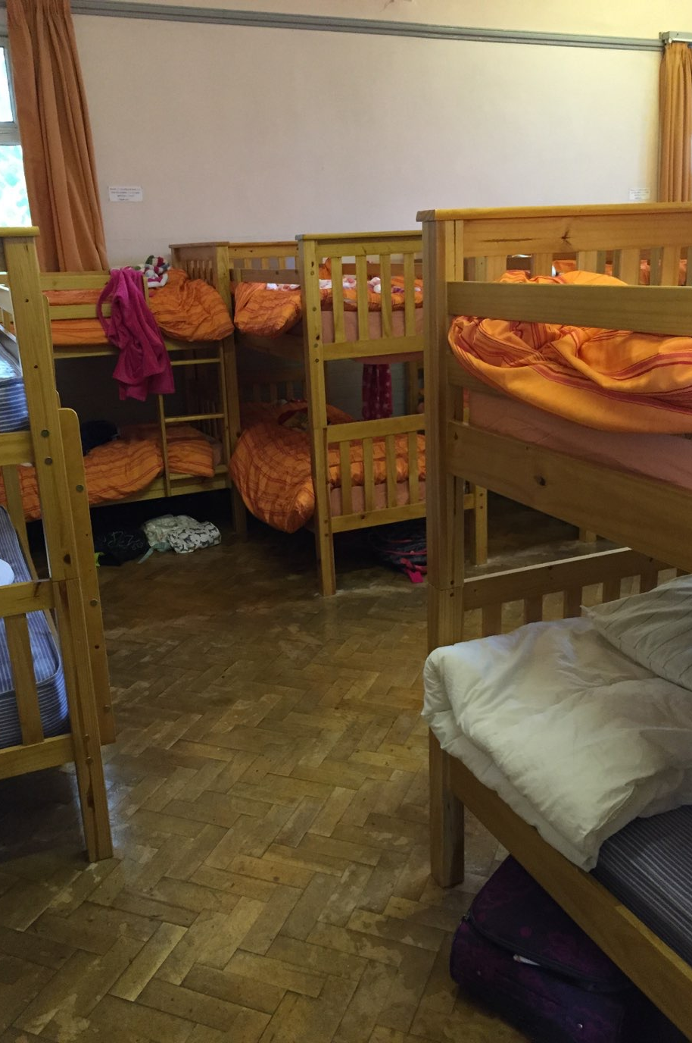
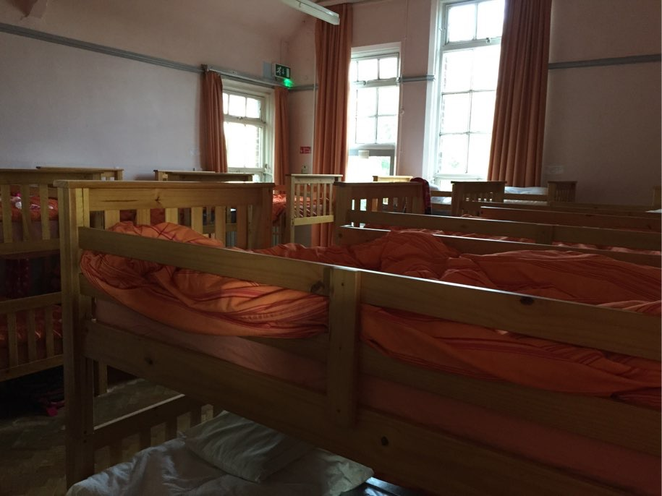
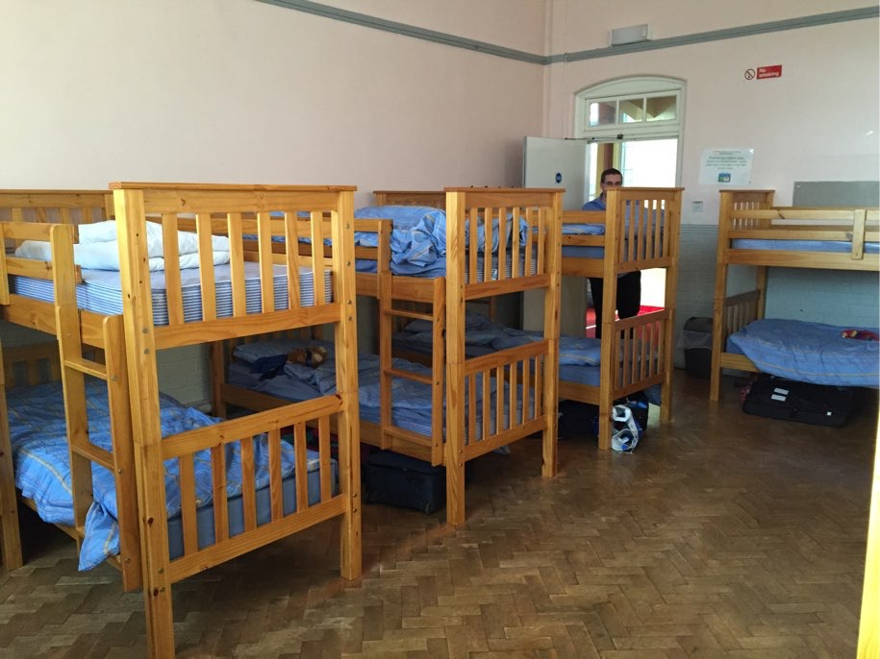

Slide 5
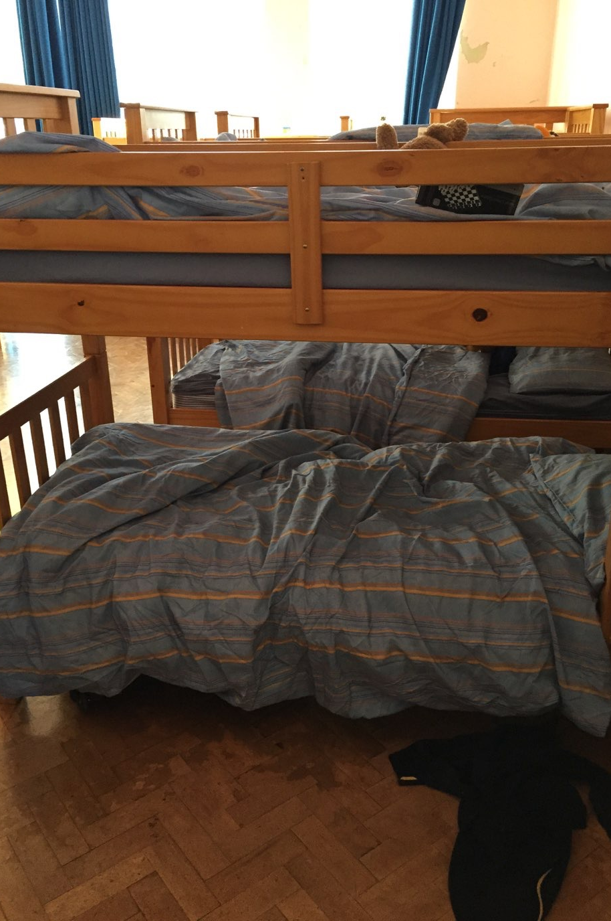
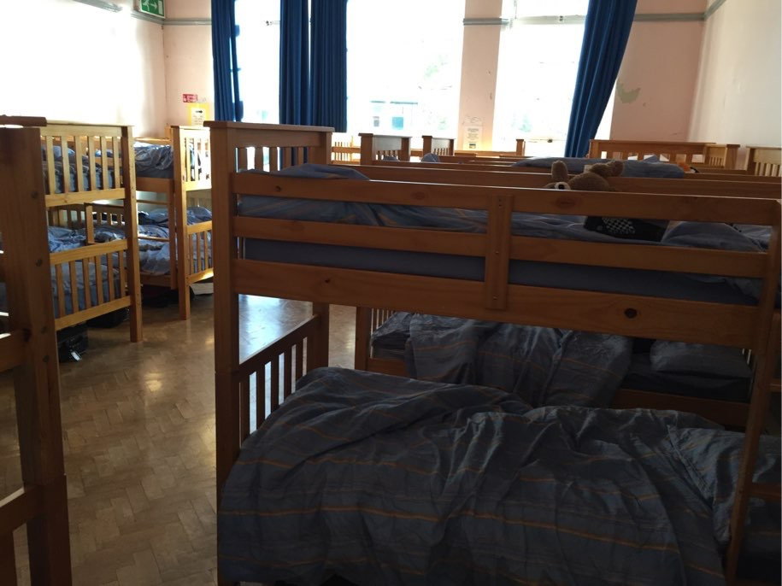
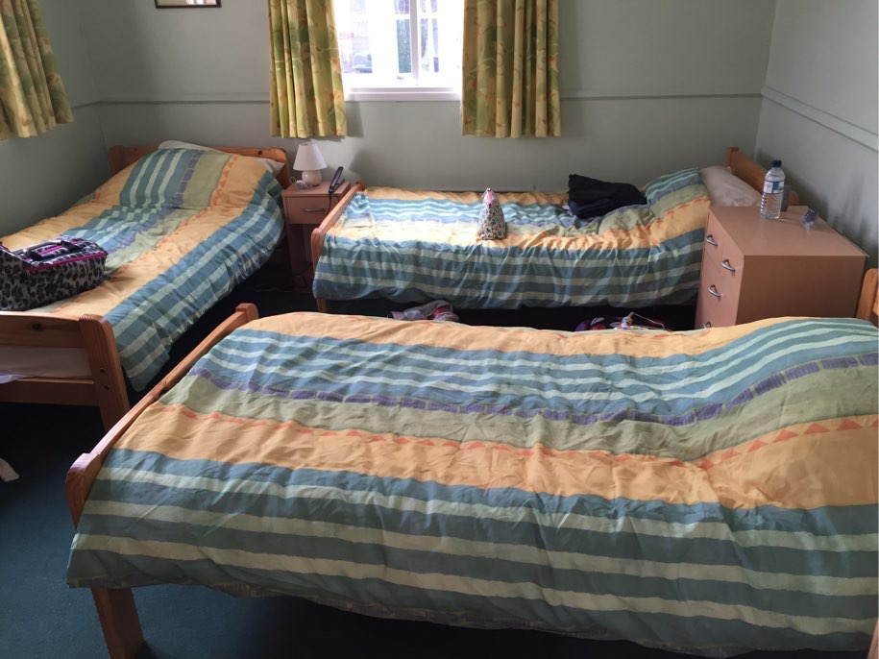

Slide 6
Organised Activities
During their stay, your child will participate in the following activities organised by centre staff:
Willow Weaving
Orienteering
Bush craft

Slide 7
Furthermore your child has the opportunity to do arts & crafts, play games or watch a film before bed.
Finally, there is a trip to the Ice Cream Farm where your child will pan for gold, play crazy golf, experience the adventure playground and see the animals.

Slide 8
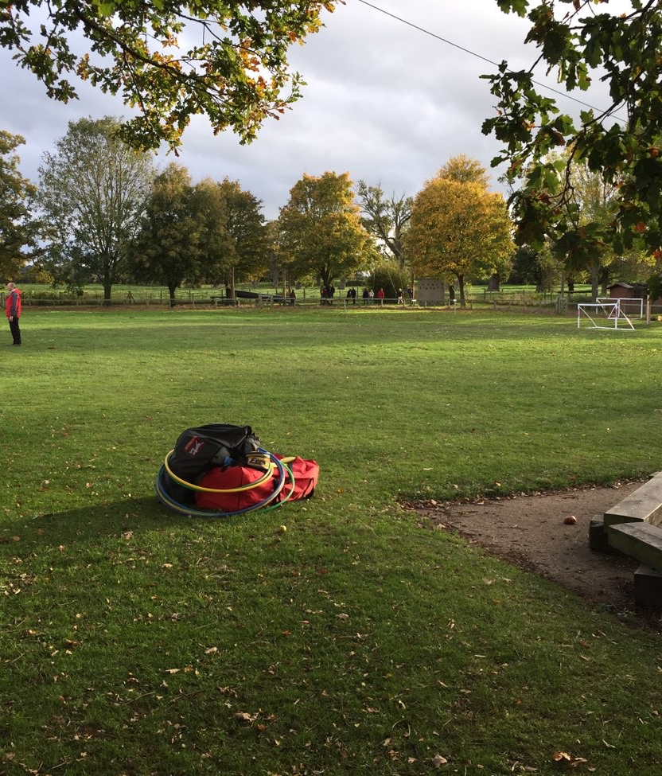
The site
Here are some photos of the site where your child will be staying.

Slide 9
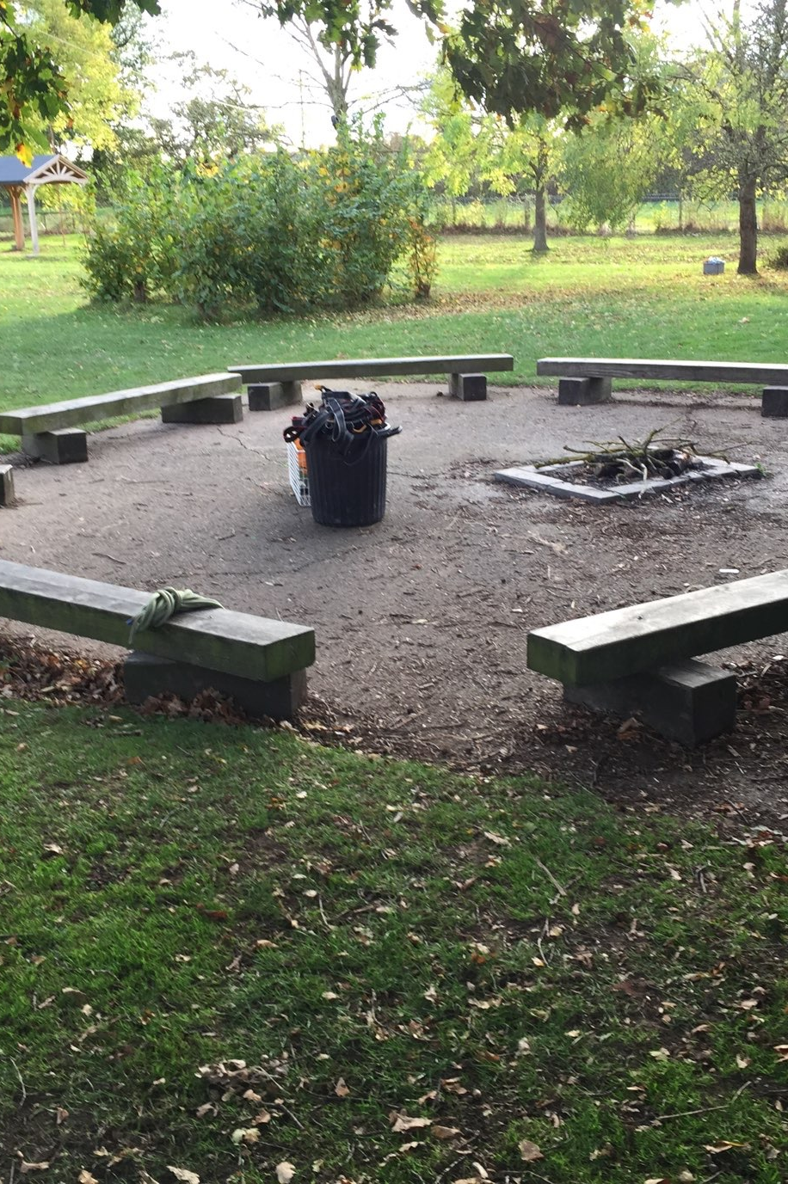
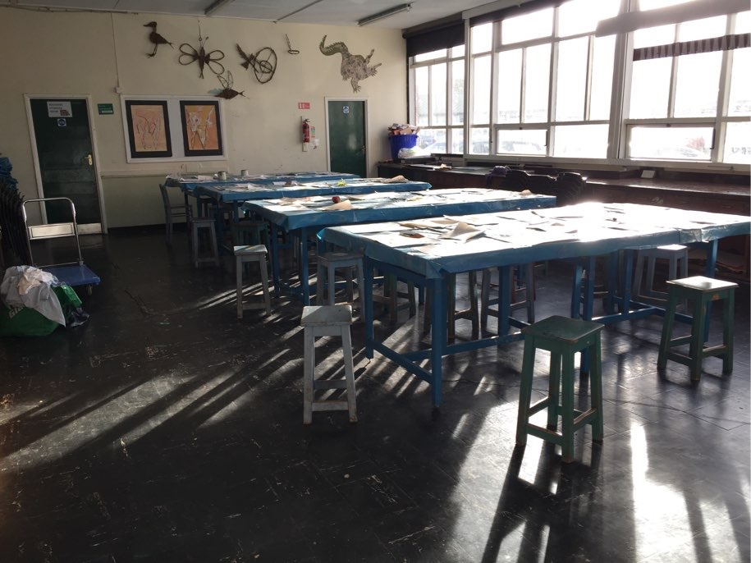
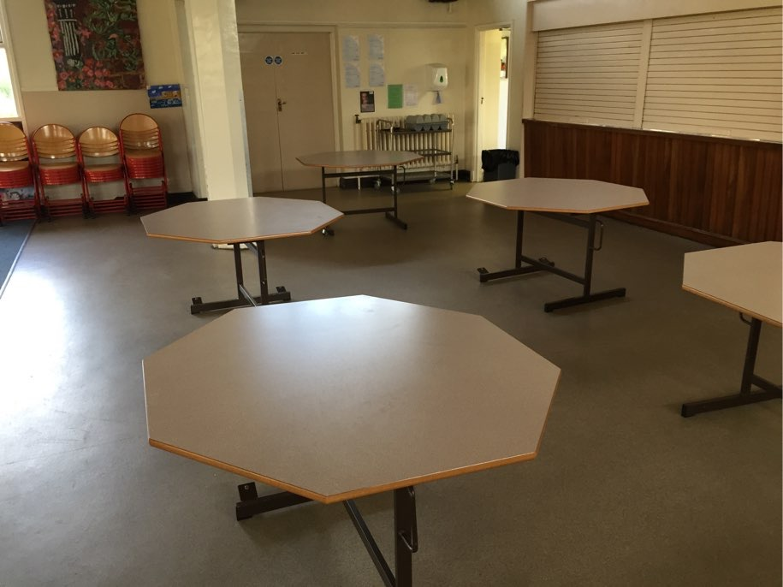

Slide 10
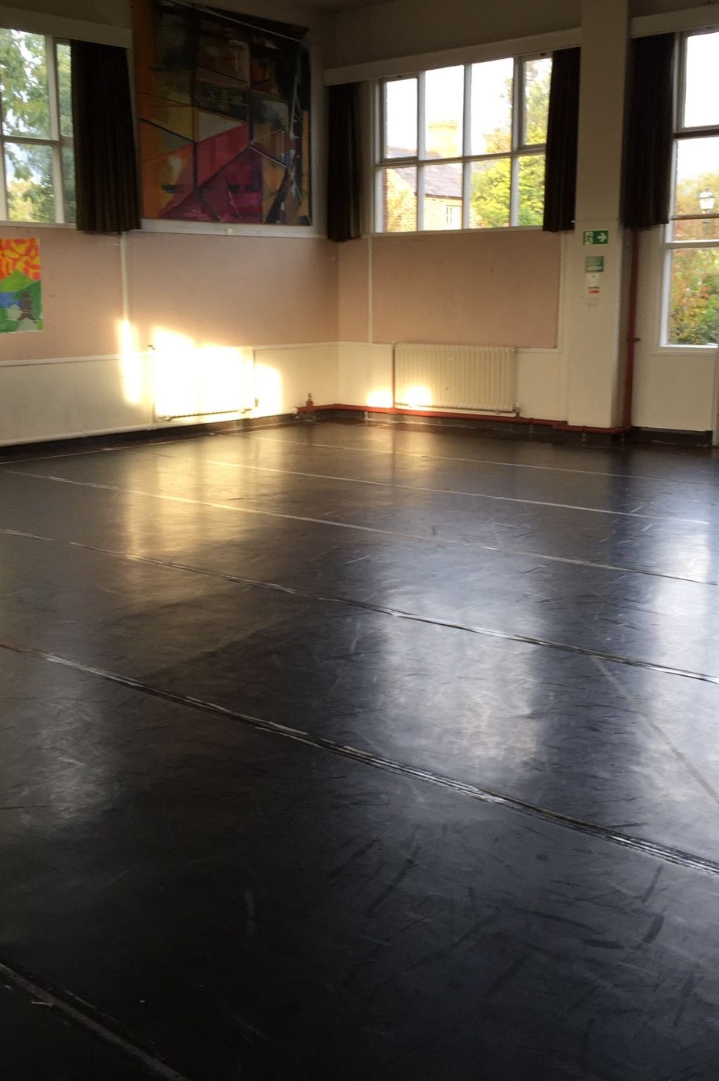
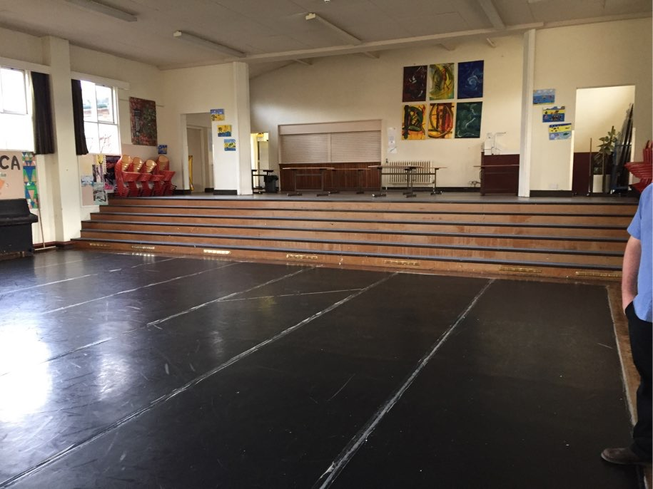
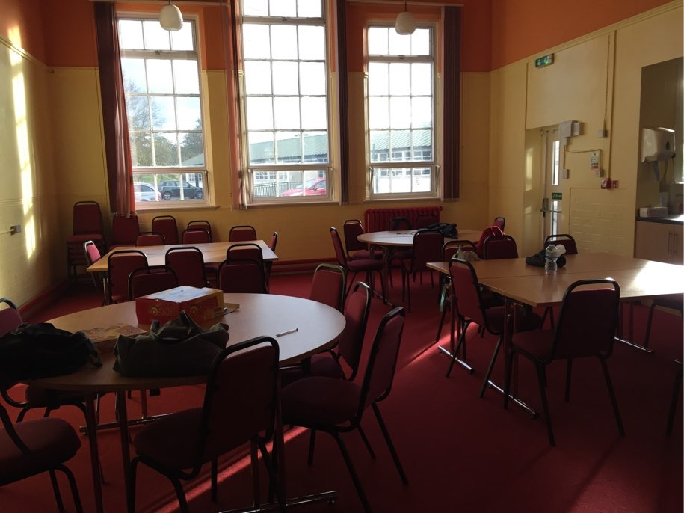

Slide 11
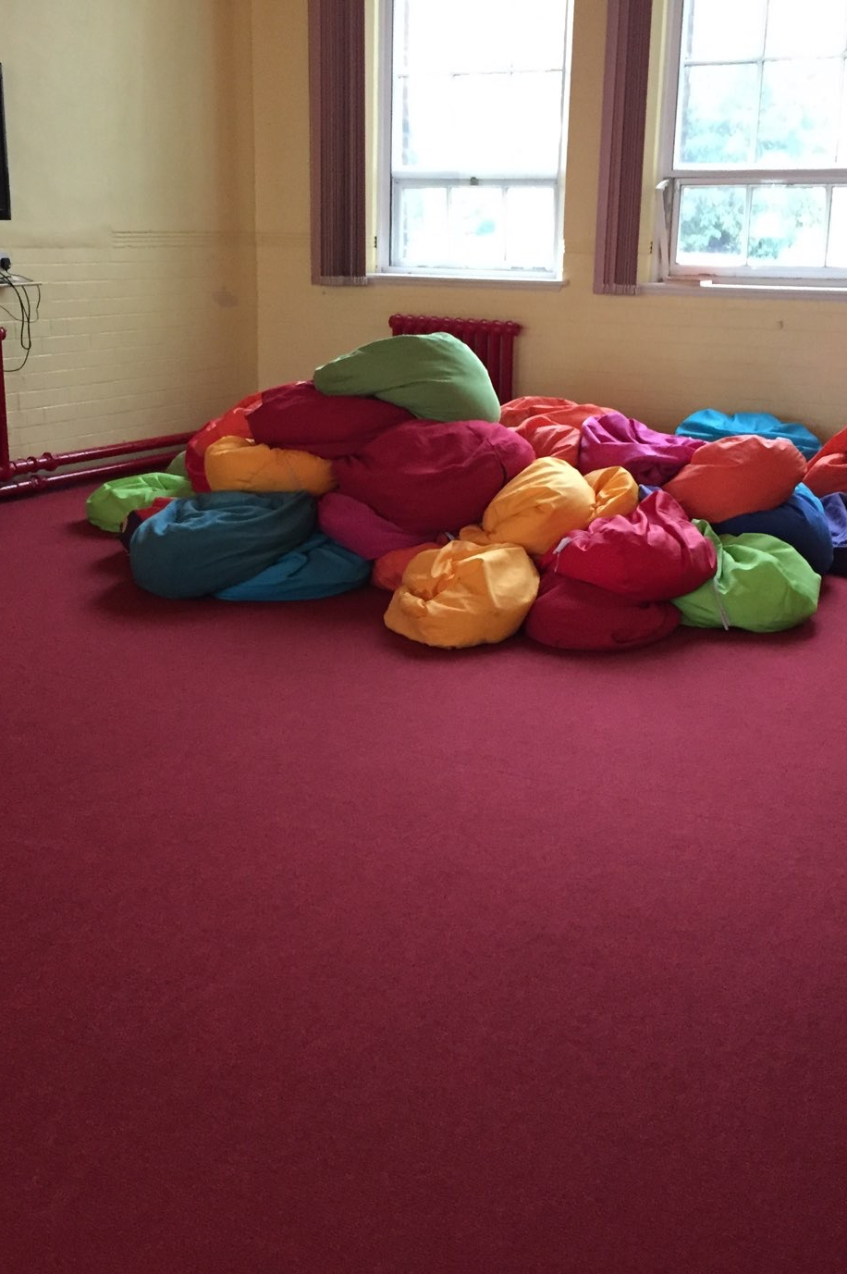
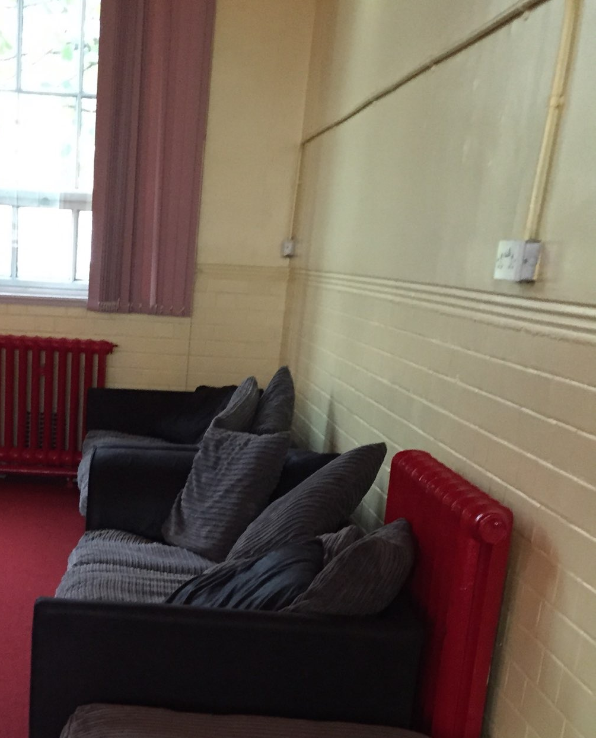

Slide 12
Departure
Your child will depart from Tattenhall Residential centre on Wednesday 12th November and aim to be back at school before 3pm.

Slide 13
Other information
Please return all letters and money as soon as possible.
We will be keeping everyone updated through a blog via the school website.
http://www.willowwoodprimaryschool.co.uk

Slide 14
Your child is permitted to bring a teddy and a book(Nothing too precious and no kindles or ebooks).
All clothes and belongings MUST be labelled.
No big bags of sweets. They will not need food as they will be fed.
No electronic equipment at all (phones, tablets and ebooks/kindles).

Slide 15
Breakfast - 8:00am.
Lunch - 12:30pm
Tea - 5:00pm
Finally, the centre expects your child to bring waterproofs and wellies as it will be muddy.

