Slide 1

Welcome meeting
Year 2

Slide 2

Year 2 Team
Teachers;
Mr Aspinall
Mrs Pye
Teaching Assistants;
Miss Hough
Miss Atherton
Mrs Murray

Slide 3

Daily Routine
Afternoons;
Mastery of Number
Subjects;
Science, PE, History/ Geography, Art/DT, Music, RE, SCARF, Computing
Blending Blast
DEAR
Mornings;
Phonics
Daily Dash
English
Maths
Little Wandle Read

Slide 4


Slide 5

Phonics and reading
Little Wandle Sessions will be taught for 30mins each day.
Whole class or in a small group.
If your child didn’t pass their phonic screening in Year 1 they will be re-screened in June.
Little Wandle Reading will take place at least 3 times a week.
Children will bring home their book at the end of the week once they have completed the guided reading sessions in school.
Reading for pleasure book from class library.
All books taken home are recorded.

Slide 6

We will count the number of reads taken place over the week at home and progress will be displayed and celebrated in the classroom- there may also be the occasional prize!
So please read with your child every night, even if it is 1 or 2 pages.

Slide 7

The children will get fruit and milk for morning snack.
If your child wants to bring their own snack, please ensure it is a healthy choice- no chocolate, crisps etc.
Please ensure your child has a named water bottle in school
Snacks

Slide 8


Slide 9
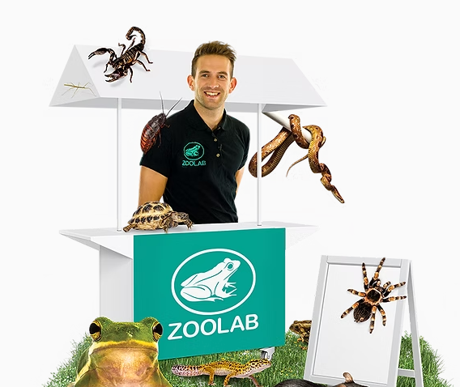
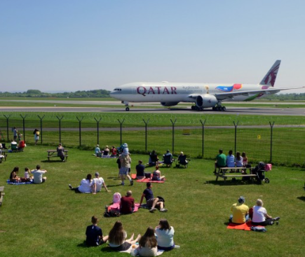
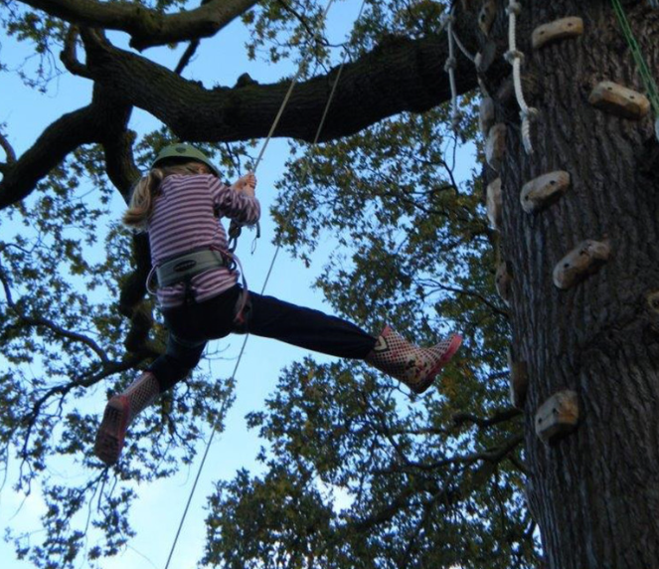
Trips and Residentials
7th November – Zoo Labs (In school)
6th March- Manchester Airport Visitor Park
14th-15th May- Tattenhall Residential

