Slide 1

Reading at home

Slide 2
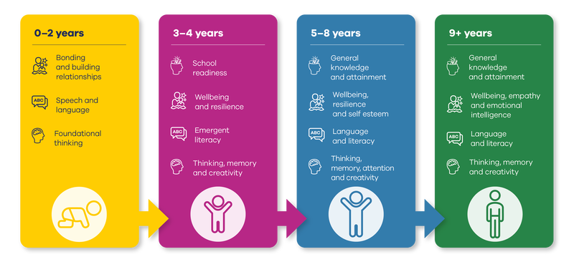
Why is reading so important?
Their vocabulary is larger and more extensive.
They perform better academically.
Their imagination can run wild.
Their creativity skills develop.
They develop empathy.
They gain a deeper understanding of their world.
Their concentration levels improve.
The parent and child bond improves.
Their cognitive development is supported.
Their social skills and interaction improve.

Slide 3
Based on research, here's how many words children would have heard by the time they were 5 years old.
never read to, 4,662 words
1-2 times per week, 63,570 words
3-5 times per week, 169,520 words
daily, 296,660 words

Slide 4
What does reading look like in school?
1:1 reading
Shared reading
Guided reading
Active reading

Slide 5
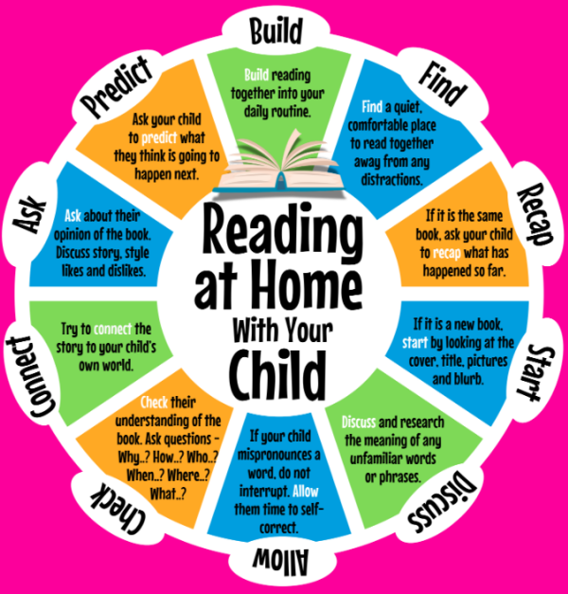
AT HOME
The journey continues

Slide 6
Books to read at home to support reading skills
Thanks to fundraising, we now have lots of new banded and free reading books for children to choose.
Each term your children will have banded books linked to the outcomes of assessments.
All children will have a reading diary, your class teacher will advise you on how to use it best.

Slide 7
Good books to read for pleasure
https://www.booktrust.org.uk/
https://www.lovereading4kids.co.uk/

Slide 8
Assessing Reading
Children are assessed formally at the end of Key Stage One and the end of Key Stage Two. They are also assessed termly within each year group to track progress and implement support where appropriate.
However, as a school we continually use assessment information to inform our planning and to allow us to choose the correct band for children to choose books from.

Slide 9

Dean Valley Reading Reward Challenge

Slide 10
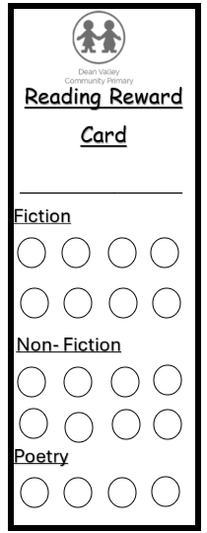
White Red Bronze Silver Gold

Slide 11
For every book your child reads at home and discusses with an adult in school, they will receive a stamp.
These cards encourage your child to read a mixture of fiction, non-fiction and poetry so that they have a good breadth of vocabulary and variation of text.
They can earn a few stamps from audio books, comics and books they have read with an adult.

