Slide 1

Welcome to our
Gin Fundraising Event
Dean Valley & the PTA

Slide 2
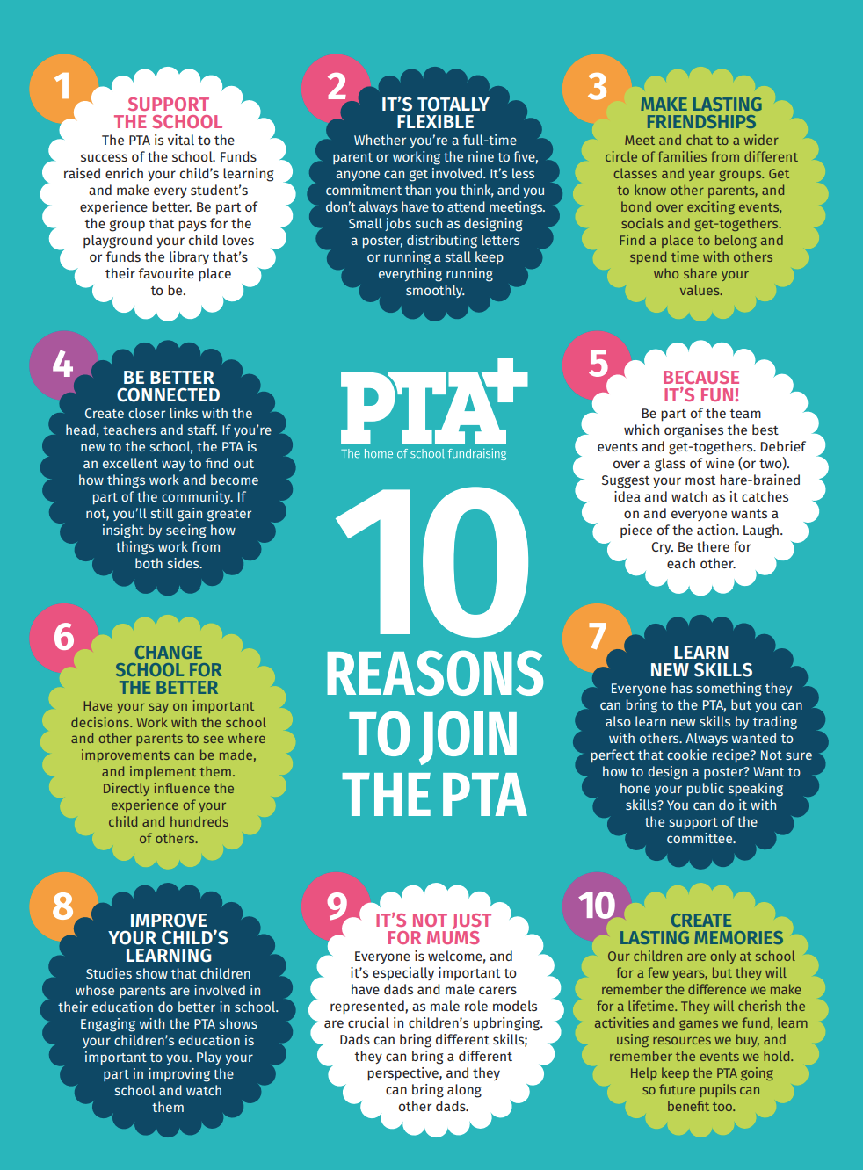
What is the role of the PTA
The PTA are an important part of the school community. They give parents and staff the chance to work together for the good of the school ensuring children get everything they need to grow, learn and experience the wisest possible range of opportunities whilst at school.
School budgets no longer allow us to provide those little extras but through fundraising and holding events like tonight we can make sure that the children attending Dean Valley don’t miss out.

Slide 3
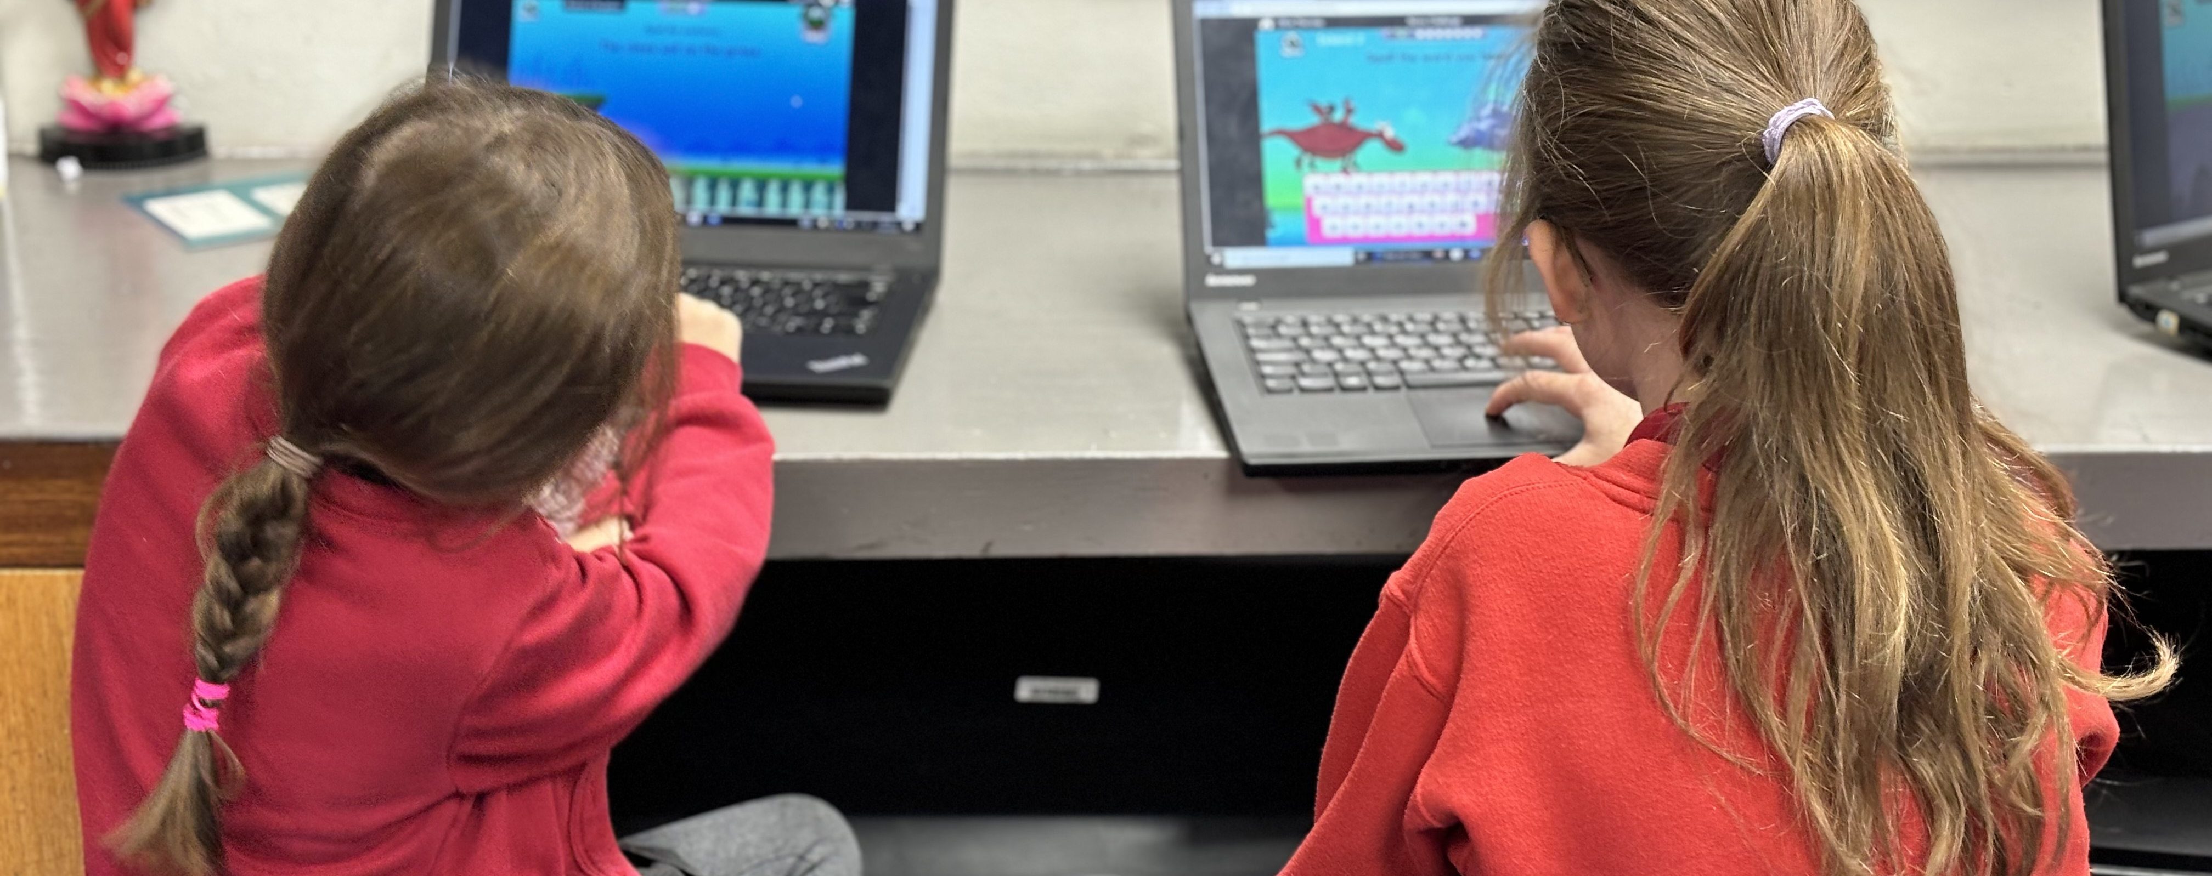
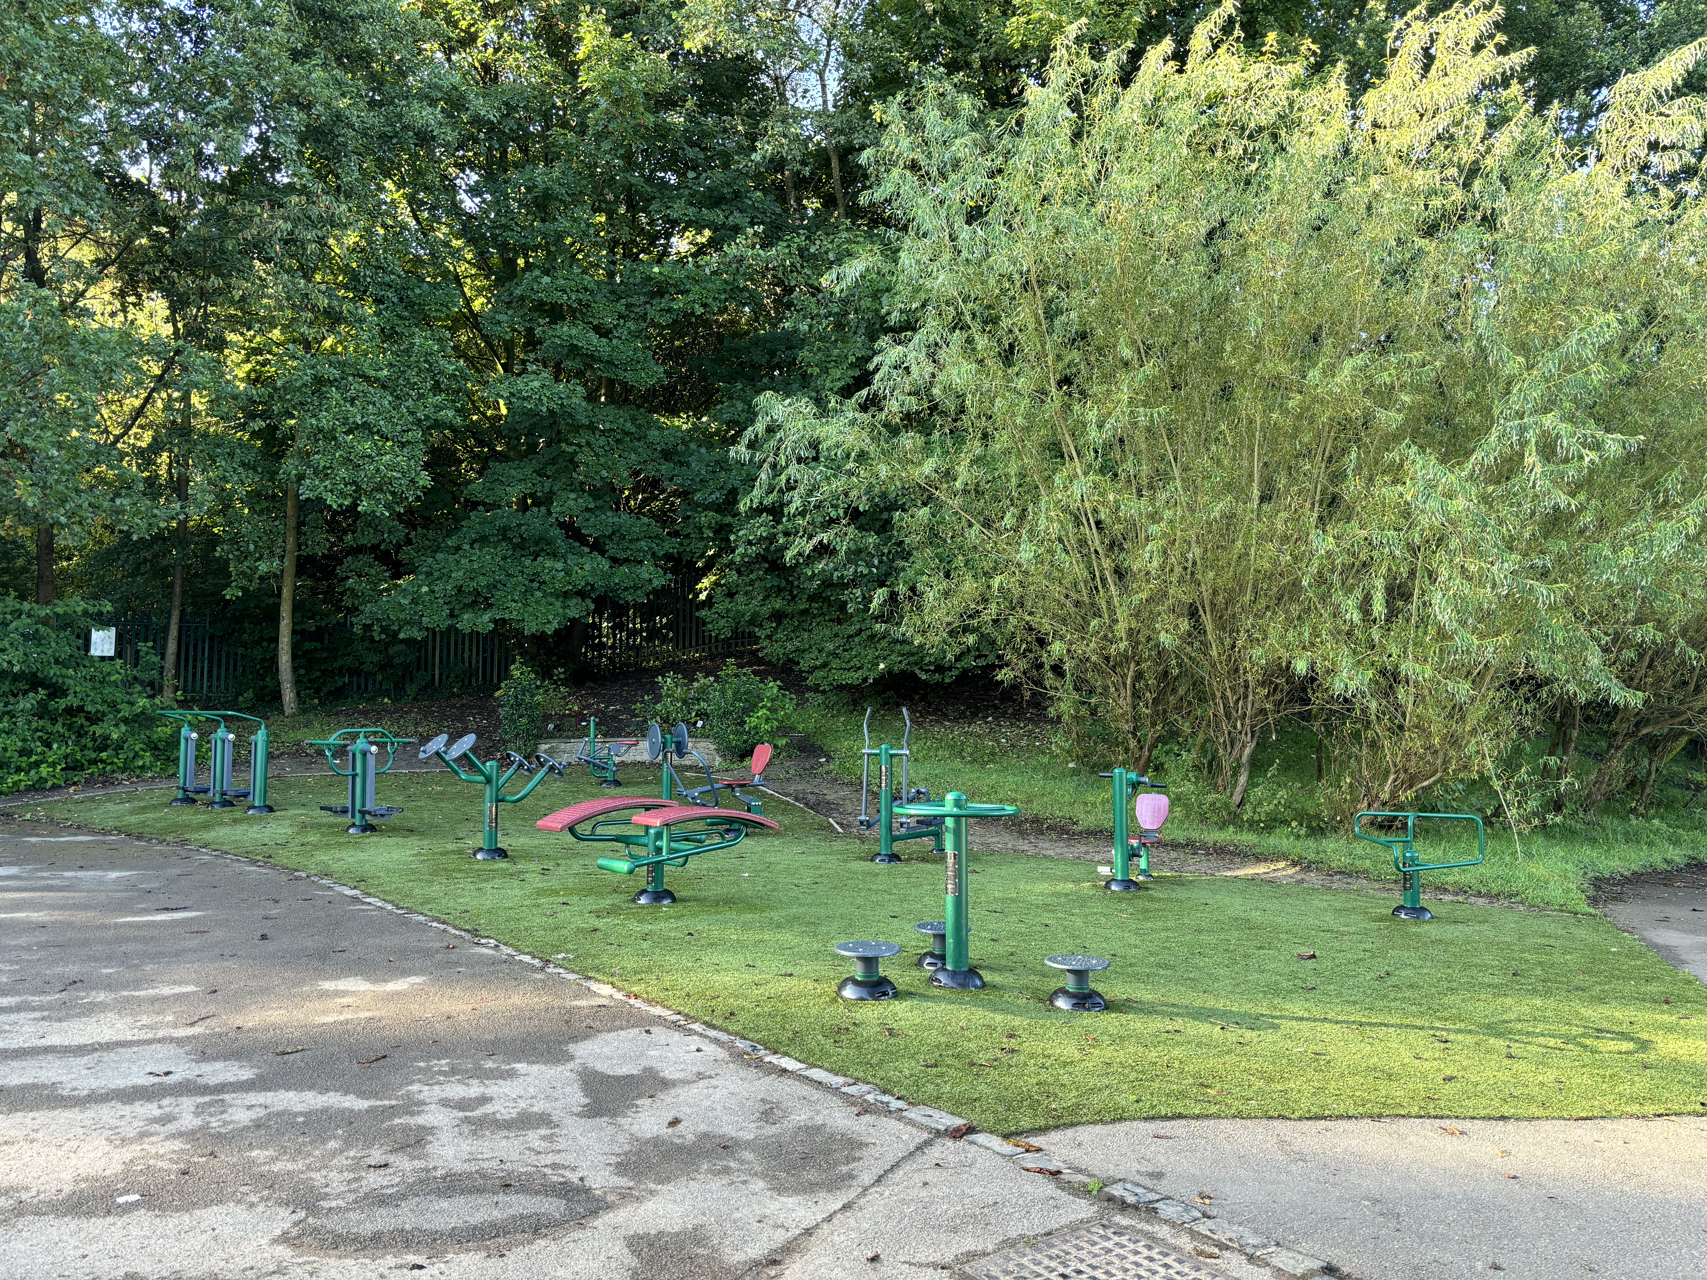
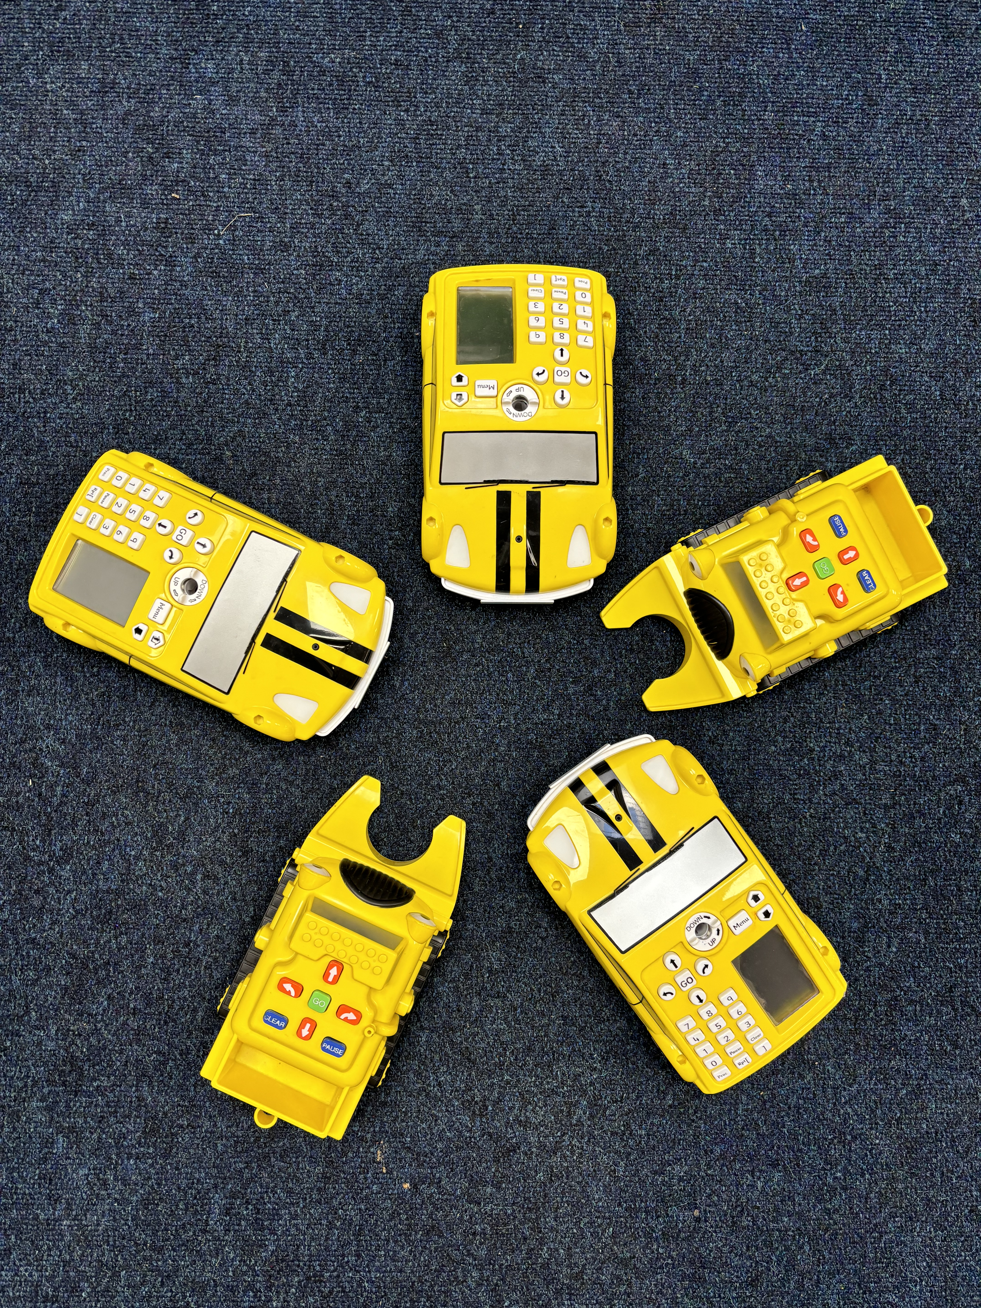
PTA
I have been involved with the PTA for many years. It has been a lovely positive experience where I have made lots of new lifelong friends, contributed in a small way to raising money for school and to be involved in school and my children’s lives.
Kate Whiting
(Treasurer)

Slide 4
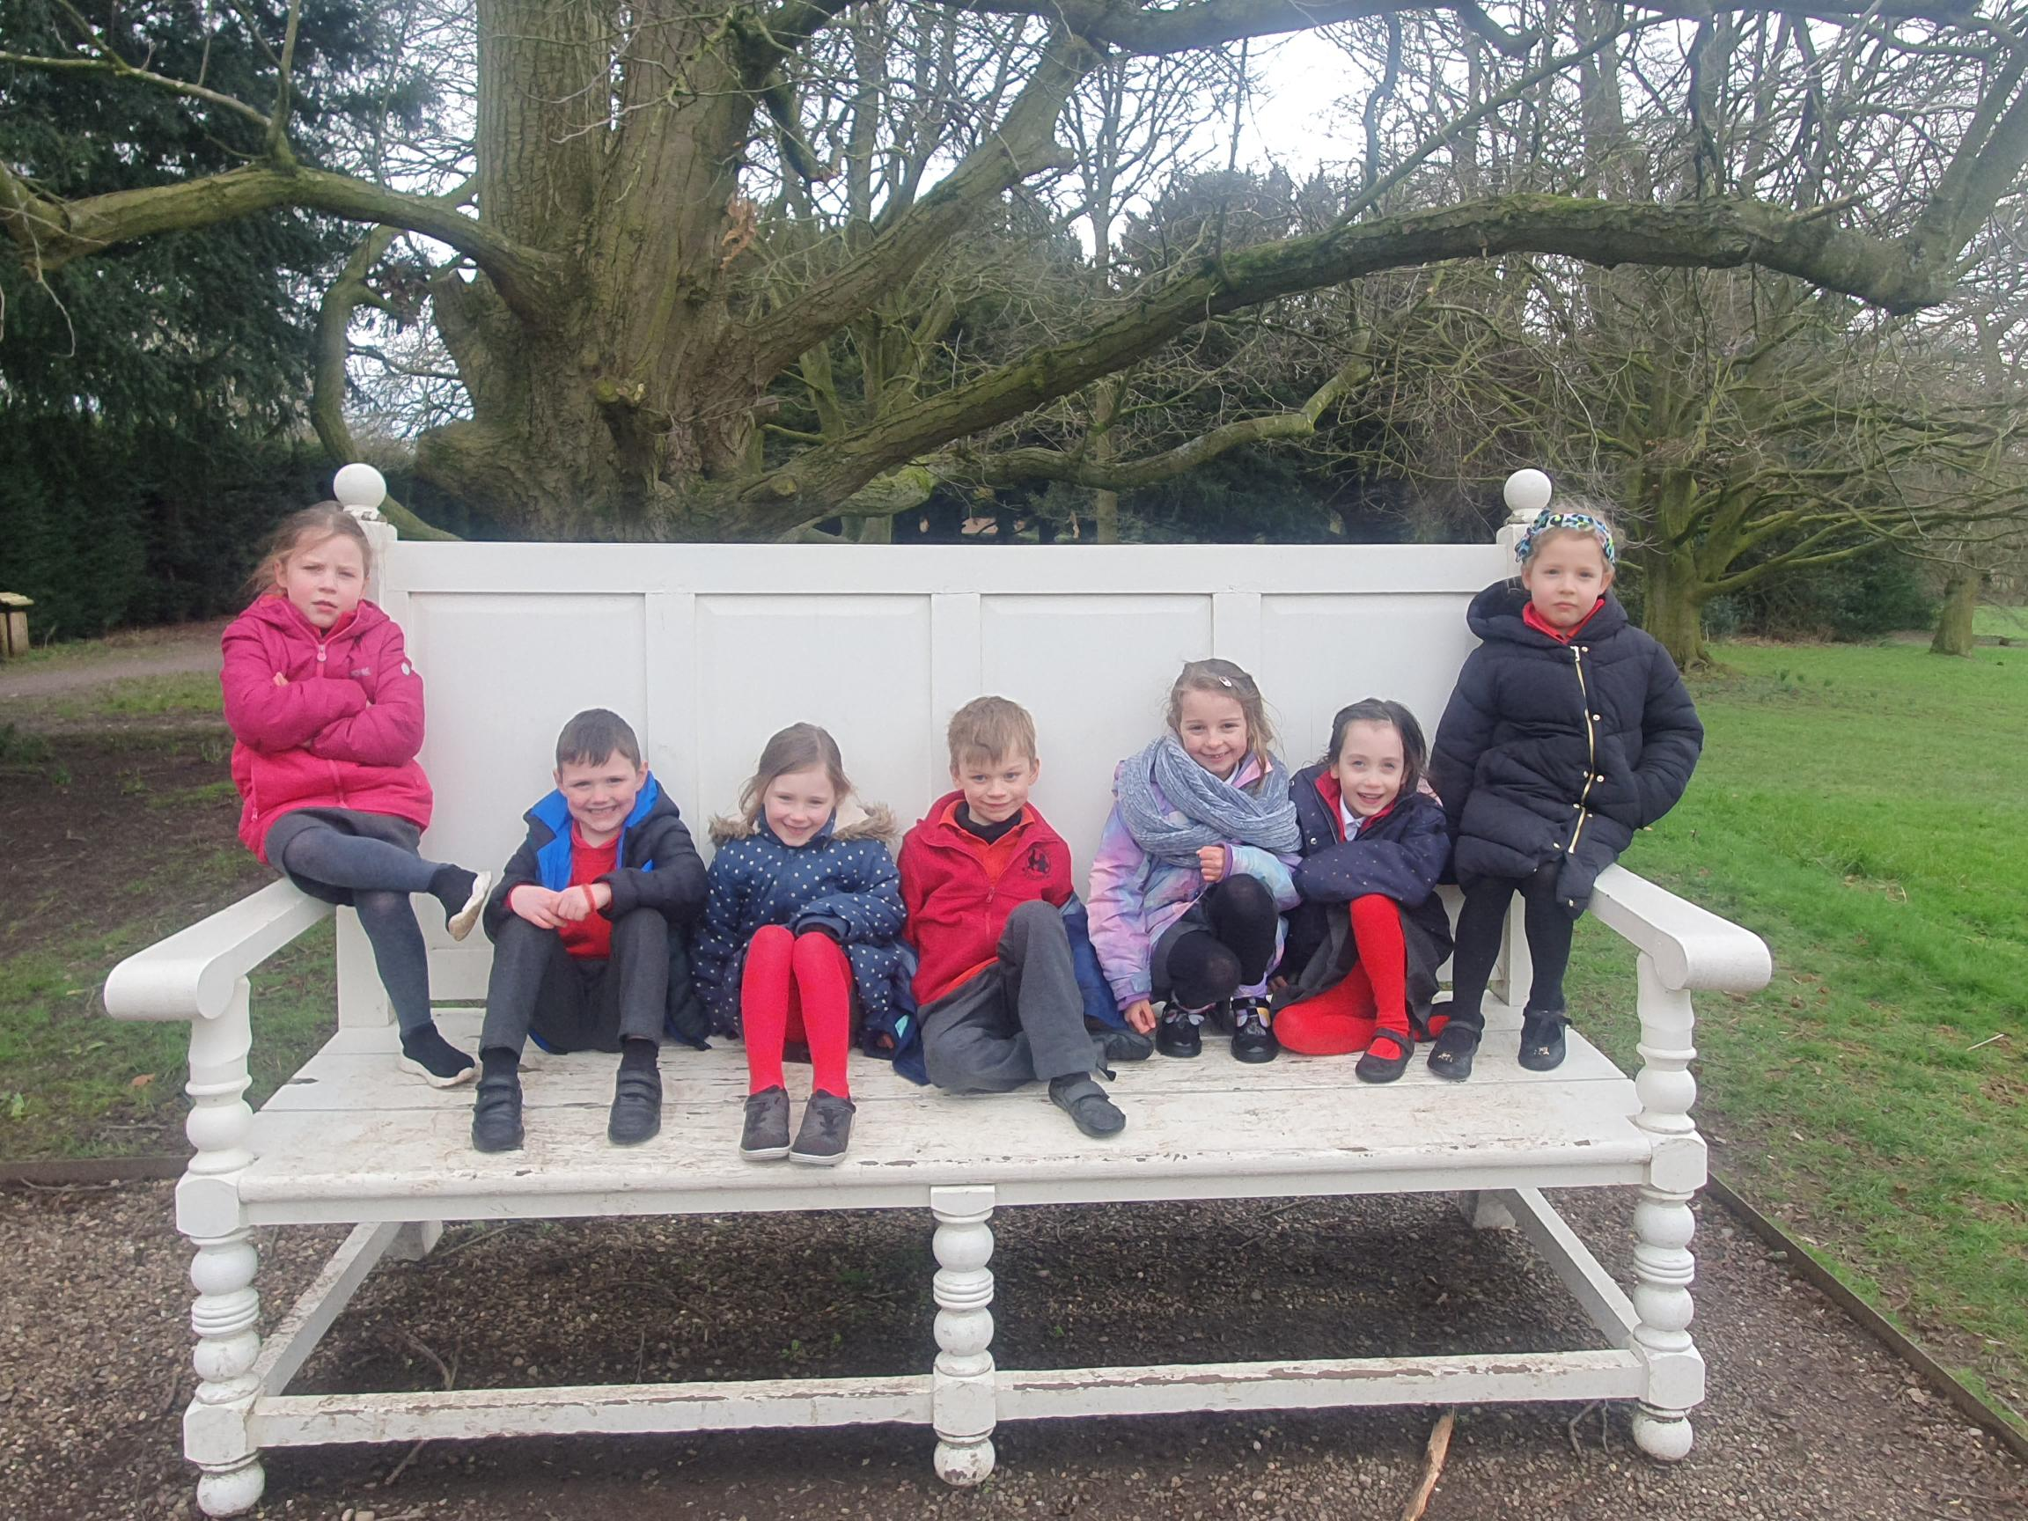
Trips
Trips are supported by the PTA every year.
£5 per child is allocated from fundraising funds to help with the cost of trips.
This amounts to £985 for this year.
In the last 5 years the PTA have contributed approximately £5000 towards the cost of trips.

Slide 5
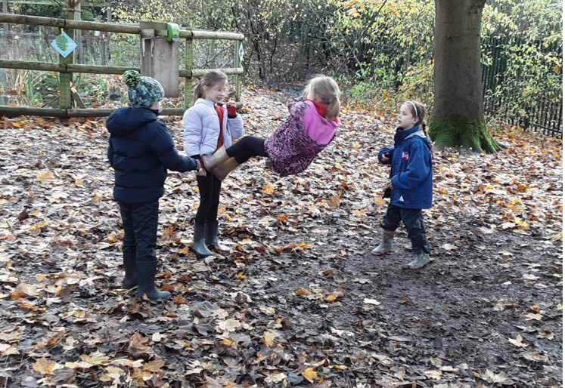
Forest School
The PTA have supported school in providing high quality Forest School provision for all children throughout the year.
They have contributed £14,294 towards these sessions so far. School funds half of the amount but even this is difficult to find. Without this support we could not continue to fund this amazing session. Studies have shown that Forest School experiences can have a positive impact on children. These experiences develop a love for the great outdoors which extends into adulthood and a lifelong appreciation for nature, a sense of environmental consciousness, and improved mental health outcomes

Slide 6
Why should you join the PTA?
Since my daughter joined Dean Valley in 2019, I've always tried to help out at PTA events in the school. My son also joined this year and I thought it was time to go along to one of the PTA meetings and try and support a bit more in any way that I can.
I always presumed the meetings would be really busy with lots of other parents volunteering time and ideas, so I was shocked to see quite a low number of people attending.
I think a lot of parents may feel similar to me in that they presume the PTA is an established group of certain parents and that they probably wouldn't be needed at the meetings. I was wrong in thinking this, everyone was really welcoming of me and a couple of other new parents. Our ideas were welcomed and listened to, and from just having a couple of new people in the room, you could see this made a difference to some of the ideas that came out of the meeting.
I didn't have to make any set commitments of my time, as I know this was one thing that prevented me from going along to meetings in the past, whether or not I had any more of my time to give. Everyone can only give the time that they can, but the more people that join and support the PTA, the less is needed of each person in it.
I'm really grateful for the opportunities the school provides for our children, I know from talking to friends outside of the school that not all schools offer the trips, equipment, events etc that our school does. It was an eye opener to me as to how much the school really relies upon the support and funding of the PTA and that without this, these events and trips and facilities just won't happen.
If anyone is thinking about joining the PTA or even just helping out at the events such as discos, Christmas and summer fairs etc, then I'd really urge you to. Your ideas and support could make a real difference to the funds that can be raised to support the school and support your kids.
Annabel Hadfield

Slide 7
Recent fundraising
The outdoor gym has been a huge hit with children of all ages.
This has cost £15,000
PTA donation so far: £10,000
Tesco blue tokens: £1000
£4000 to go…. The funds from the Gin Night will be the next payment – Thank you from all at DV!

Slide 8
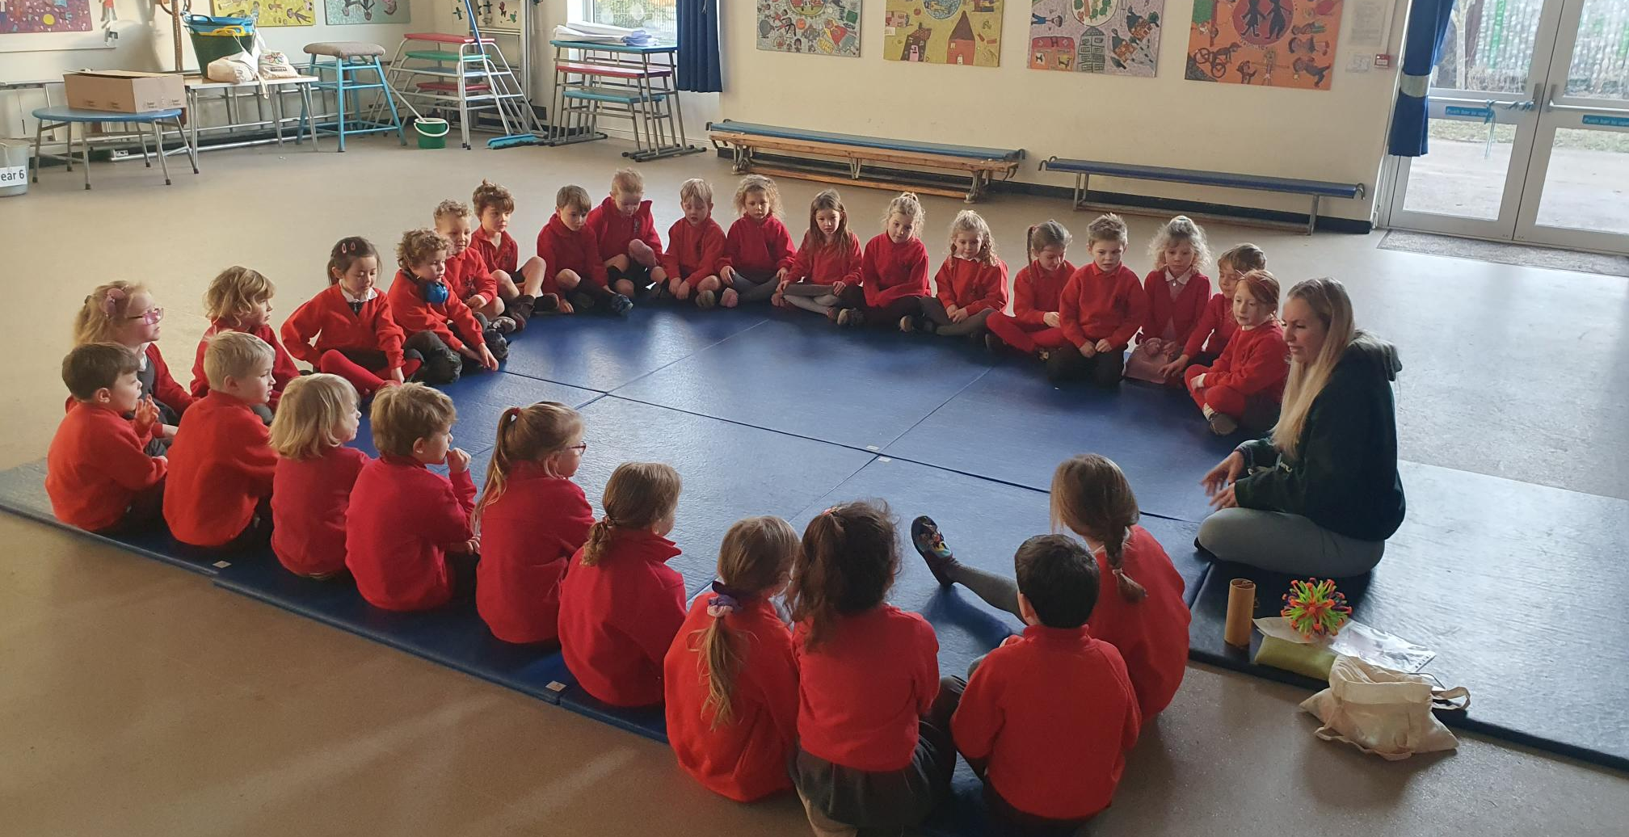
My Dean Valley journey started when I moved my son to the school in year 3.
I knew a couple parents at the school but not well, joining the PTA helped me to get to know and become part of the Dean Valley community whilst feeling I was contributing and giving back to the amazing provision our children are offered.
I was very grateful to be able to access such a brilliant school and the time I have given to help on events has not been nearly as consuming as I thought.
Overall it has been great to see the enrichment and support the PTA is able to offer to our own kids education and experiences at Dean Valley.
Sadie Walker

Slide 9
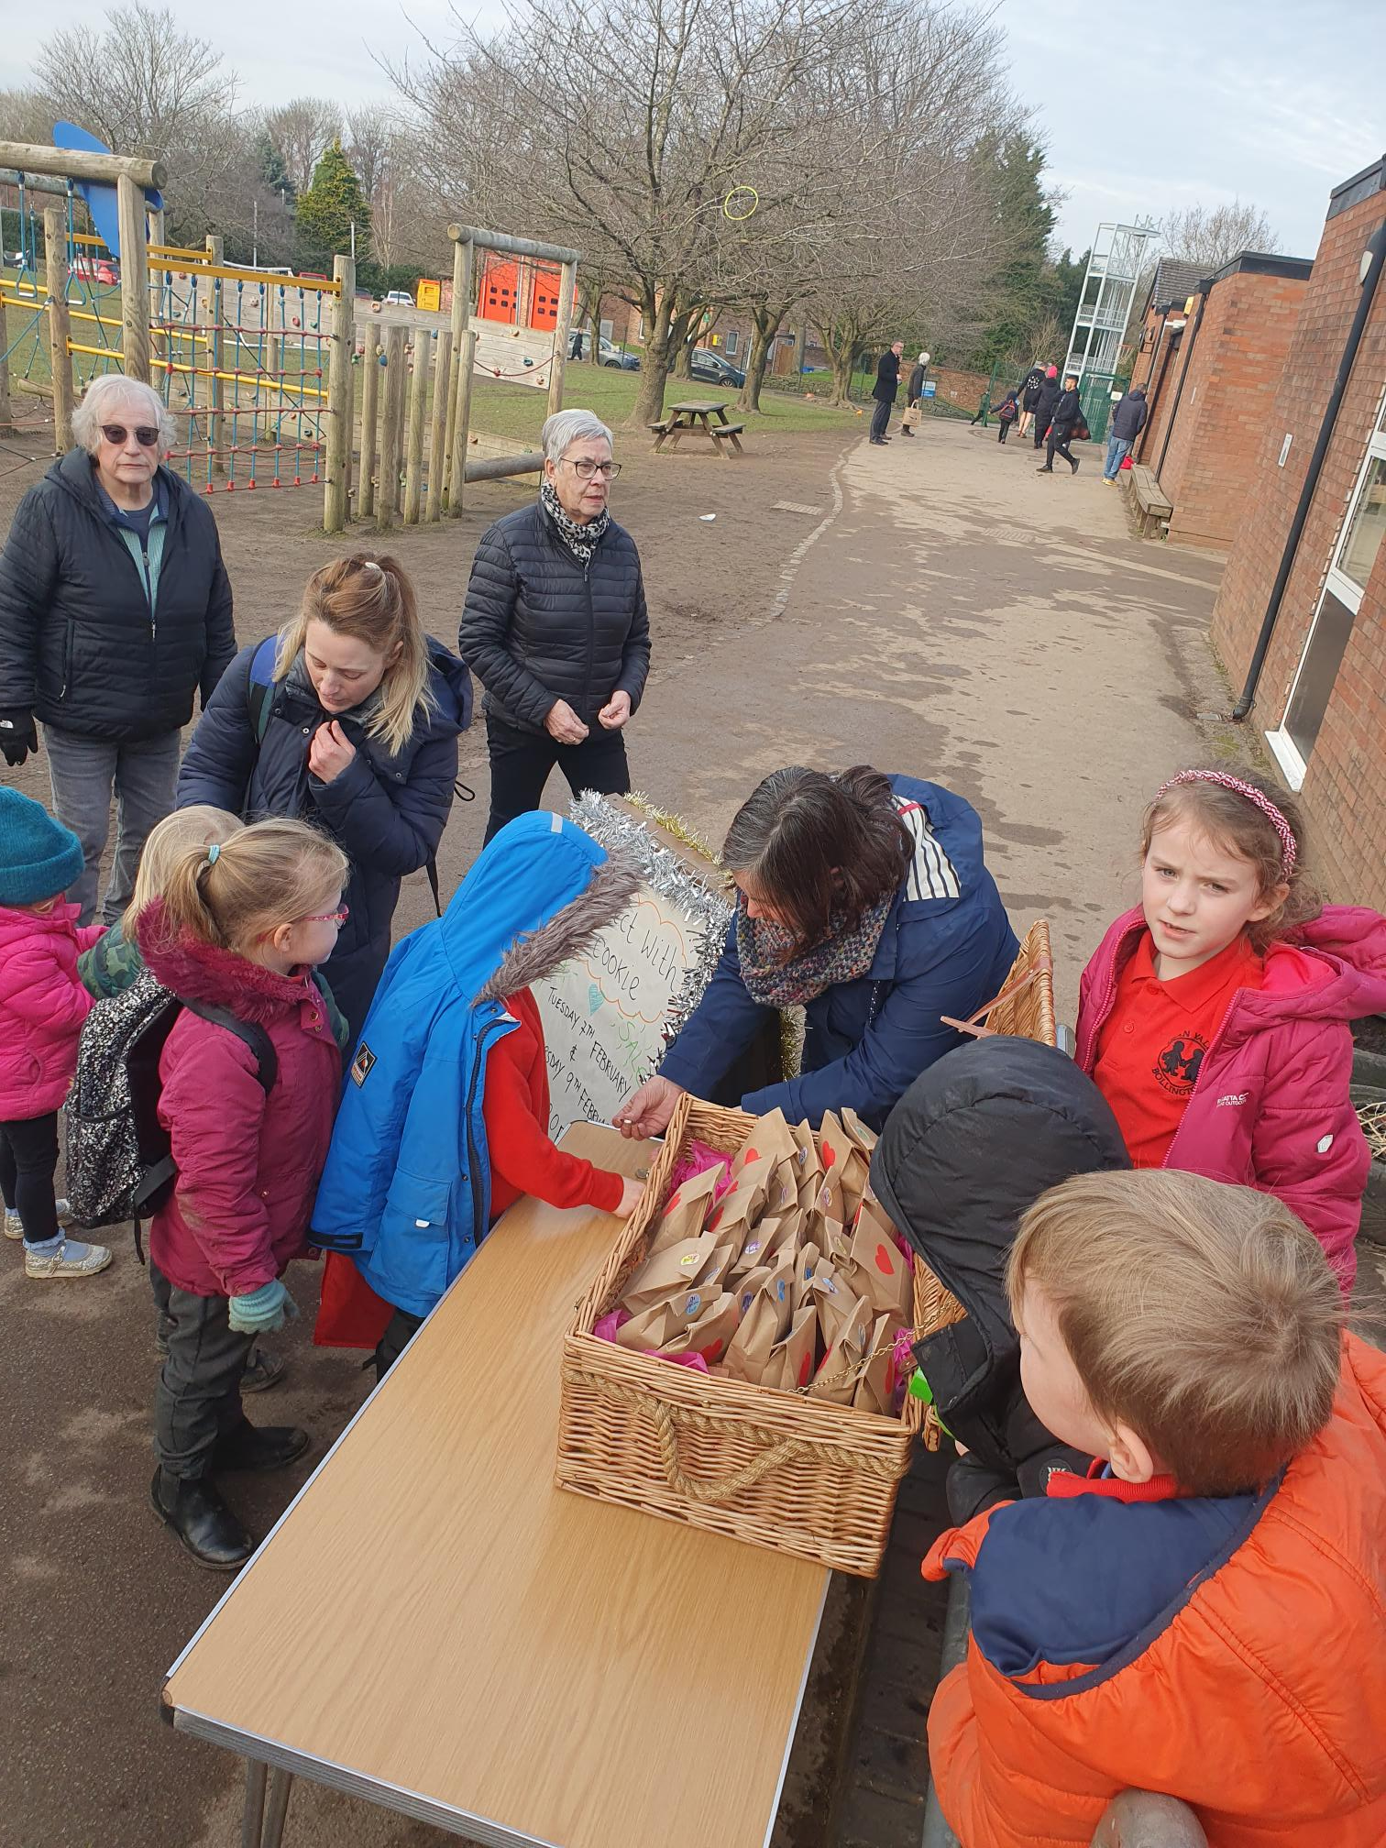
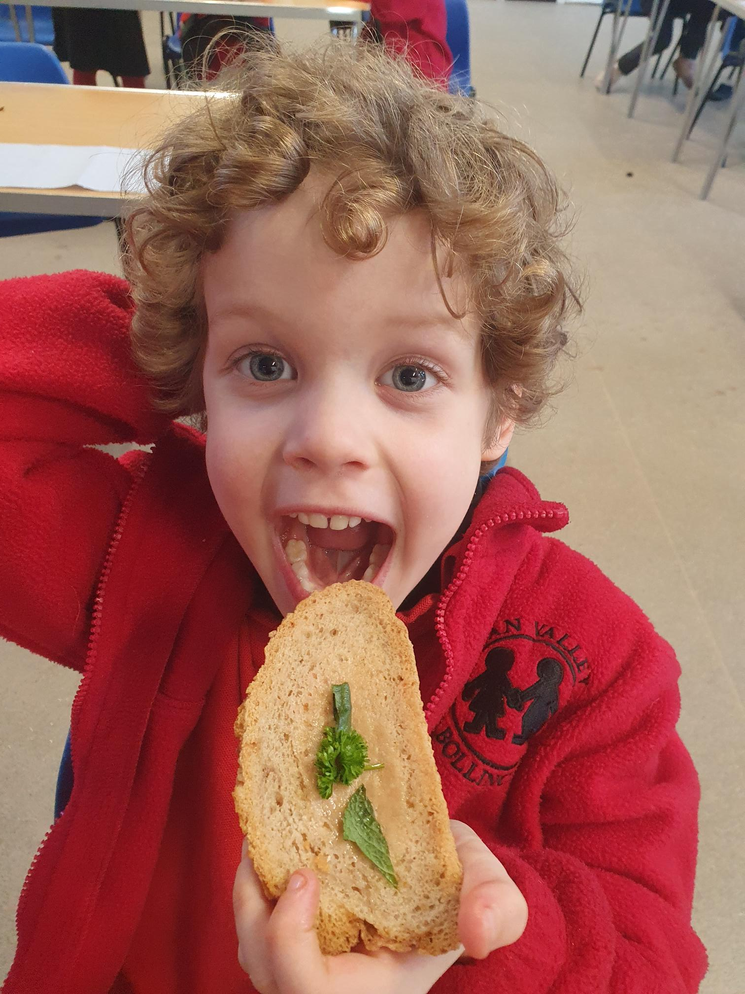
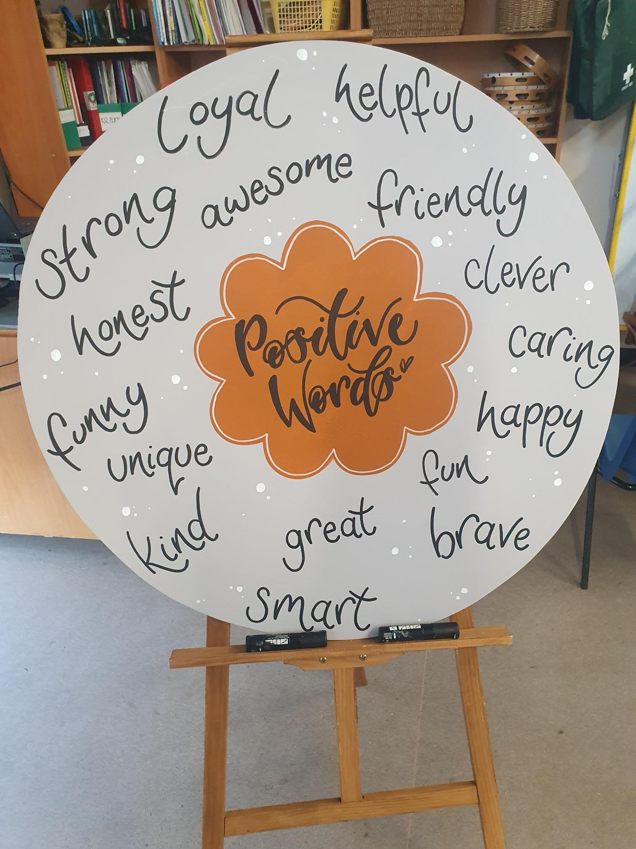
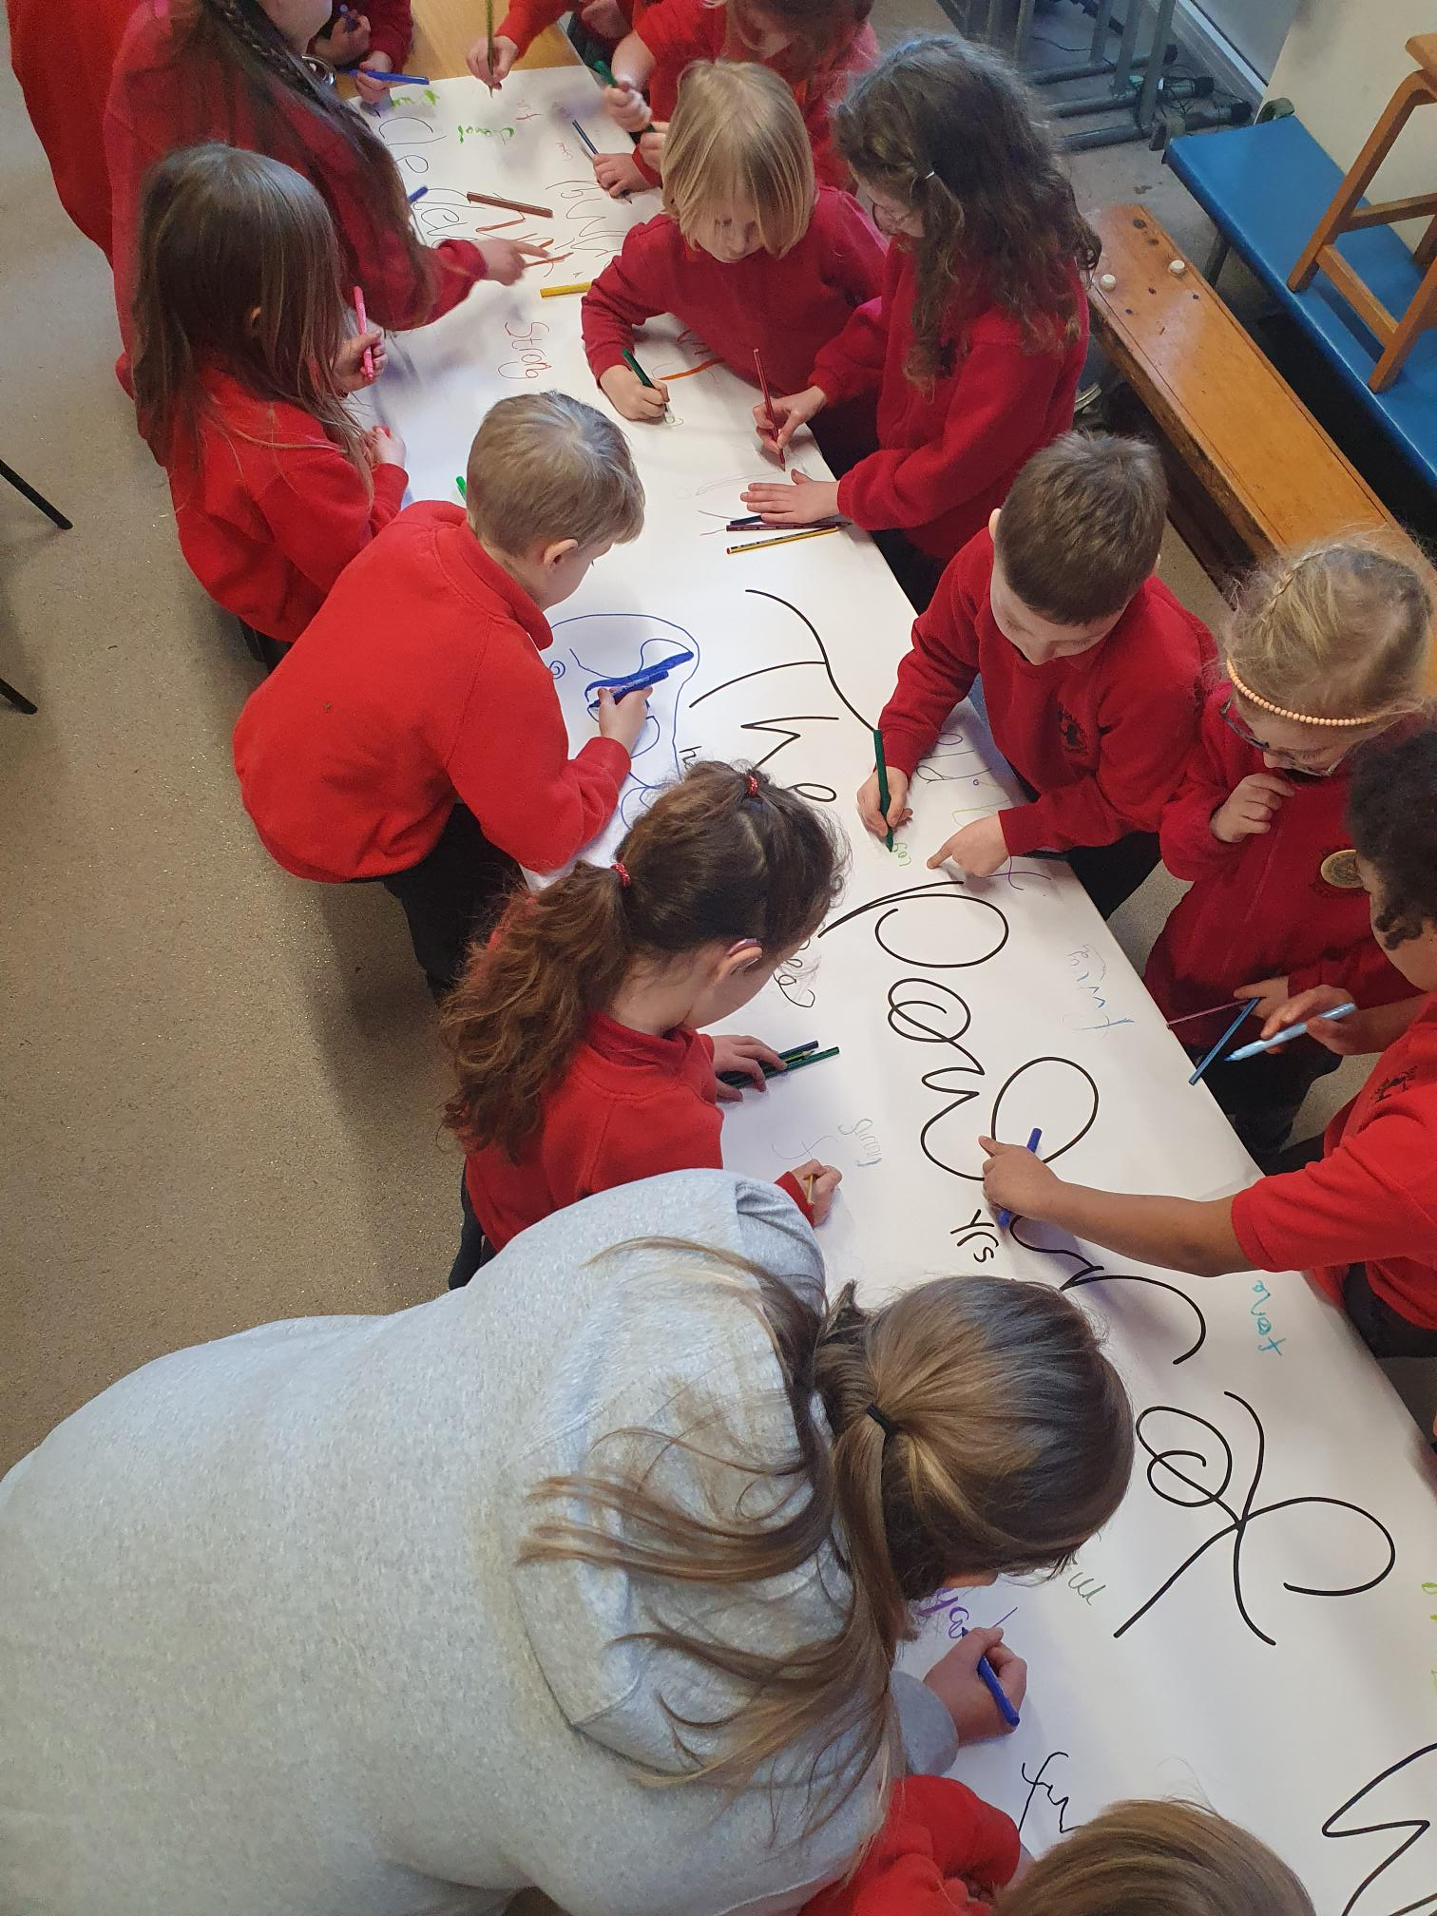
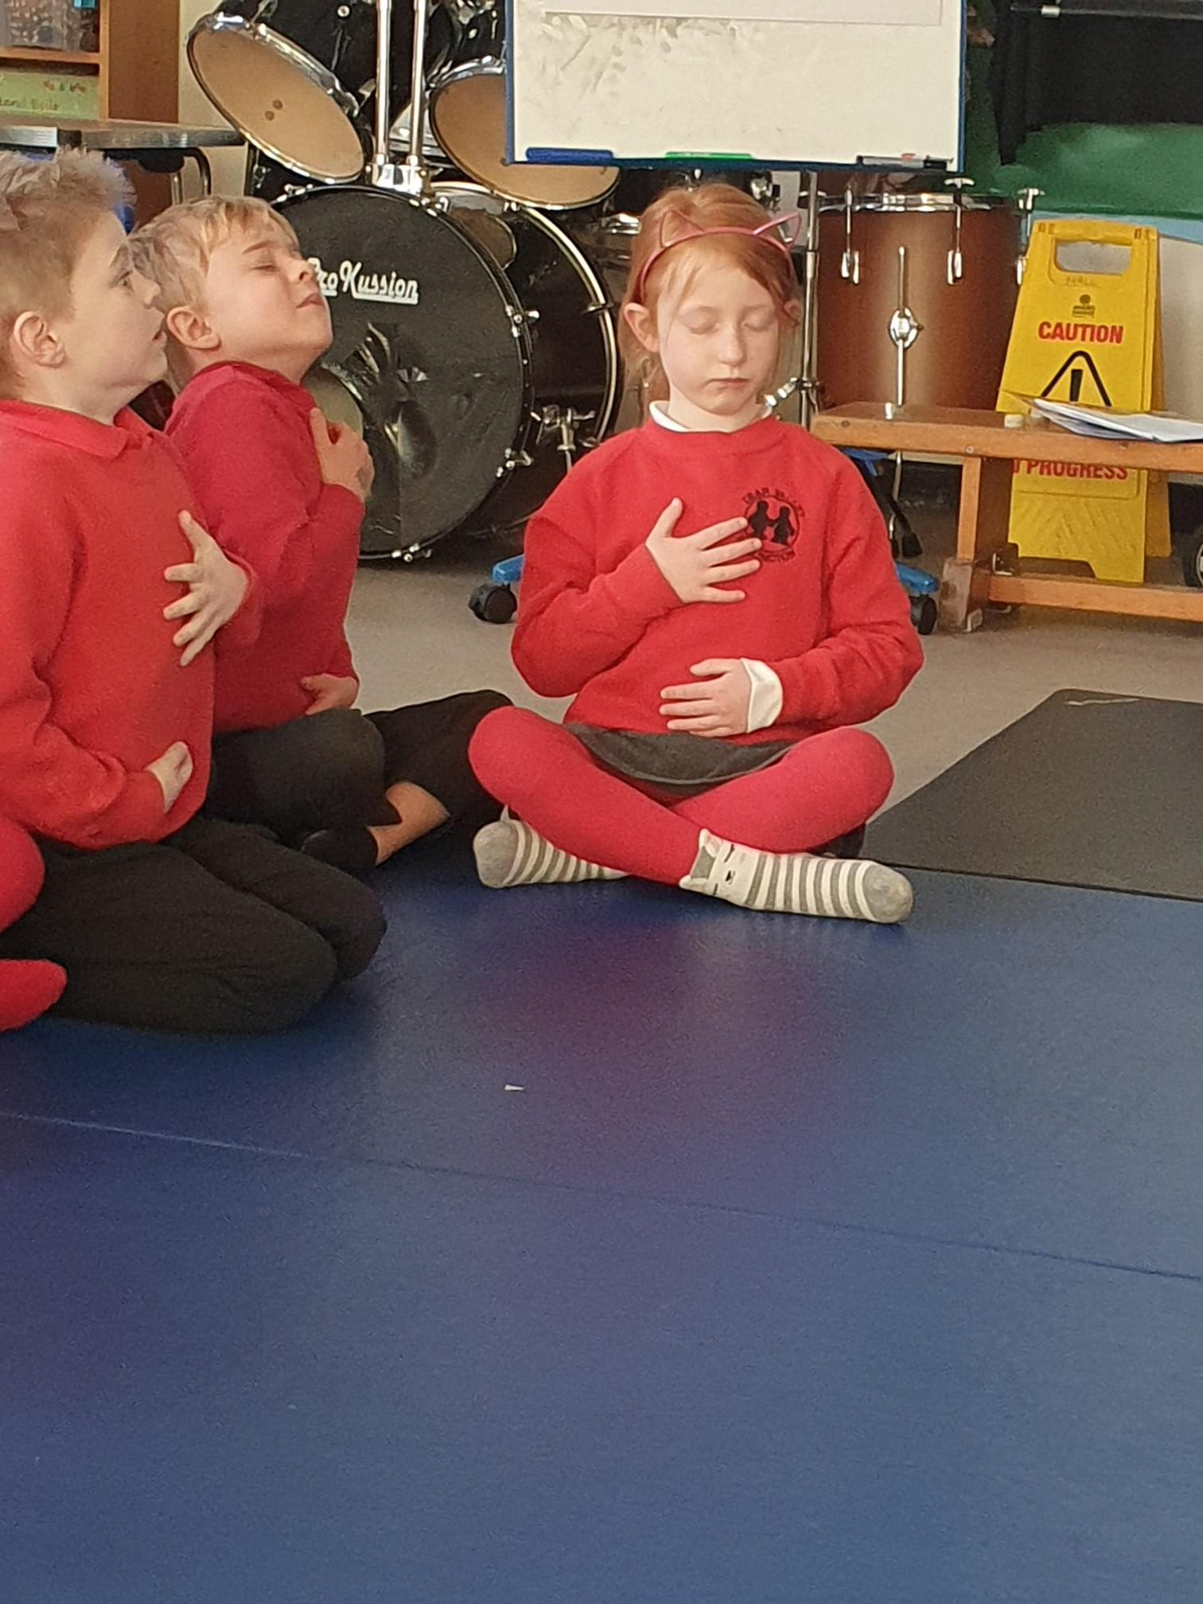
How we have supported the school…
Outdoor Gym
Updating Computing equipment
Providing money to improve the library
Presents for each class at Christmas
Super learning weeks – Science, Art/DT, Wellbeing Week
School piano
Sports kit
School BBQ
Playground markings
Pond grant

Slide 10
The Dean Valley PTA ….
Scott Gair
PTA Chair
kate Whiting
Treasurer
Vicky McPherson
Head Teacher
Alex Fisher
staff

Slide 11
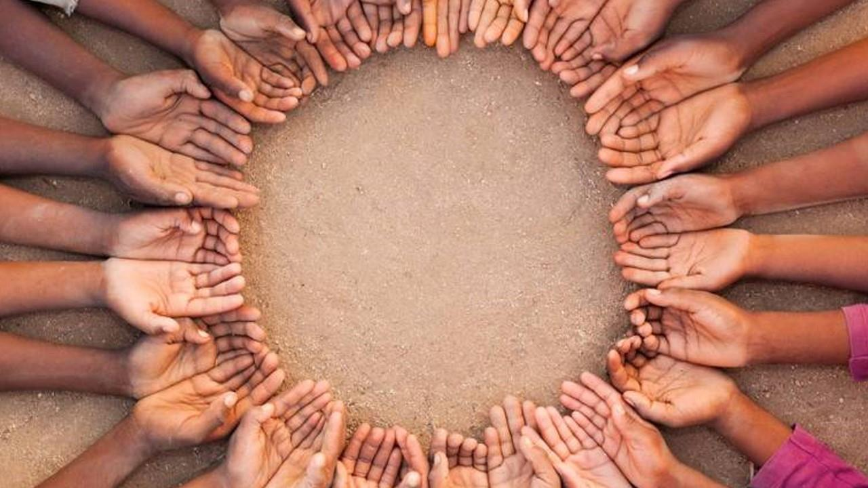
The way to get started is to quit talking and begin doing.
Walt Disney

Slide 12
The Gin Raffle
Raffle prizes kindly donated by:
£50 Tyrz voucher
£50 Sterioscopic Artwork voucher
Art by Pauline McCluskey
Cushion by Gill Leicester
Hampers – Mrs Mackenzie
£10 voucher – Belfields
Boiler Check – Carl Enser
Treats – Choc & Biscuits – Eryn & Scott
Heroes - Chadwicks
Strawberry Tequila – Amanda Murphy
Whisky – Mark Gardiner
Prosecco – Mrs Russell
Gordons Gin – Miss Warburton
Drum Lesson – Jamie Muncaster
Bramble Gin – Mrs Fisher
Wine - Barrows
Hamper–Bollington Cross Stores
Prosecco - Annabel Hadfield & Lyndsay Lamb
Chiropody Treatment – Amy Platts
74 Deli - Voucher & Prosecco
Prosecco – Lisa Brookes
Cinemac - £20 voucher
Cutlers – Paper plates
Wine glass – Joh Cox
Glasses – Mrs Brotherston, The Cock and Pheasant, The Spinners and Bargain Booze
£50 – Mr Warburton
£50 – Solutions PT

Slide 13
Gin Donations
Gin kindly donated by:
Tarquins gin – Carl Enser
Bathtub gin – AT Sports
Hendricks gin – Jodie Manning
Gordons gin – Waterside Cafe
Rhubarb gin liqueur – The Spinners
Whitley Neil gin – Barrows Butchers
Sipsmith gin – The Dog and Partridge
Gordons gin – The Post Office
Whitley Neil gin – The Turners
JJ Whitley – Anonymous donor
Gordons gin – The Cock and Pheasant
Hendricks – Mrs Palmer
Bloom gin – Julie Mackenzie
Whitley Neil – Mrs Tennant

