Slide 1

Year 4
Meet the Teacher
27th January 2026

Slide 2
Welcome
Class Teacher – Mr Southworth
Class TAs/Support – Mrs Downie and Miss Simpson
Thank you for the exceptionally warm welcome from yourselves and your children!
Excited and looking forward to a fantastic rest of the year.

Slide 3
Our Learning this Half Term
Literacy – ‘A Street Through Time’, Non-chronological report
Maths – Multiplication and Division
Science – Classifying and grouping animals & plants
Geography – Are all settlements the same?
History – Why did the Romans invade and settle in Britain?
Art – Sculpture and 3D: Mega Materials (Soap)
Computing – Data Handling: Investigating Weather
RE – Islamic Artefacts and Muslim Faith
PE – Cricket
DT – Pneumatic Toys (Hinged cardboard boxes e.g. egg box/tea or coffee box)

Slide 4
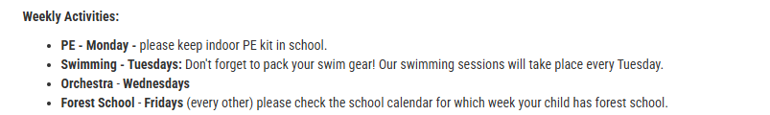
Weekly Activities
Children will come home in PE kit on a Monday and can bring it back in to school ready for the following Monday.
Please pack warmer clothes (jumpers and joggers) for PE during the colder weather.

Slide 5
Homework
Weekly homework set each Monday and due back by the following Monday.
1. Written Task (Literacy and Numeracy to alternate) 2. Times Table Rockstars – 7 games on Garage and 2 games on Soundcheck. 3. Numbots – 7 minutes per week. 4. Spelling Shed - 7 games per week.
Logins and technical issues

Slide 6
Year 4 Key Dates:
Parents Evening Tuesday 24th & Wednesday 25th March
Year 3/4 Class Assembly Friday 27th March at 2pm
Robinwood Residential Wednesday 29th April – Friday 1st May Information Evening – Wednesday 15th April 5:30pm
Multiplication Tables Check Monday 1st June – Friday 12th June

Slide 7
Thank you for your time! Any questions?

