Slide 1
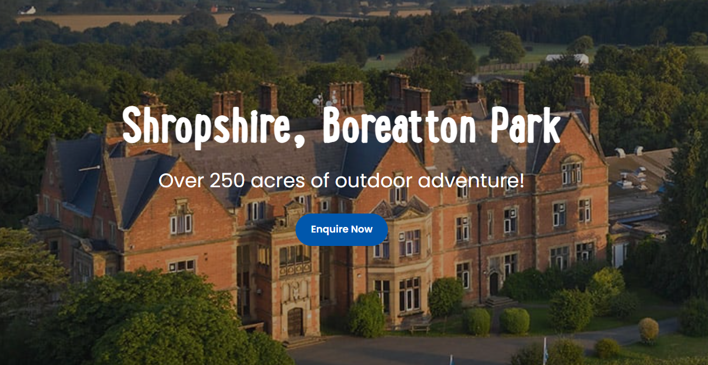
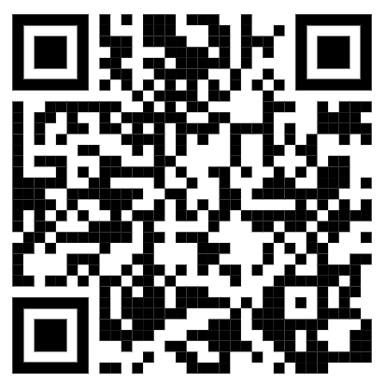

PGL Y4/5 Residential Trip
29th April – 1st May 2026

Slide 2

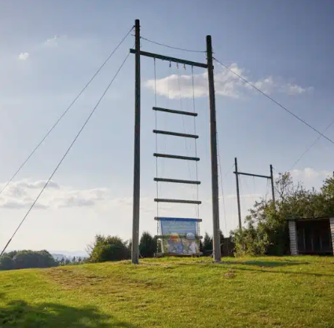
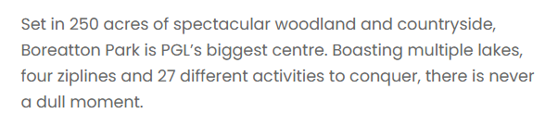
About Boreatton Park
The UK’s leading provider of children’s holidays.
Established in 1957, we are the UK’s leading children’s adventure holiday company. Our expertise, safe environment and unrivalled pastoral care mean that we are trusted and respected by schools and families nationwide.
Every year our teams work with over 350,000 lively children and teenagers. They are dedicated to helping your child discover their independence, build their confidence and make new friends during their exhilarating and action-packed adventures.

Slide 3
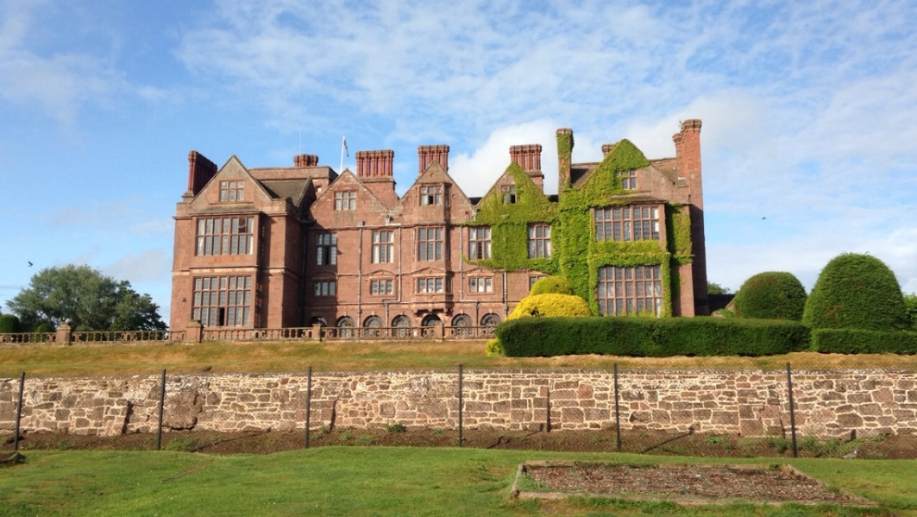
The Value of PGL
PGL’s residentials provide children with the essential National Curriculum P.E. criteria of ‘developing flexibility, strength, technique, control and balance’ as well as ‘taking part in adventurous activity challenges both individually and within a team.’
Increasing self-esteem and confidence
Achieving personal and team goals
Solving problems and taking responsibility
Trying new and exciting activities
Conquering fears
Team-work
Revealing undiscovered strengths
Respecting and valuing each other’s abilities
Experiencing living away from home

Slide 4
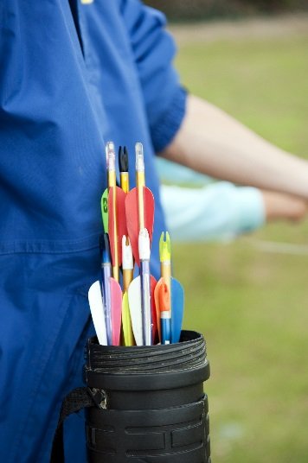
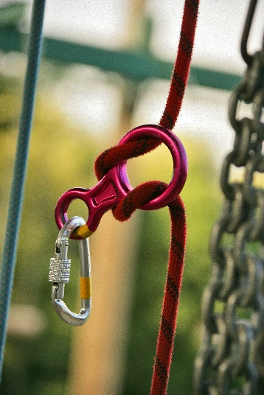
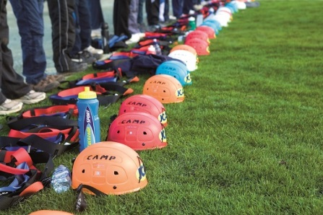
Safety Is Top Priority
All centres are Health and Safety compliant.
Safety Management Systems has been externally inspected and verified.
First-Aid Kits are taken on all activity sessions.
Centre Activity Managers hold the Emergency First Aid at Work Accreditation.
Daily safety and equipment checks are carried out
Thorough Risk Assessments have been conducted.
All staff are DBS checked.

Slide 5
Itinerary
Wednesday | Thursday | Friday
Arrive at school normal time | Get up | Get up
Coach leaves approx. 9:30am | Breakfast 8:00am | Breakfast 8:00am
Arrive at PGL 10.30am | Morning activities | First activity 9:00am
Snack time! |  | Second activity 10:45am
Tour, safety chat, eat packed lunch | Lunch | Lunch 12:15pm
Settle into rooms, unpack into cubby holes. | Afternoon activities | Leave ☹ 1.30pm
First activity afternoon |  | Arrive back at Highfield ☺ before the end of the school day
Evening Meal | Evening meal 5:30pm
Evening activity | Visit to the shop
Return to centre for supper | Evening activity
Lights out 8:30pm | Return to centre for supper
 | Lights out 8:30pm

Slide 6
School staff attending
The Year 4 and 5 Team!
Mr Bull
Miss Beardsall
Mr Howarth
Mrs Henderson
Miss Gregory

Slide 7

Wednesday Morning
Please make arrangements so that children can get to school on time.
Once children come to school, the children come into the hall first to drop their luggage off and say their goodbyes before going to the classroom for registration .
Suitcases need to be labelled with your child’s name and name of school.
Medicines must be labelled and handed to Mrs Henderson (Y5) or Miss Beardsall (Y4)
If your child gets travel-sick, please administer travel-sickness tablets with departure time in mind. They will be placed near the front of the coach, so please let your child’s teacher know.
Form Cs give teachers consent to administer medication provided if needed, but staff will call home before doing so.
Children will need a packed lunch for the first day. Please ensure the children do not pack this in their suitcase. This should be in a disposable bag that the children will take onto the coach.
If free school meals please let us know by 22nd April for a pack lunch to be made.
Any pocket money should be placed into an named envelope and handed to Mr Howarth (Year 5) or Mr Bull (Year 4) (no more than £5).

Slide 8
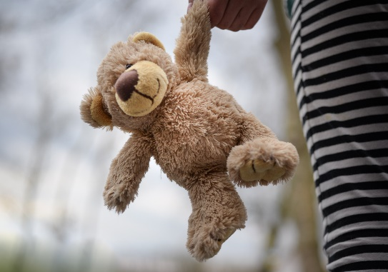
Luxuries
Reasonably sized teddies are allowed.
But consider how you would feel if they were damaged or lost…
A book, magazine or activity book to read at night-time.

Slide 9

NOT ALLOWED!
Mobile phones or cameras
Computer games or handheld consoles
Jewellery or watches (studs in ears allowed)
iPods, tablets, smart watches
Other items of value or sentimental value
Sharp or dangerous objects
Snacks or drinks aren’t necessary
(except those in the Wednesday lunch)

Slide 10
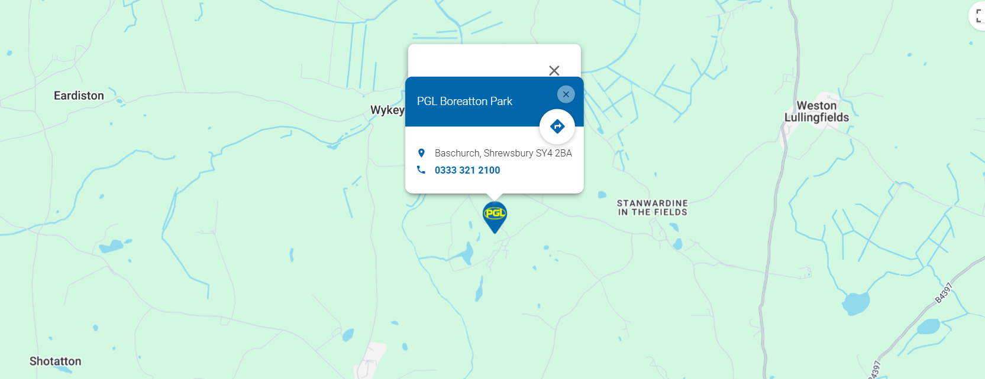
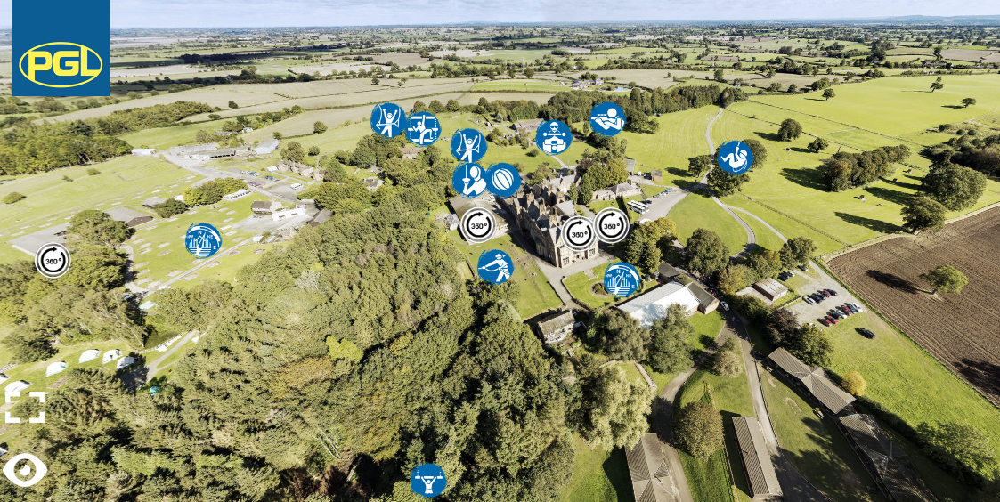
Boreatton Park
Notes:
https://www.pgl.co.uk/Files/Templates/Designs/PGLCore/res/swf/virtual-tour/boreatton-park/tour.html

Slide 11
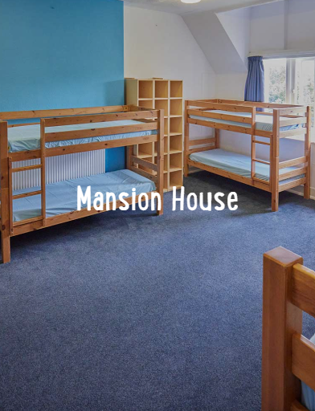
Accommodation
There are options of multi bedded dorms (between 8 and 14) for students.
Teacher rooms are situated within the same building as the children.
Centre doors are secured in the evening, but can be opened in case of emergency and security barriers guard the entrance to the site.
All bedding is provided.
Rooms have not yet been allocated, but we will ensure everyone is happy. Children will find out their room allocation once at PGL.
Year 5 and 4 girls and boys will be in separate rooms but in the same building.

Slide 12
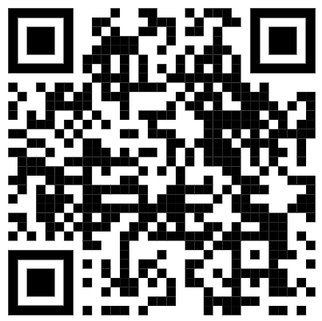
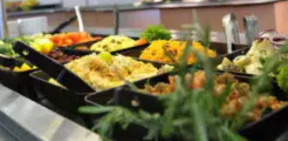
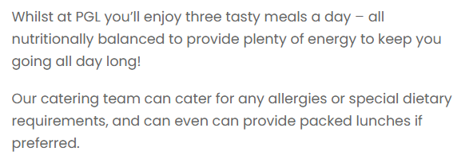
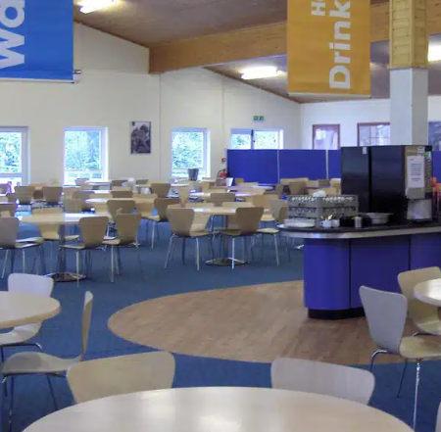
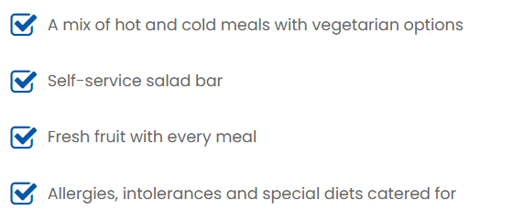
Food at Boreatton Park

Slide 13

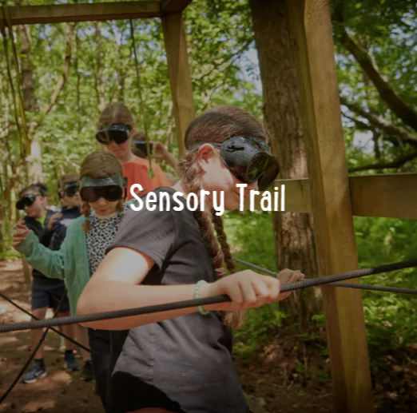
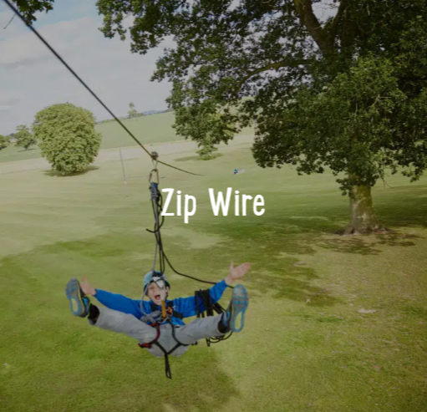
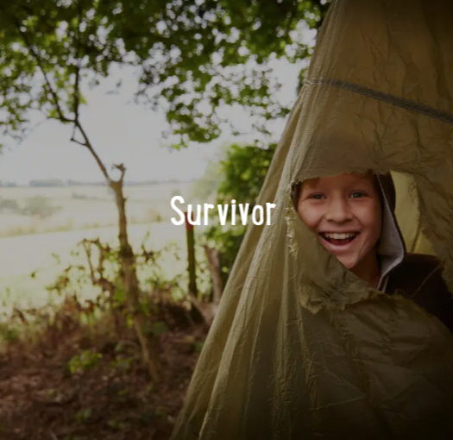
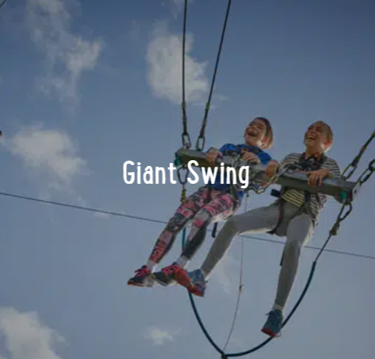
Adventure activities
Archery Tag
Fencing
Rifle Shooting
Canoeing
High and low ropes
Trapeze
Orienteering
Archery
Giant Swing
Sensory Trail
Raft Building
Problem Solving
Zipwire
Climbing
Notes:
The activities shown offer individual as well as team challenges
Activities are designed to encourage new skills and develop existing ones
Specific activities can be requested (though not guaranteed) and the programme is discussed on arrival at the centre

Slide 14
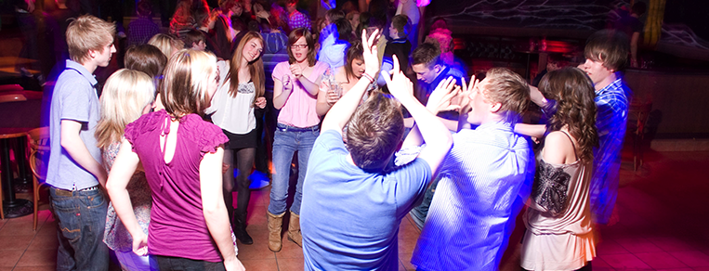
Evening entertainment
Campfire
Disco
PGL Games
PGL Quiz
Passport to the World
Relay races

Slide 15
Important Information
The complete payment is due before the trip. If there are any problems doing this, please speak to Ms Dowling or the ladies in the office.
Please complete Medical Form C to indicate if your child has any of the following - detailing any allergies, dietary requirements and medication which can be administered if necessary.
Tetanus- If your child has had their vaccinations when they were around 3 years old, they will have had it. You can put on the form pre-school.
Updates including photos will be provided each day on Class Dojo.
Medication is to be given in on the day of the trip with a complete medical form and the correct dosage of medication required for all three days if possible.

Slide 16
Q&A
Any questions?
Please drop us a message on Dojo or chat outside.

Slide 17

Q&A

