Slide 1


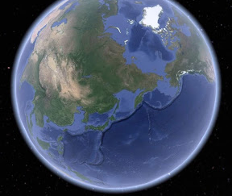
Mrs McGowan’s Magnificent Maps
Home Learning week 2.

Slide 2
Explore our world on Google earth.
https://earth.google.com/web/@0,0,0a,22251752.77375655d,35y,0h,0t,0r/data=OgMKATA?authuser=0
Can you find The United Kingdom on the globe?
Mrs McGowan’s Magnificent Maps
Challenge 1: Where in the world?

Slide 3
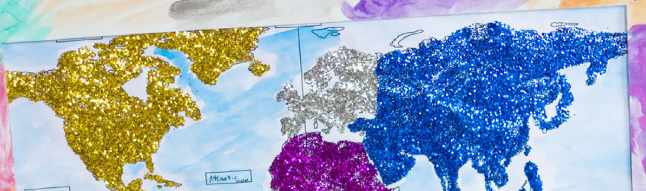
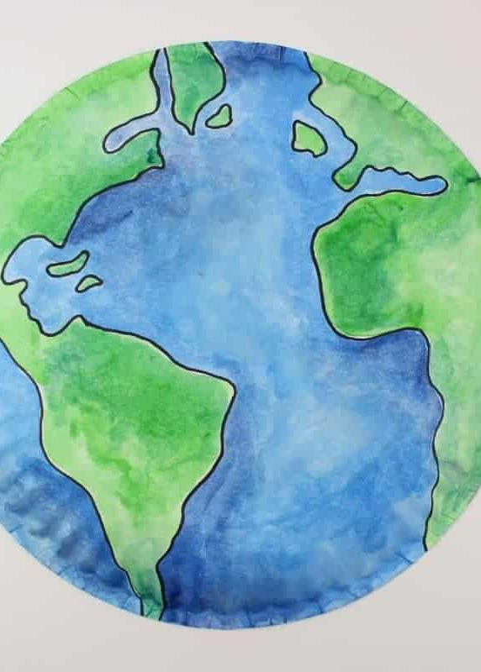
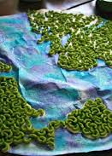
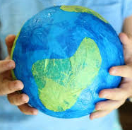
Mrs McGowan’s
Magnificent Maps
Challenge 2: Globe craft
Make sure you have made the land and the seas clear.
Today, I would like you to create your own picture or model of our world.
Don’t forget to send Mrs. McGowan a picture.

Slide 4
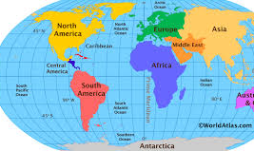
Mrs McGowan’s Magnificent Maps
Challenge 3: What is a continent?
A continent is a large area of land.
Our world has 7 continents.
Listen to and learn the song to find out about them all! Copy the link below:
https://youtu.be/K6DSMZ8b3LE

Slide 5
Mrs McGowan’s Magnificent Maps
Challenge 3: Naming the 7 continents
You could:
Label the globe you made for challenge 2 with the 7 continents;
Complete the worksheet on the website;
Draw your own world map and label the continents;
Or an idea of your own!

Slide 6
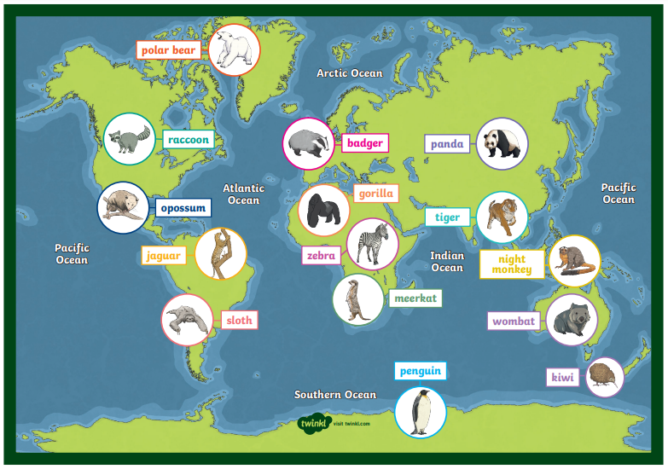

Mrs McGowan’s
Magnificent Maps
Challenge 5: What animals?
Time for some research!
Different animals live all over the world.
Take a look at my map.
Can you find out about any other animals you might find around the world? In the desert? The rainforest? A cold habitat?

Slide 7
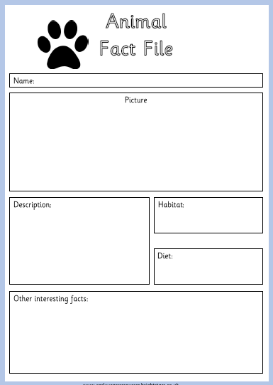
Extra challenge!
Choose one of the animals you have learnt about and create an animal fact file.

