Slide 1

Year 1 Phonics
Home Learning Week 2

Slide 2
Session 1
WALT- Reading and writing words with the ow digraph.

Slide 3
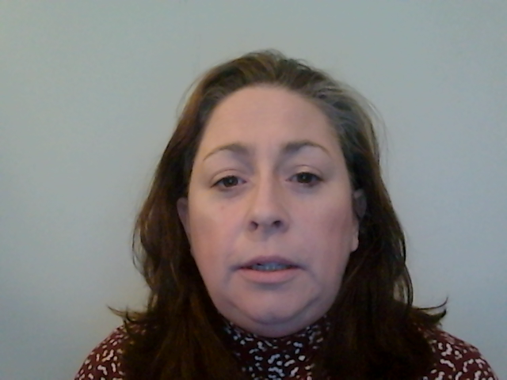

Session 1
WALT- Reading and writing words with the ow digraph.
crown
cow
low
snow
brown
bowl
window
owl

Slide 4
Session 2
WALT- Reading and writing words with the ie digraph.

Slide 5
Session 2
WALT- Reading and writing words with the ie digraph.
denied
pie
chief
thief
fried
mischief
shriek
cried

Slide 6
Session 3
WALT- Reading and writing words with the ea digraph.

Slide 7
Session 3
WALT- Reading and writing words with the ea digraph.
stream
bead
head
deaf
bread
cream
meat
feather

Slide 8
Session 4
WALT- Reading and writing words with the er digraph.

Slide 9
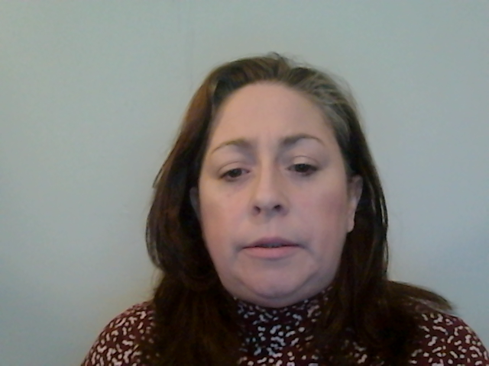

Session 4
WALT- Reading and writing words with the er digraph.
feather
letter
hammer
herb
jerk
stern
her
boxer

Slide 10
Session 5
WALT- Read and write tricky words.

Slide 11
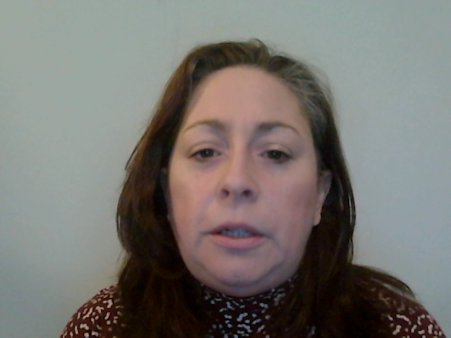
Session 5
WALT- Read and write tricky words.
who

Slide 12

who

Slide 13
water

Slide 14
water

Slide 15
people

Slide 16
people

Slide 17
where

Slide 18
where

