Slide 1
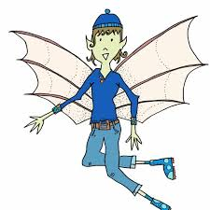

Pippety Skycap
A tale of mischief

Slide 2
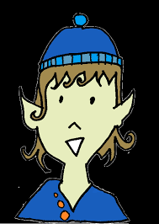
Once upon a time, there was a pixie called Pippety Skycap who lived in the corner cupboard in a room just like yours. Pippety loved to have fun and loved to giggle, but most of all he loved to play tricks!

Slide 3
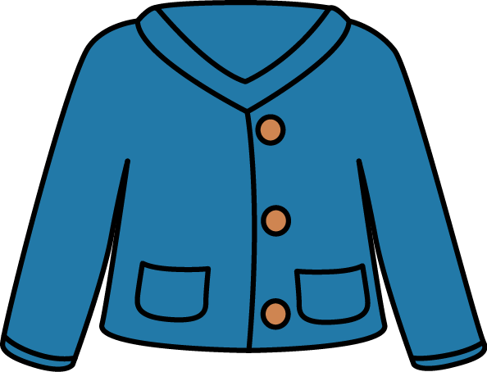
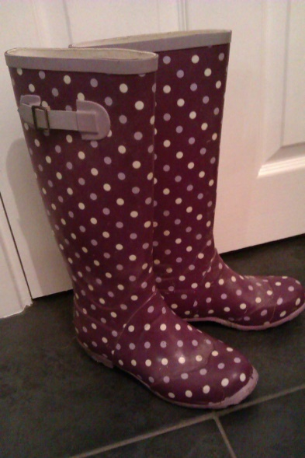
One cloudy morning, he woke up feeling full of mischief. So, he put on his best blue jacket,
squeezed into his spotty boots and set off to find some fun –
Hoppity skip, hoppity skip, hoppity skip.

Slide 4
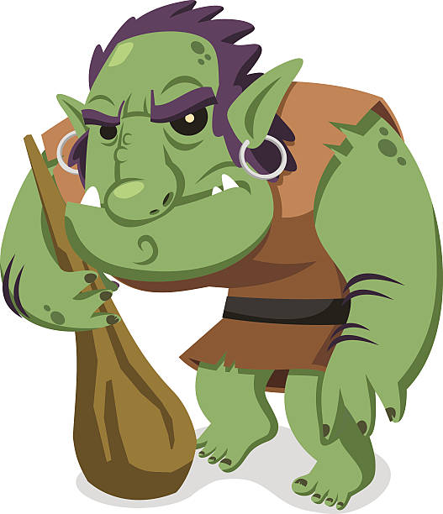
Soon, he came to the old stone bridge where a grumpy troll was sleeping. “Now for some fun!”
giggled Pippety and he pulled
a soft feather from his pocket.
Nearer and nearer he crept to
the troll until he could tickle
his warty nose with the feather.
“A-A-A-CHOO!”
The poor old troll woke up with
a huge sneeze and tried to grab
the tricky pixie. Luckily, Pippety
was a tiny pixie, a teeny pixie
and he slipped through the troll’s
fat fingers.
Off he sped - hoppity skip,
hoppity skip, hoppity skip.

Slide 5
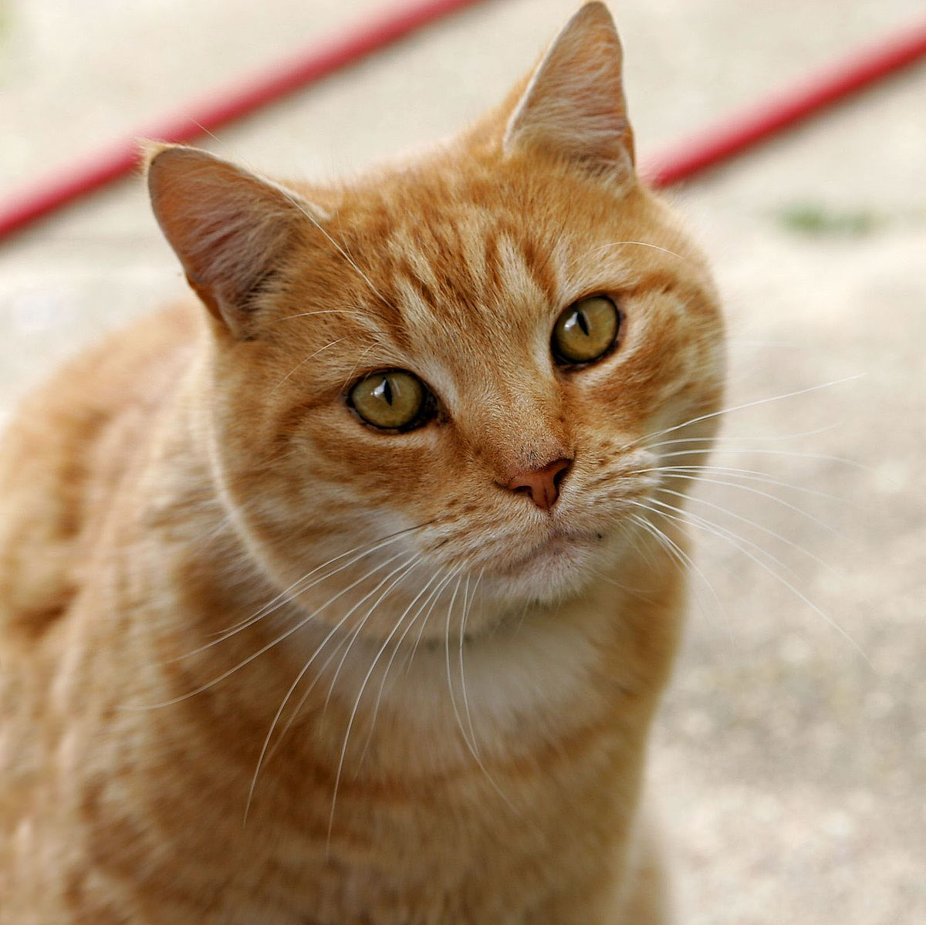
Next, he came to a prickly bush where a ginger cat was watching the birds. “Now for some fun!” giggled Pippety and he snapped off a sharp thorn from the bush.
Nearer and nearer he crept to the cat until he could prick her tail with the thorn.
“OUCH! OUCH! OUCH!” The poor cat spun round with a yowl and a howl and swiped at the tricky pixie. Luckily, Pippety was a tiny pixie, a teeny pixie and he dodged the long, sharp claws.
Off he sped, hoppity skip, hoppity skip, hoppity skip.

Slide 6
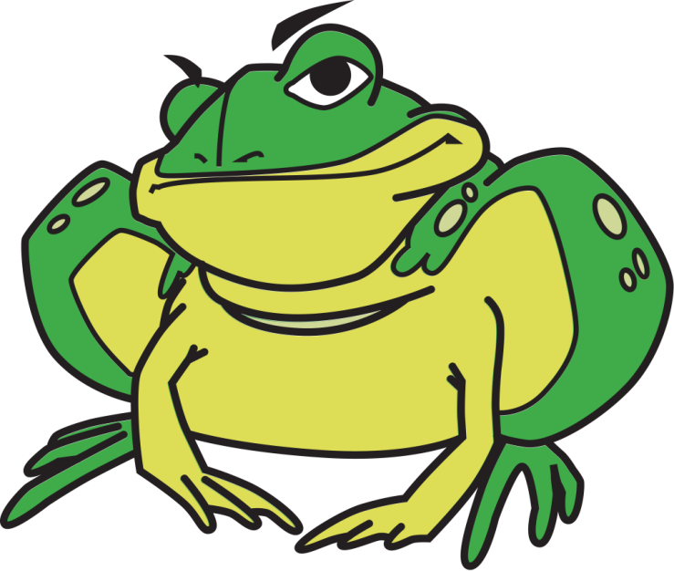
Soon, he came to riverbank where an old toad was dozing on a shiny lily pad.
“Now for some fun!” giggled Pippety and he pulled a bright blue balloon from his pocket.
Nearer and nearer he crept to the toad until he was right beside his ear. He blew and he blew and he blew until – BANG!
“My poor ears!” croaked the toad and he wibbled and wobbled and finally fell into the river with a gigantic splash.

Slide 7
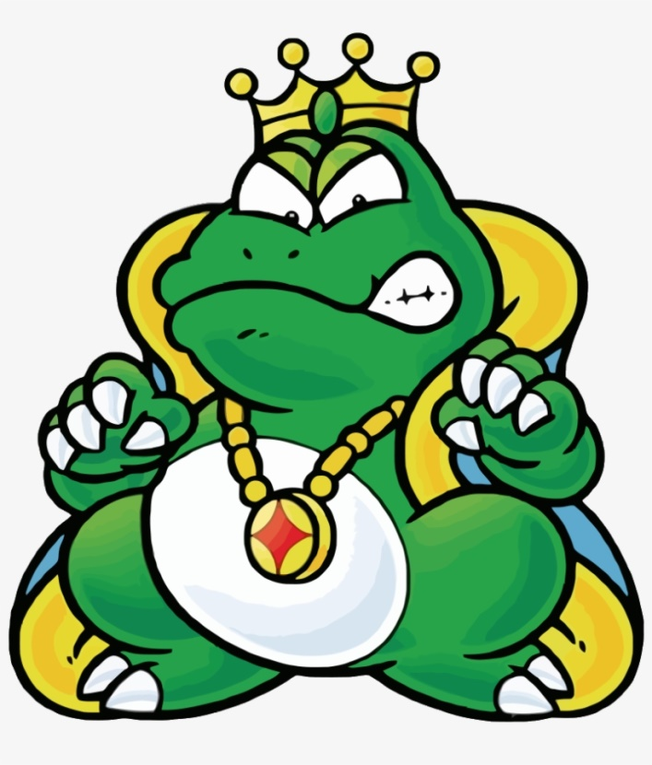
Unfortunately, Pippety had not seen that
on the next lily pad was the King Toad.
It looked at him with mean, beady eyes,
flicked out an enormous tongue and
covered him in a thick, sticky goo!
“YUCK!” cried Pippety and he ran off,
squishing and squelching and squelching
and squishing all the way home.
That evening, Pippety Skycap had a long, hot bath, snuggled up with a mug of hot chocolate and thought about his day. He remembered the sticky, oozy goo that had covered him head to toe and frowned. “I’ll just have to be a careful tricky pixie tomorrow,” he mumbled and settled down to plan some more mischief!

