Slide 1


Slide 2



Slide 3

The Olympic Games and Paralympic Games were due to be held in Tokyo this Summer. They were postponed.

Slide 4
Instead, they will take place next Summer – starting on 23rd July 2021.

Slide 5
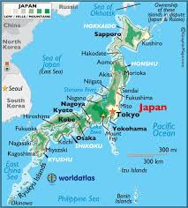
Tokyo is the capital city of Japan.

Slide 6
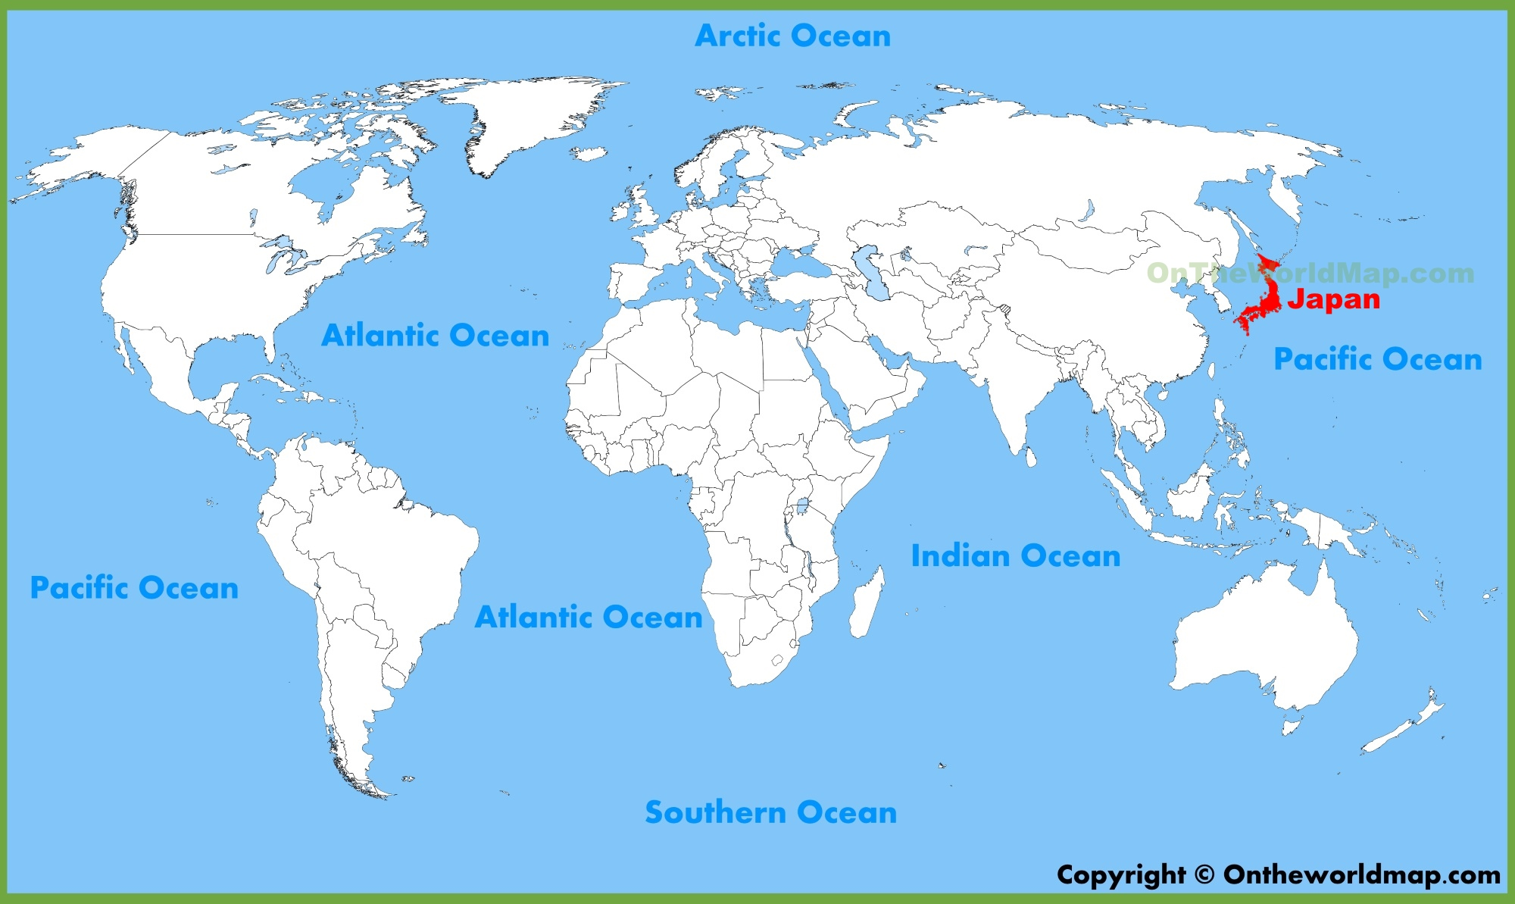
It is 9,490km from here to Tokyo.

Slide 7

Our school challenge is to run or walk the 9,490km to Tokyo

Slide 8
Maths time…
Our track measures 250 metres.
There are 1,000 metres in a kilometre.
So St Wilfrid’s, we need to do 4 laps of the track to do 1km.
So to travel 9,490km, we need to do:
4 x 9,490 = 37,960
That’s 37,960 laps

Slide 9
37,960 laps – we had better get started!
When can we walk or run?
In the morning before school
At break, if it is your turn to use the field
At dinner time, if it is your turn to use the field
At the start or end of your PE lesson
Your teacher may find some time to trek to Tokyo each week

Slide 10
The tracker
Every afternoon or every two days, your teacher will ask, “How many laps have you run or walked today?”
She will record your number of laps on a Tracker.
We will keep a record of how many laps you do each month; how many laps your class does each month and how many laps our school does each month.

Slide 11

You will become fitter, faster, stronger and healthier.
Your school work will improve
Your mind will be happier

Slide 12

You will help our school reach Tokyo.
Can we get there before other local schools?
We’ll do our best, won’t we
St Wilfrid’s! Mrs Clark

