Slide 1





Notes:
Introduce the assembly as an interactive presentation on sugary drinks and why we should all consider cutting down on sugary drinks

Slide 2
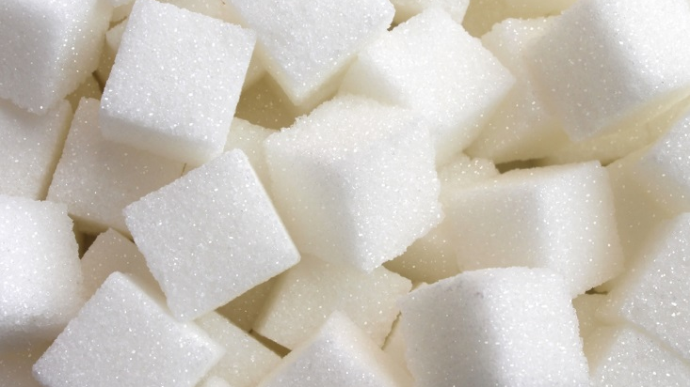
Can you name some food and drink items that contain lots of sugar?
Notes:
Ask the children if they can put their hand up if they can name a food or drink item which contains a lot of sugar. Possible answers include:
Sweets, ice cream, cakes, sweet pastries, biscuits, chocolate, ice lollies, sugary drinks. Also point out that sugar is hidden in savoury foods such as tomato sauce, ready meals and even bread.
A can of Coca-Cola contains 9tsp of sugar. Ask the children to remember this fact (for later in the presentation).

Slide 3
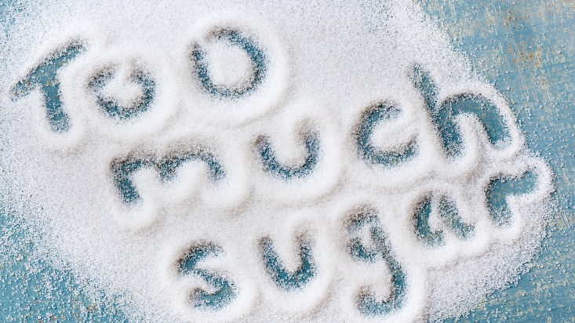
Notes:
Too much sugar can cause problems with your teeth. Ask the children “who likes to go to the dentist?” If any of the children put their hand up ask them “why?”, perhaps use the following prompt “is that because you look after your teeth?” Children and adults alike only tend to like the dentist if they receive glowing reports. Let the children know that “some children have to have rotten teeth pulled out by the dentist which can be very painful. This is often caused by too much sugar.”
“What else happens if we eat too much sugar?”
“It is easy to eat or drink too much sugary foods, therefore we can put on weight quickly. It takes 30 minutes walking to burn off the calories from a can of Coca-Cola.”

Slide 4
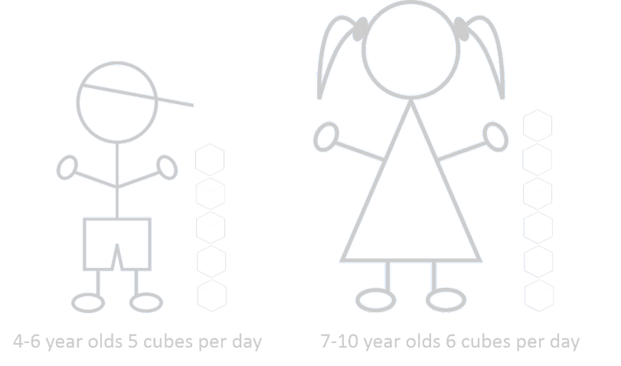
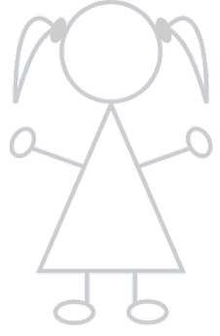



In Cheshire West and Chester…
20.7% of 5 year olds experience dental decay before they start primary school.
That’s more than one in every five children!
Notes:
In Cheshire West, 20.7% of 5 year olds experience dental decay before they start primary school – the equivalent of more than one in every five children.

Slide 5
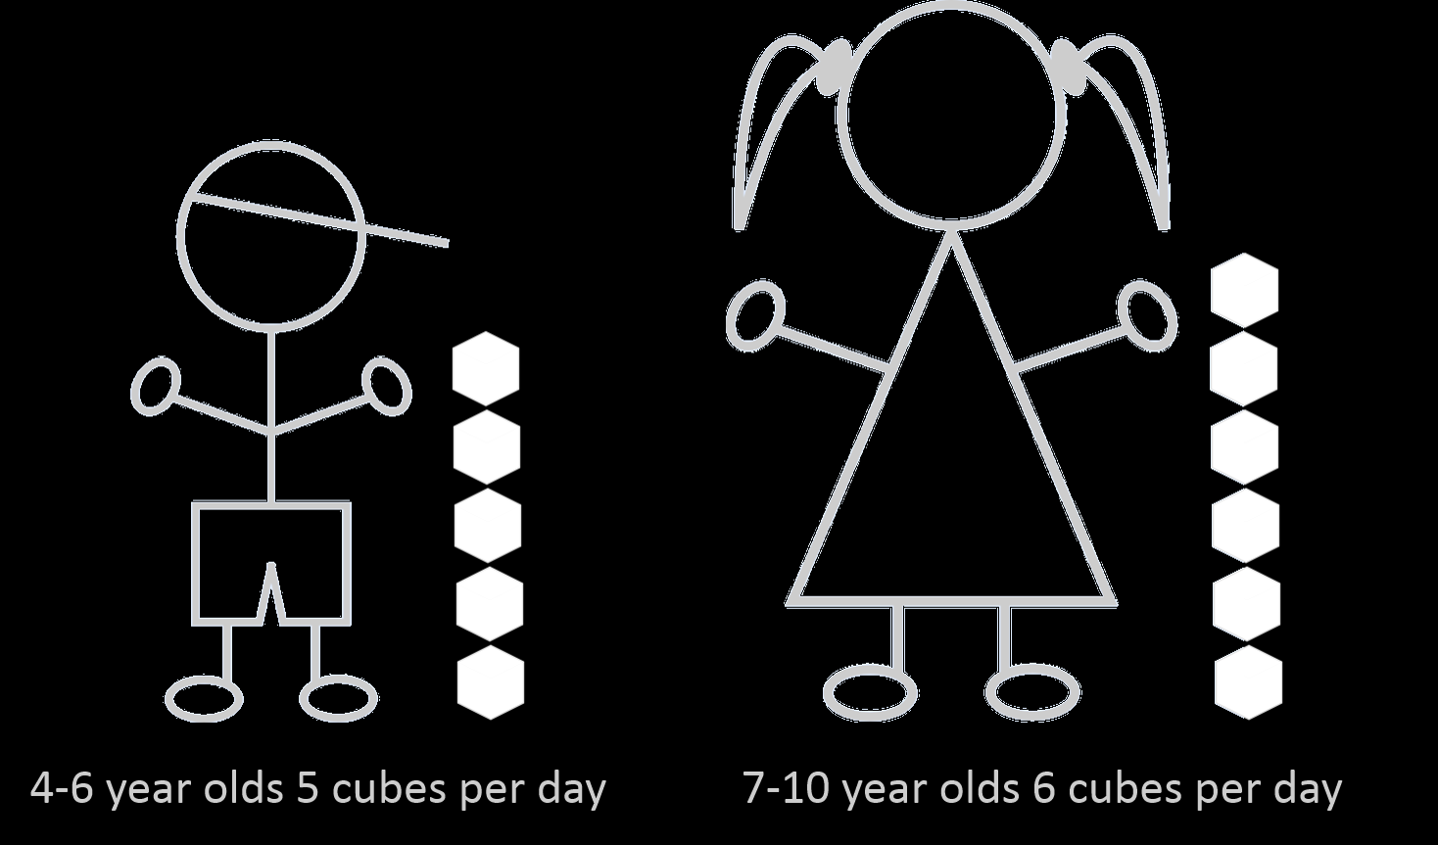
Notes:
Ask children who are aged 4-6 to put their hand up – tell them they should have no more than 5tsp/cubes of sugar per day. Ask the 7-10 year olds to put their hands up – tell them they should have no more than 6tsp/cubes of sugar per day. (One teaspoon/ cube of sugar equals 4grams)
“Does this seem like a lot or a small amount of sugar?”
Ask the children “can you remember how many teaspoons of sugar there are in a can of Coca-Cola?” (If you need a reminder it is 9tsp).
Ask “how many cans of Coca-Cola could you have per day to stay within the maximum guidelines?” The answer is none. A can of Coca-Cola would take all of the children way over the maximum amount and this is without considering the sugar is other food and drink you have during the day.

Slide 6
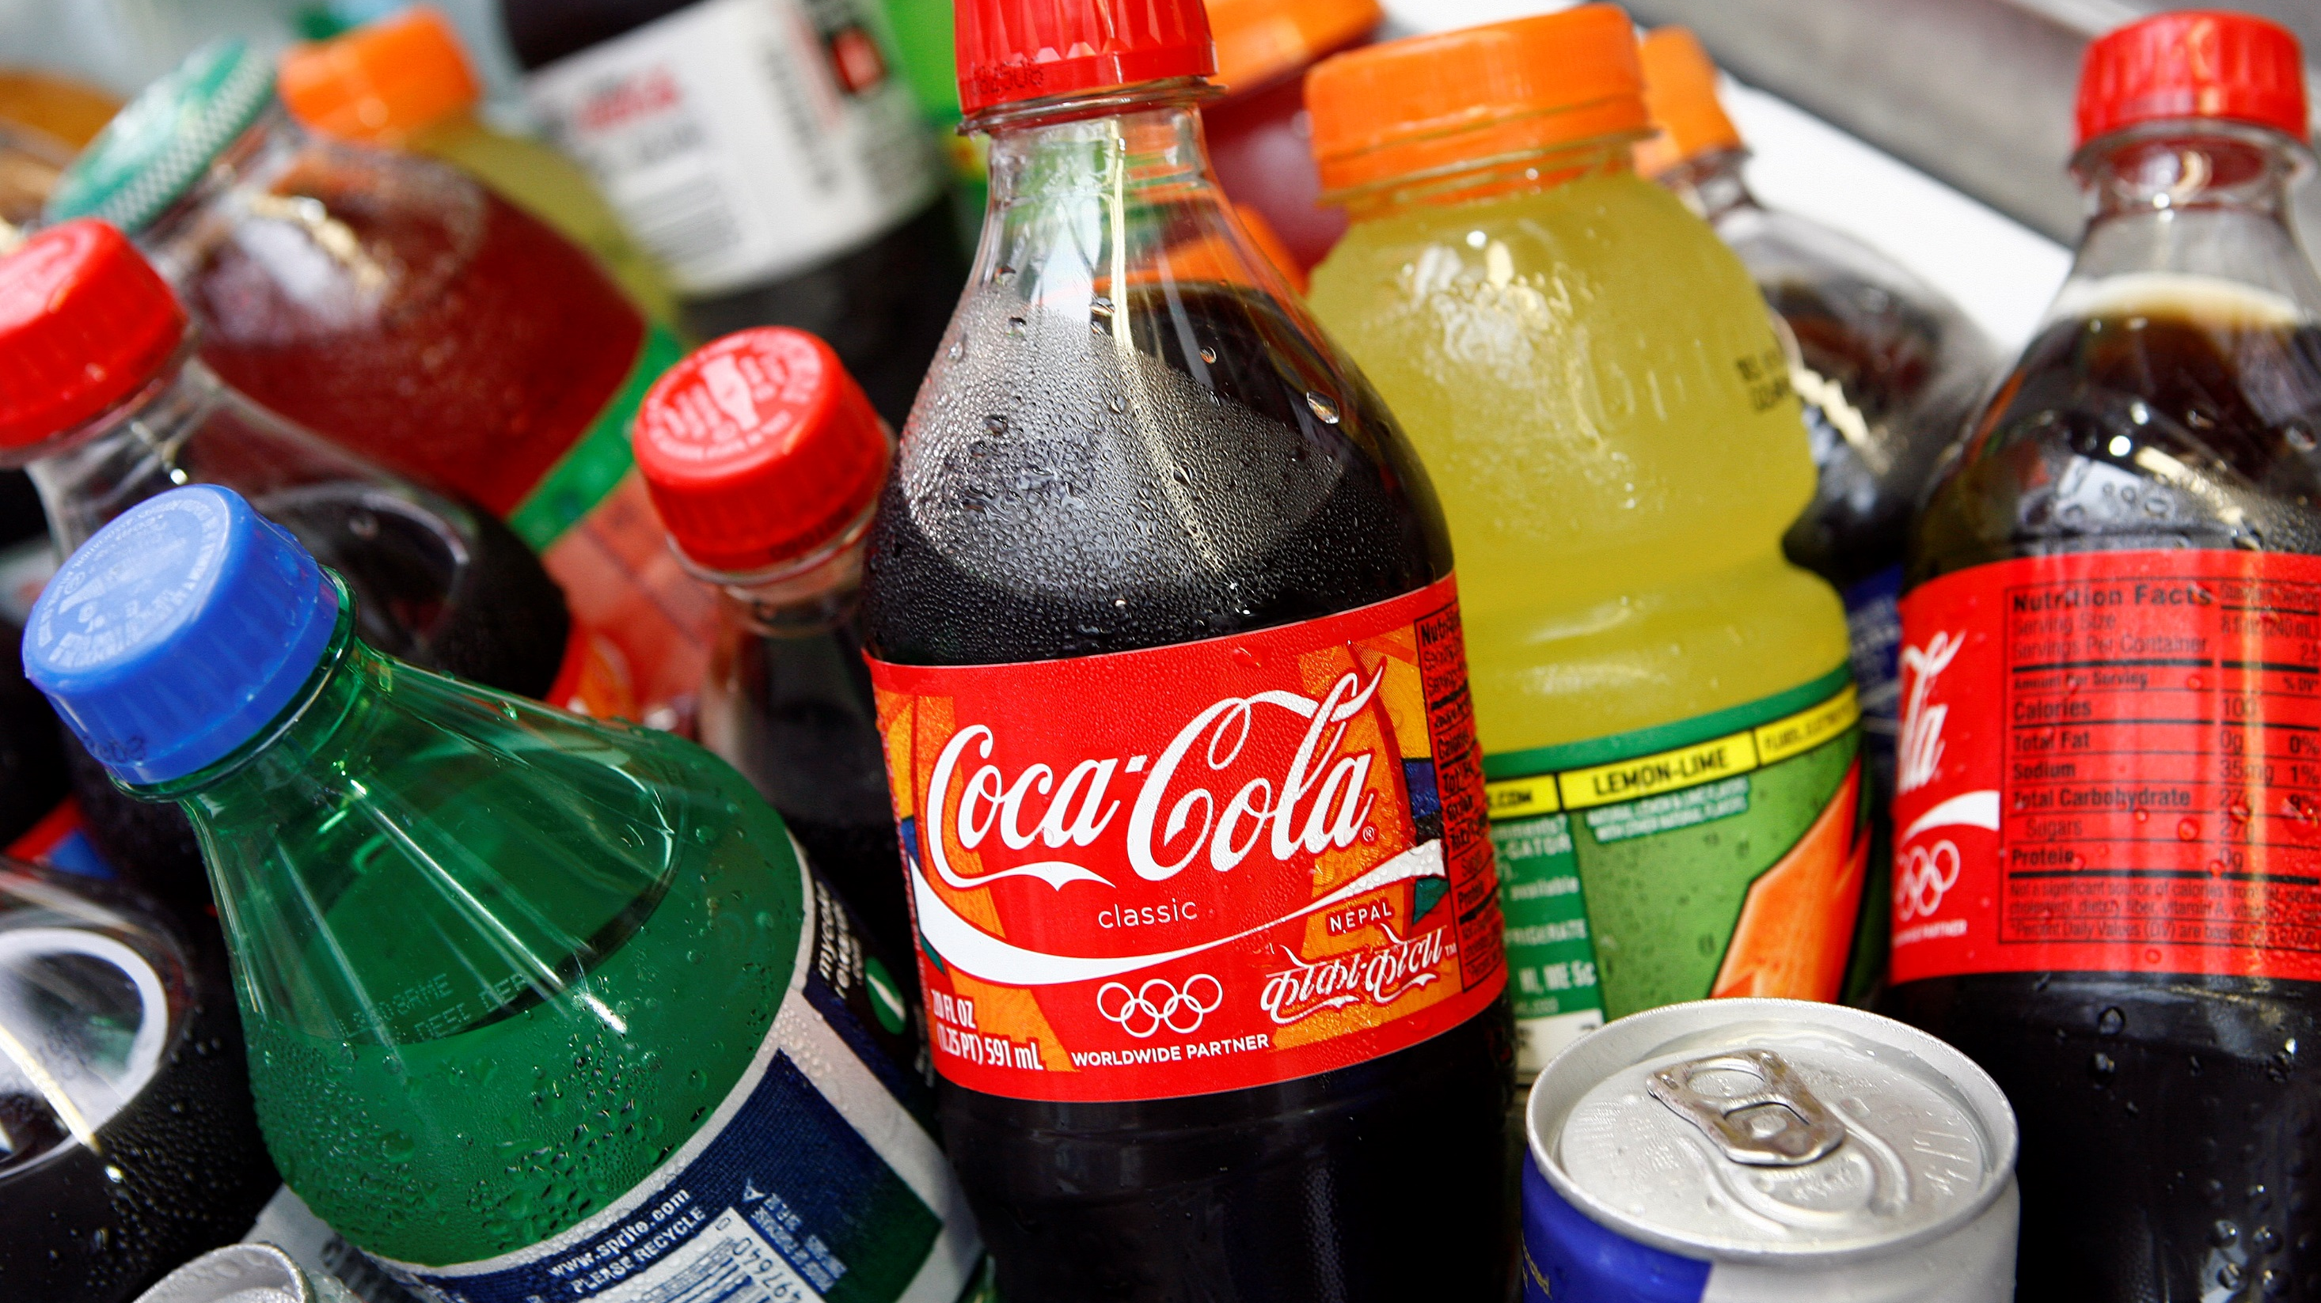
Let’s have a look at how much sugar is in some popular drinks
Let’s have a look at how much sugar is contained in some popular drinks
Notes:
Introduce the higher or lower game. Ask the children if they remember how much sugar they should have as a maximum per day.
19g or 5 sugar cubes for children aged 4 to 6
24g or 6 sugar cubes for children aged 7 to 10
Then explain that you will show a number of drinks, the children need to stand up if there is more sugar than in the previous drink and sit down if there is less sugar than in the previous drink. They start with the number of sugar cubes they should consume per day as a maximum (don’t worry if there are a range of ages, the first drink is higher than the maximum recommended amount for both age groups).
This game will get them thinking and also get them moving!

Slide 7
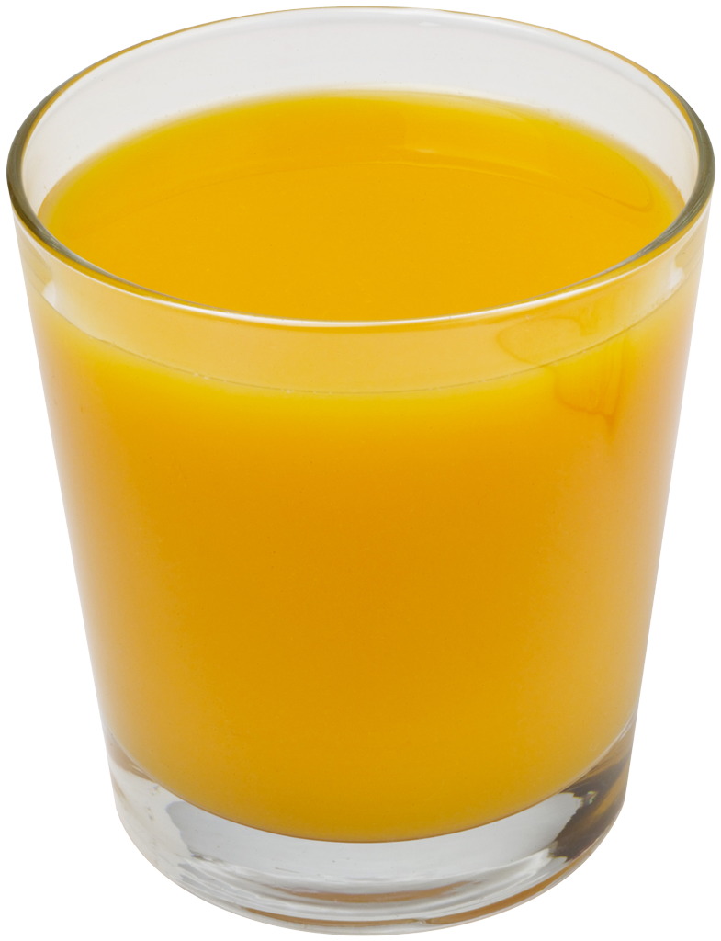
A glass of pure fruit juice counts towards your 5 a day but still contains a lot of sugar. Best to have orange juice during meal times.
21g
200ml
Notes:
Pure orange juice
Fruit Juice
~ 5 sugar cubes
A glass of pure fruit juice counts towards your 5 a day but still contains a lot of sugar. Best to have juice during meal times.

Slide 8
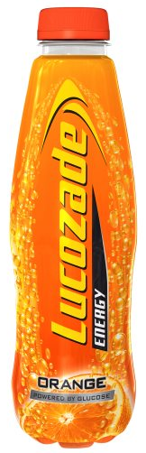
22.5g
500ml
Notes:
Lucozade Energy Orange
Energy Drink
~ almost 6 sugar cubes

Slide 9
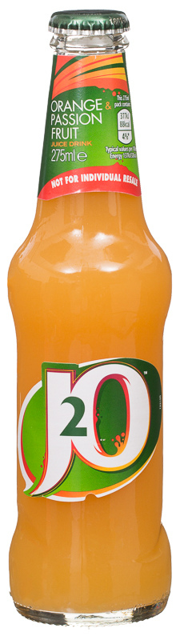
13g
275ml
Notes:
J2O Orange and Passion Fruit
Soft drink
~ 4 sugar cubes

Slide 10
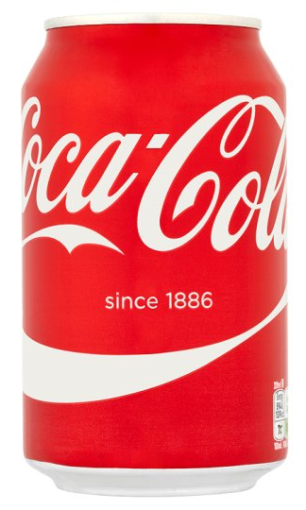
35g
330ml
Notes:
Coca-Cola
Soft drink
~ 9 sugar cubes

Slide 11
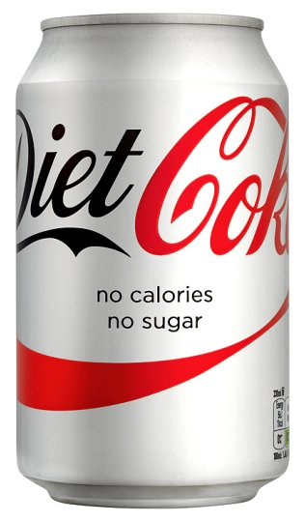
0g
330ml
Notes:
Diet Coke
Diet / Zero Drink

Slide 12
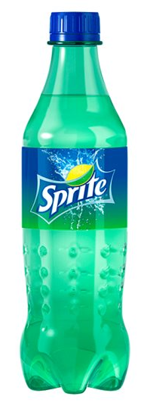
16.5g
500ml
Notes:
Sprite
Soft drink
~ 4 sugar cubes

Slide 13
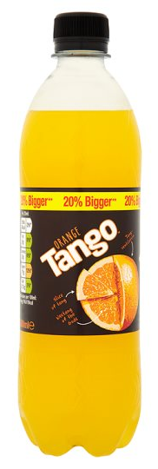
21g
500ml
Notes:
Tango Orange
Soft drink
~ 5 sugar cubes

Slide 14
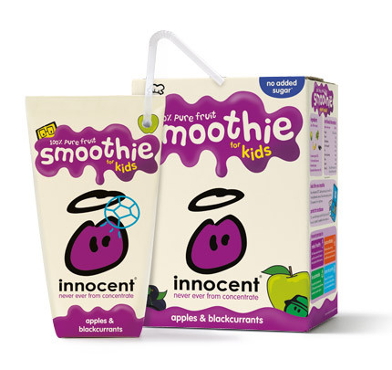
Although they contribute to your 5 a day, smoothies have lots of sugar in them!
18g
180ml
Notes:
Innocent Smoothie Apples and Blackcurrant
Smoothie
~ 5 sugar cubes

Slide 15
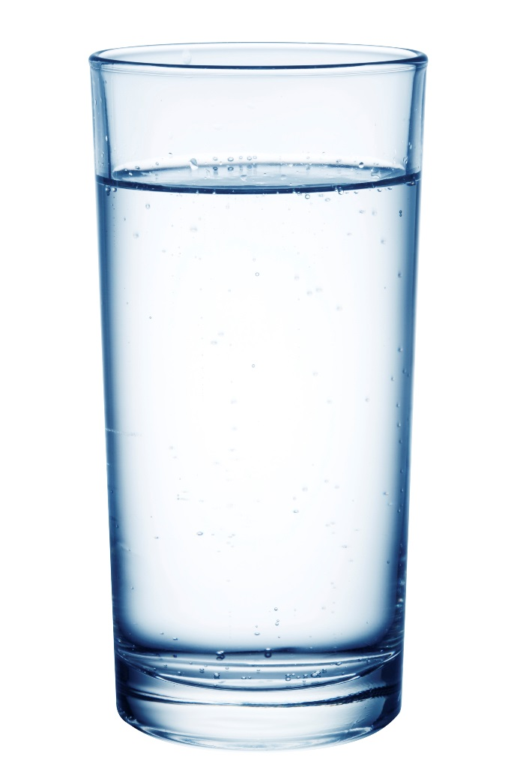
0g
200ml
Notes:
- Tap water

Slide 16
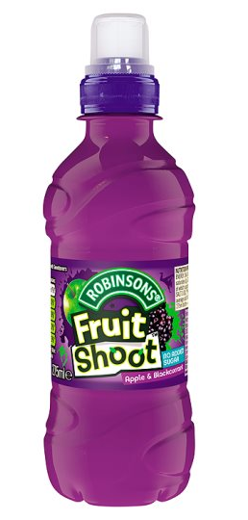
1.6g
200ml
Notes:
Fruit Shoot Blackcurrant & Apple
Fruit juice
Less than 1 sugar cube
Product has been reformulated

Slide 17
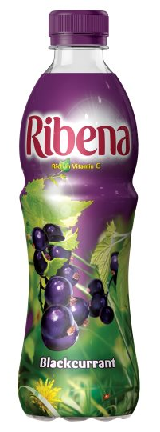
23g
500ml
Notes:
Ribena Blackcurrant
Soft drink
~ almost 6 sugar cubes

Slide 18
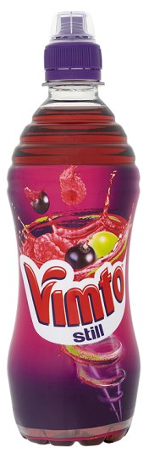
33g
500ml
Notes:
Vimto
Soft drink
~ 8 sugar cubes

Slide 19
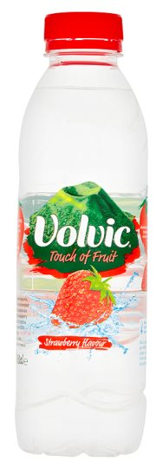
Be wary of flavoured waters, they contain sneaky sugar!
23g
500ml
Notes:
Volvic Touch of Fruit Strawberry
Flavoured water
~ 6 sugar cubes

Slide 20
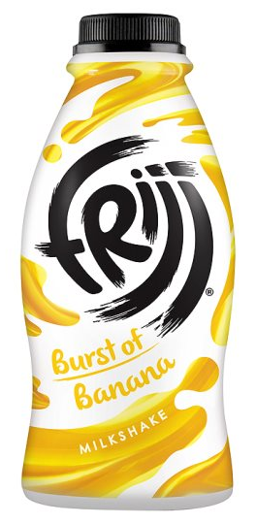
Be aware - milkshakes can have a lot of sugar in them!
38.8g
471ml
Notes:
Frijj Burst of Banana
Milkshake
~ 9 sugar cubes

Slide 21
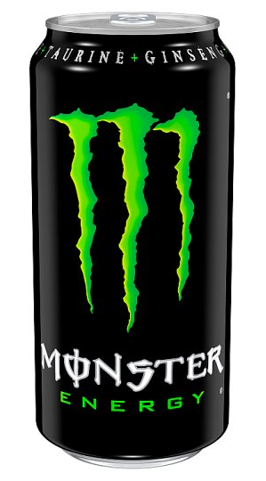
Remember energy drinks can contain lots of caffeine too which can be unsuitable for young children!
48g
440ml
Notes:
Monster
Energy drink
~ 12 sugar cubes

Slide 22
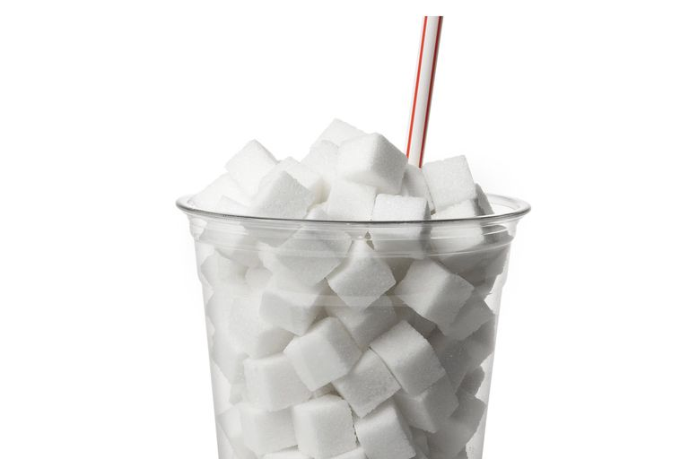
Notes:
An easy way to reduce your sugar intake is to stop or cut down on sugary drinks and to Give Up Loving Pop.
Remember, the maximum amount of sugar for your age group* includes added sugar found in food too.
* 5tsp/ cubes for 4-6 year olds and 6tsp/ cubes for 7-10 year olds.

Slide 23
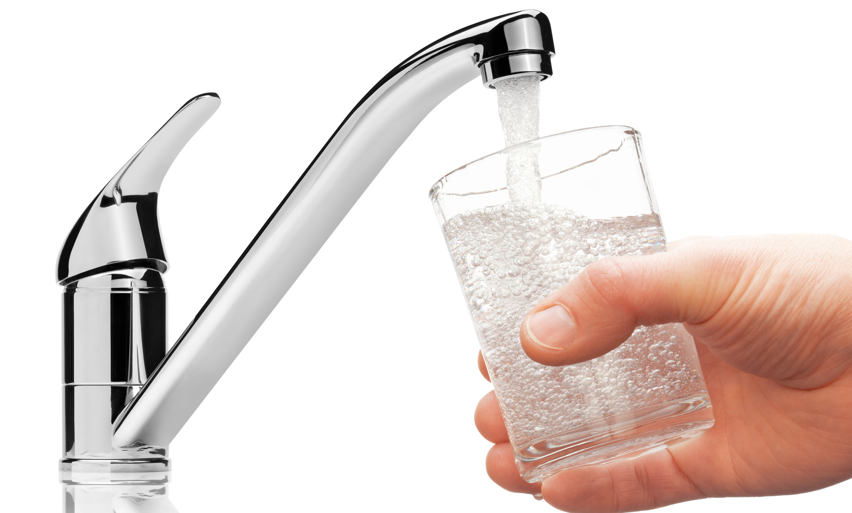
Who thinks they could Give Up Loving Pop for four weeks and switch to water and milk?
Some of the benefits:
Healthier teeth
More energy
Better concentration
Water is free
Milk builds strong bones
Notes:
Cutting out sugary drinks is an easy way to reduce how much sugar we eat and drink. Why not see if you can stop drinking sugary drinks for four weeks and see how you feel. You never know you may not even miss them.
There are lots of benefits to drinking water or milk instead (see slide) – ask “can you think of any more?”
Finish with a show of hands “who will Give Up Loving Pop for four weeks and switch to water and milk?”

Slide 24
@gulpNOW #GiveUpLovingPop
www.giveuplovingpop.org.uk

