Slide 1




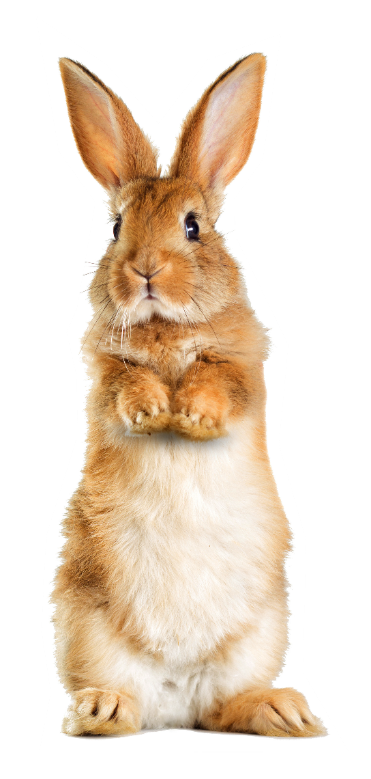






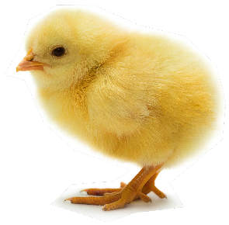








Science is happening all around us! Get hunting and discover the everyday science all around you this spring and Easter.
Twenty days of fun and engaging spring and Easter-themed science. Quiz questions with 10-minute science activities and suggestions and resources for diving deeper.

Slide 2








Before you start…
Make sure you are viewing this PowerPoint in ‘Slide Show’ mode.
Click on this highlighted icon in the bottom-right of your screen.
This will allow you to see the full resource and to use any interactivity.

Slide 3
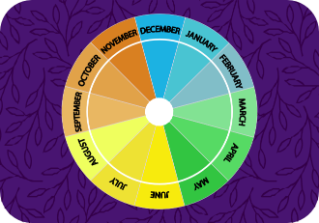



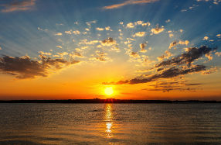
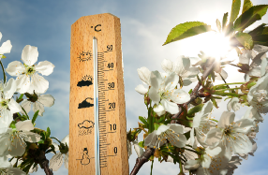
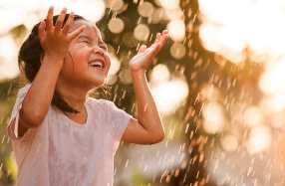
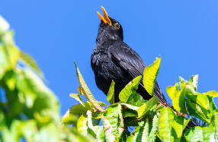





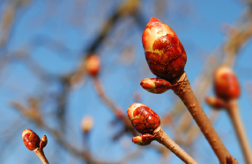
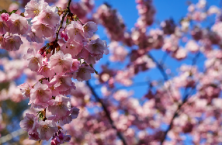




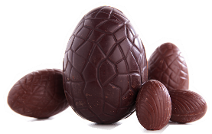




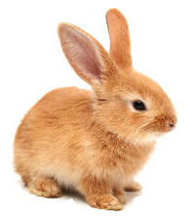
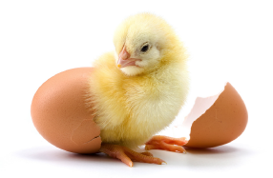
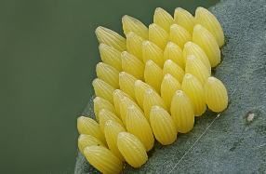


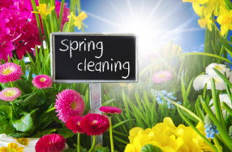



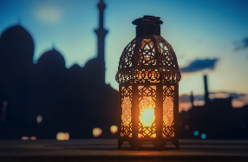




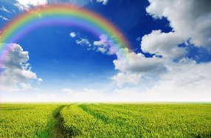
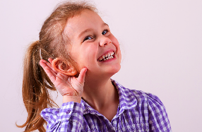
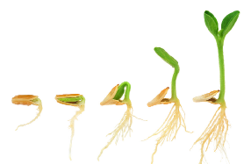
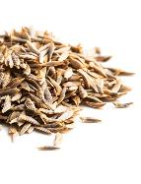
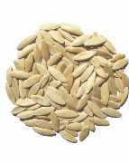

Get hunting and click on a day!

Slide 4

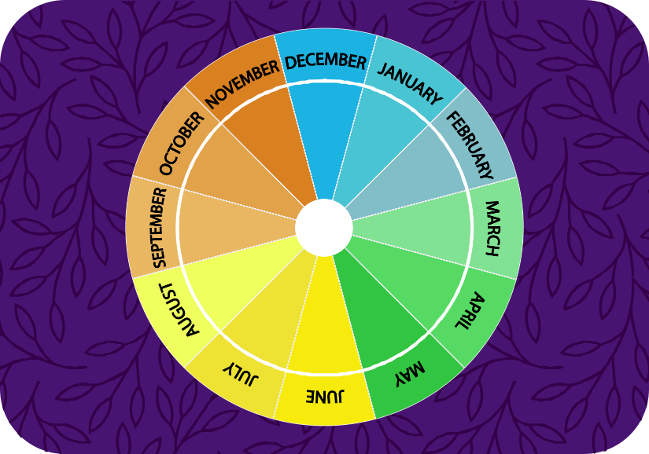




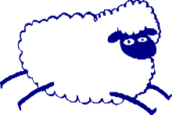

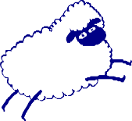





₁st
Day of science
When does spring start and finish?
Go back
Hint
Answer

Slide 5

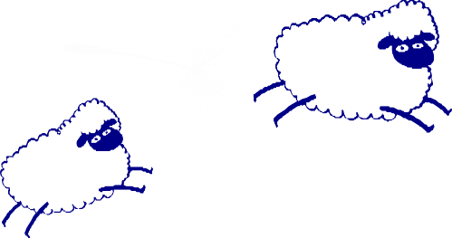
₁st
Day of science
When does spring start and finish?
Spring comes after the winter and before the summer.
It lasts for 3 months.
Go back
Hint
Answer

Slide 6



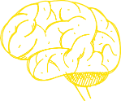
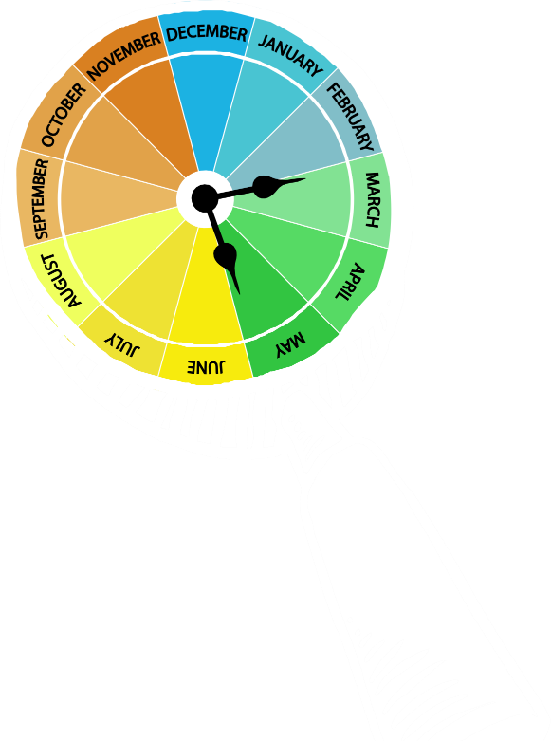
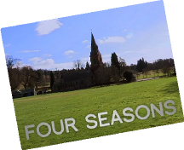






1
10-minute science
Make a list of the four seasons. Then list the
3 months in each season. Describe or draw some of the features of each season. Which is your favourite season? Explain why.
st
Day of science
Answer
Our spring starts on March 1st and ends on May 31st. It lasts for three
months: March, April, May.
Australia and New Zealand and other countries in the southern half of the Earth, have spring in September, October and November.
SPRING
Dive deeper
Do you need to remind yourself about the seasons and how they are different from each other? Watch this clip or use the Science in stories: The Emperor’s new clothes presentation.
Go back

Slide 7





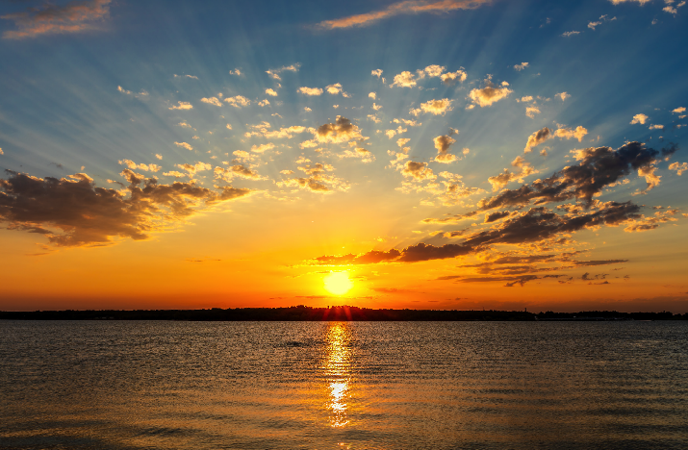

₂nd
Day of science
Does daylength get longer or shorter as we go through April and May? Use the data in the table to find out.
Go back
Hint
Answer

Slide 8
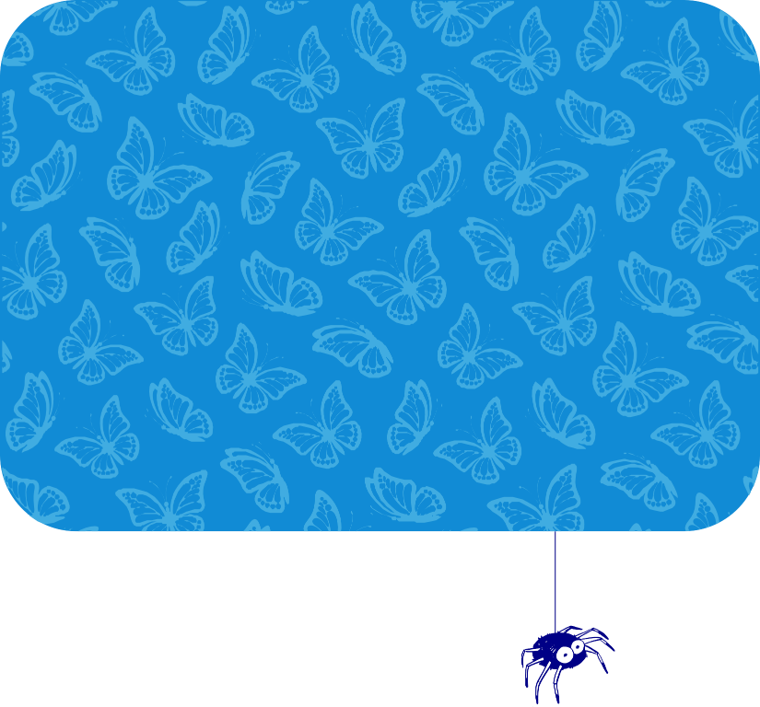
₂nd
Day of science
Does daylength get longer or shorter as we go through April and May? Use the data in the table to find out.
Daylength is the daylight hours between sunrise and sunset.
Go back
Hint
Answer

Slide 9








2
10-minute science
Work out the daylength for the two days in the table that are missing. Explain how you worked it out to the person next to you. Use this website to find out about daylength where you live.
nd
Day of science
Date
Sunrise Sunset
06:36 19:33
06:05 19:57
05:32 20:23
05:08 20:45
04:49 21:07
Total daylight
Answer
As we go through April and May, the sun rises earlier
each day and the sun sets later so daylength gets longer.
April 1st
12 hours 57 mins
April 15th
?
May 1st
14 hours 51 mins
May 15th
?
May 31st
16 hours 17 mins
Dive deeper
On March 27th we change our clocks so they are 1 hour later. This is
called ‘Daylight Saving Time’ (DST). It means we make better use of the daylight but also means you get one less hour in bed! Find out more about why our clocks ‘spring forward’ in spring and back in autumn here and which countries use DST here.
Go back

Slide 10







₃rd
Day of science
How does the weather change in the spring?
Go back
Hint
Answer

Slide 11
₃rd
Day of science
How does the weather change in the spring?
Think about how hot or cold it is in spring compared to winter, and how much rain falls.
Go back
Hint
Answer

Slide 12







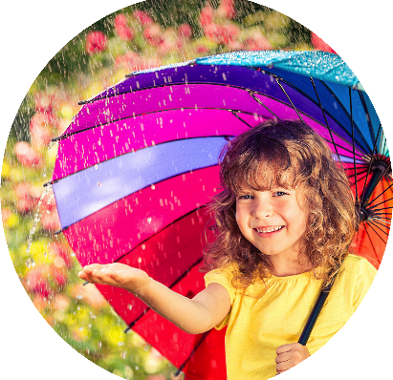
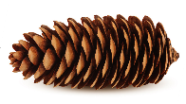


₃rd
10-minute science
Set up a spring weather diary. Make a key with symbols for the different types of weather. You could use a thermometer to record temperatures and make a rain gauge from a plastic bottle, to measure how much rain falls each day.
Day of science
Answer
As we move from winter to spring it starts to get warmer. Early spring can still be cold and it may snow. April has more rain showers than other months.
Dive deeper
Did you know pine cones can help with forecasting the weather.
Find out more here.
Go back

Slide 13


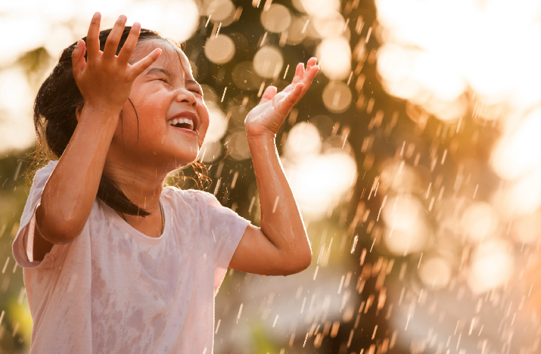





₄th
Day of science
What type of material do you need to wear to keep you dry in a spring rain shower?
Go back
Hint
Answer

Slide 14
₄th
Day of science
What type of material do you need to wear to keep you dry in a spring rain shower?
You need a material that doesn’t let water though it. What do we call this type of material?
Go back
Hint
Answer

Slide 15




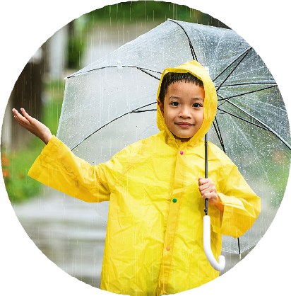
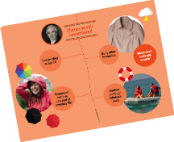
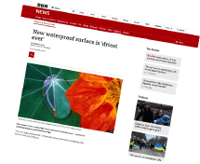






₄th
10-minute science
Look at the coats in your school cloakroom. Which ones do you think are the most waterproof? What materials are they made from? You can find the names of the materials on the same label that tells you how to clean the coat.
Day of science
Answer
You need to wear a waterproof material. Materials like rubber, wax, Gore-tex, PVC (polyvinyl chloride) and PU (polyurethane) plastic
are waterproof.
Dive deeper
Use this presentation to find out how scientist Charles Macintosh made the first waterproof material more than 200 years ago.
Engineers have recently made a new material that they say is the most waterproof material ever.
Read more about it here.
Go back

Slide 16



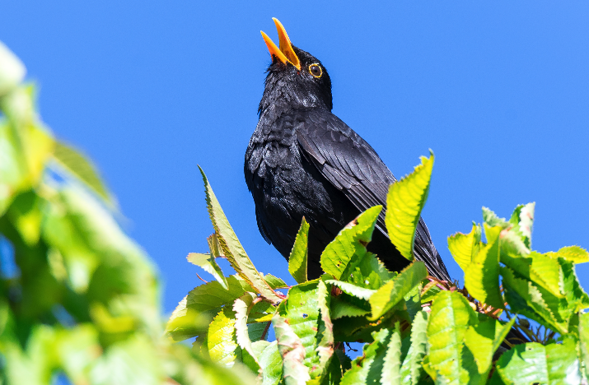





₅th
Day of science
How do birds change their behaviour in spring?
Go back
Hint
Answer

Slide 17

₅th
Day of science
How do birds change their behaviour in spring?
Do you think they eat more or less?
Why do they start gathering twigs, straw and other plant materials?
Go back
Hint
Answer

Slide 18

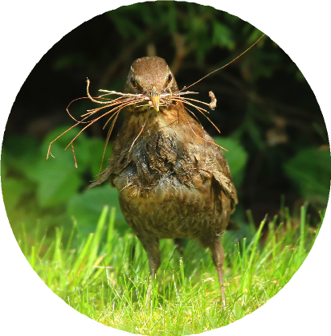

5
10-minute science
Go outside and listen to the birds. List the things you see them doing. If you’re lucky you might see a bird gathering materials for its nest. Use
this website to identify the birds you see.
th
Day of science
Answer
Birds sing and eat more during spring as they get ready to lay their eggs. They also build nests and defend themselves if other birds come too close to their homes.
Dive deeper
Can you make a birds nest using mud, water and natural materials like leaves, grass, twigs and moss?
Watch this clip to find out more.
Go back

Slide 19



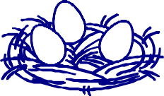

₆th
Day of science
What happens to this part of a tree in spring?
Go back
Hint
Answer

Slide 20
₆th
Day of science
What happens to this part of a tree in spring?
This part of the tree is the bud.
What grows from a bud?
Go back
Hint
Answer

Slide 21
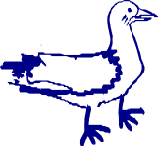
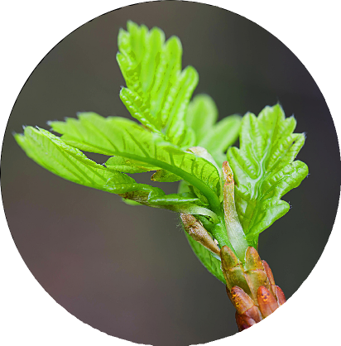
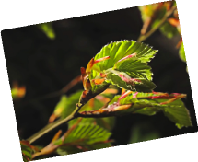



₆th
10-minute science
Choose a branch on a deciduous tree in your school grounds or near your home.
Sketch what it looks like every few days and see how it changes.
Day of science
Answer
As the days grow longer, buds begin to open and new leaves, flowers and branches grow out of them.
Dive deeper
Spring is a time of amazing growth.
Watch this clip to see how young green leaves grow from buds.
Go back

Slide 22









₇th
Day of science
What do we call the pink and white flowers that grow on trees and hedges in spring?
Go back
Hint
Answer

Slide 23
₇th
Day of science
What do we call the pink and white flowers that grow on trees and hedges in spring?
Choose from these words: catkins, blossom, daffodils
Go back
Hint
Answer

Slide 24
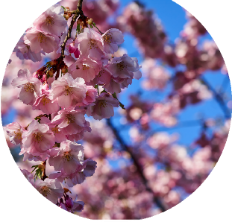



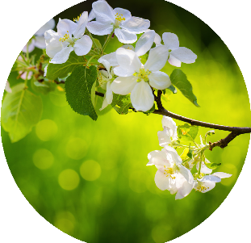


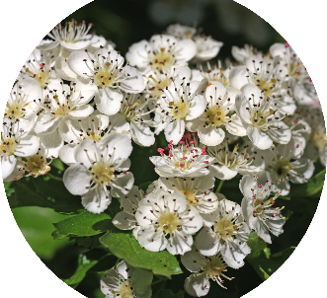
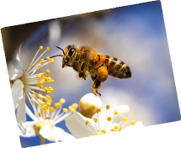

₇th
10-minute science
Go outside and look for trees and hedges that have blossom. Use this National Trust Blossom spotter sheet to identify the ones you find.
Cherry Blossom
Day of science
Answer
We call these flowers blossom.
Blossom comes in lots of different shapes and colours. You can tell what type of tree you are looking at by its blossom.
Apple Blossom
Hawthorn Blossom
Dive deeper
Why do bees like blossom flowers?
Why are bees important to plants that produce blossom? Why are bees important to humans? Use this Eden Project resource to answer these questions and more.
Go back

Slide 25












₈th
Day of science
You grow more in spring than you do in winter.
True or false?
Go back
Hint
Answer

Slide 26

₈th
Day of science
You grow more in spring than you do in winter.
True or false?
You do grow more
in one of these seasons. But is it spring or winter?
Go back
Hint
Answer

Slide 27




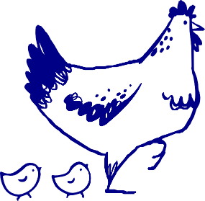

₈th
10-minute science
Work with a partner to measure your height. Measure and record your height, every few weeks and discover how much you have grown during spring.
Day of science
Answer
It’s true! Children grow faster in spring and summer than they do in winter. Scientists think this has something to do with the higher number of daylight hours.
Dive deeper
Are you taller in the morning than you are at night? Follow this investigation to find out the truth!
Go back

Slide 28





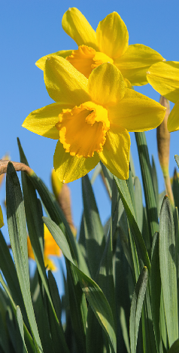
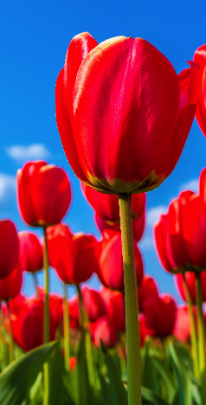
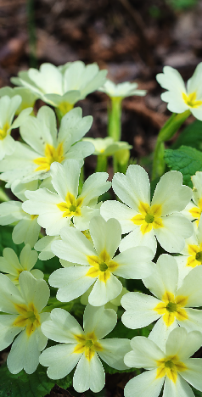



₉th
Day of science
1
2
3
When these flowers start to grow, it is a sign of spring.
Can you name these flowers?
Go back
Hint
Answer

Slide 29

₉th
Day of science
1
2
3
When these flowers start to grow, it is a sign of spring.
Can you name these flowers?
Choose from this list: tulip, dandelion, crocus, daffodil, daisy, primrose, pansy.
Go back
Hint
Answer

Slide 30
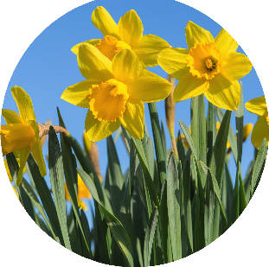








₉th
10-minute science
Go on a daffodil hunt! There are over 50 different types of daffodil. How many
can you spot? Draw and label your favourite daffodil. Use these labels: petal, trumpet, sepal, stem, leaf.
Day of science
Daffodil
Answer
Daffodil
Tulip
Primrose
Where you right?
Tulip
Dive deeper
Daffodils and tulips grow from bulbs. Onions and garlic are bulbs too. But what are bulbs and how do they grow? Do some research online and find out as much as you can about bulbs.
Present what you find to your classmates.
Primrose
Go back

Slide 31






₁₀th
Day of science
During spring, Christians celebrate Easter by giving each other chocolate eggs. Chocolate melts when it is heated. Is this change reversible or irreversible?
Go back
Hint
Answer

Slide 32
₁₀th
Day of science
During spring, Christians celebrate Easter by giving each other chocolate eggs. Chocolate melts when it is heated. Is this change reversible or irreversible?
A reversible change means that a material can be turned back
to how it was before the change took place. An irreversible change means it cannot.
Go back
Hint
Answer

Slide 33






₁₀th
10-minute science
How do materials change when they’re heated? Write down this list of materials: chocolate, wax, ice, hard cheese, butter, egg. Describe what happens to the material when it’s heated. Put a tick next to materials where the change is reversible.
Day of science
Answer
When chocolate is heated, it melts. That means it changes from a solid to a liquid. When it cools, it changes back from a liquid to a solid.
This is a reversible change.
Dive deeper
Did you know that in the UK we buy around 80 million Easter eggs every year! Watch this clip to find out how chocolate Easter eggs are made in a factory.
Go back

Slide 34







₁₁th
Day of science
The Easter Bunny is a well-known symbol of Easter. Rabbits give birth to their babies in spring.
What is the correct name for
a baby rabbit?
Go back
Hint
Answer

Slide 35

₁₁th
Day of science
The Easter Bunny is a well-known symbol of Easter. Rabbits give birth to their babies in spring.
What is the correct name for
a baby rabbit?
The correct name isn’t bunny!
It’s the same name that we give to a baby cat.
Go back
Hint
Answer

Slide 36










11
10-minute science
A doe is pregnant for between 28-31 days and gives birth to up to 14 kittens! That doe could have 10 litters per year! How
many kittens is that in one year? Now imagine that there are
7 females in each of her litters and they have 7 litters each
in their first year. How many kittens would there be then?
th
Day of science
Answer
A baby rabbit is called a kitten.
Sometimes this name is shortened to a kit. The mother is called a doe and the father is called a buck.
A group of kittens born at the same time is called a litter.
Dive deeper
Discover more rabbit facts here or investigate how long different animals are pregnant for and look for patterns with this
Go back
resource from The Association for Science Education.

Slide 37




₁₂th
Day of science
What do we call a bird that hatches from an egg?
Go back
Hint
Answer

Slide 38
₁₂th
Day of science
What do we call a bird that hatches from an egg?
Choose from these words: nestling, chick, hatchling, fledgling.
Go back
Hint
Answer

Slide 39





₁₂th
10-minute science
Draw a diagram of a birds nest with a hatchling, nestling or fledgling inside it. Label and explain what you have drawn.
Day of science
Answer
A bird that has just hatched from an egg is called a chick or a hatchling.
A nestling is a bird that is growing in the nest but relies on it’s parents for food.
A fledgling has feathers and sometimes leaves the nest to look for its own food.
Dive deeper
Eggs are stronger than you might think. Investigate how strong they are and find out why they are oval shaped rather than round, with this Excellent eggs presentation.
Go back

Slide 40









₁₃th
Day of science
Birds aren’t the only animals that lay eggs in spring.
Who laid these eggs?
Go back
Hint
Answer

Slide 41
₁₃th
Day of science
Birds aren’t the only animals that lay eggs in spring.
Who laid these eggs?
Insects, fish, reptiles, amphibians and even some mammals lay eggs.
What type of animal do you think laid these tiny eggs on a leaf?
Go back
Hint
Answer

Slide 42


₁₃th
10-minute science
Make a list of as many animals you can think of that lay eggs.
Then sort the animals into invertebrates (animals without backbones) and vertebrates (animals with backbones).
Day of science
Answer
A cabbage white butterfly laid these eggs. Small green caterpillars will hatch from the eggs. They like to feed on cabbage, broccoli,
and cauliflower leaves.
Dive deeper
Did you know you can turn a hard-shelled chicken egg into a bouncy egg overnight!
Click here and choose ‘Ready.
Go back
Steady. Science! (Primary)’ for simple instructions.

Slide 43








₁₄th
Day of science
1
2
Many animals have babies in spring. Can you give these young animals their correct names?
3
4
Go back
Hint
Answer

Slide 44
₁₄th
Day of science
1
2
Many animals have babies in spring. Can you give these young animals their correct names?
3
4
These are their correct names: hoglet, duckling, lamb, tadpole.
Can you match each name to the correct baby?
Go back
Hint
Answer

Slide 45









₁₄th
10-minute science
Animals are born, they grow, become adults, may have babies and eventually die.
We call this their life-cycle. Draw a diagram to show the life-cycle of a frog. Here are some words to help you: adult, frogspawn, froglet, tadpole.
Day of science
Hoglet
Answer
Were you right?
Duckling
Life Cycles
Embryo
Mammal
Foal
Eggs
Adult Horse
Juvenile
Bird
Nestlings
Pupa
horse
Froglet
Adult bird
Fledgling
Insect
Tadpoles
Amphibian
Adult frog
Caterpillar
Adult butterfly
Frogspawn
Eggs
Find out more
to run so in the wild www.bp.com/bpes/lifecycles
Foals are born ready
Why not run a science day?
Frogs don’t look after Being different
they can escape from
www.bp.com/bpes/scienceexplorers
Did you know?
their young, so having means caterpillars
predators
Birds sing to attract
lots mean some will and butterflies don’t
a mate. A strong song
survive compete for food
means a healthy bird
Dive deeper
Use this life-cycle poster to check the life-cycle diagram you have drawn and to find out about the life cycles of some other animals.
Lamb
Tadpole
Go back

Slide 46




₁₅th
Day of science
What is spring cleaning and why do people do it?
Go back
Hint
Answer

Slide 47
₁₅th
Day of science
What is spring cleaning and why do people do it?
It is when people clean their houses in spring time, but why do you think they do a special clean at this time of year?
Go back
Hint
Answer

Slide 48


₁₅th
10-minute science
Keeping our homes clean is important for our health. Dirt can contain microbes that make us ill. Make a list of things that help us to keep our homes clean. Include equipment (brooms, cloths) as well as chemicals (window spray, washing up liquid). Remember:
Always get permission from an adult before you touch cleaning chemicals as they can be dangerous.
Day of science
Answer
A spring clean is when people clean their houses from top to bottom,
in spring time. Dirt has built up during the winter and cobwebs and smeared windows show up more in the light of spring.
Dive deeper
Make your own natural toy cleaner with this simple water and vinegar recipe. Give your cleaner a name and design an attractive label for the bottle.
Go back

Slide 49





₁₆th
Day of science
Ramadan is a sacred time during spring, when Muslims over the age of about 14 years old don’t drink or eat during the hours of daylight, for a
whole month. When someone doesn’t
eat or drink, we say that they are…
Go back
Hint
Answer

Slide 50

₁₆th
Day of science
Ramadan is a sacred time during spring, when Muslims over the age of about 14 years old don’t drink or eat during the hours of daylight, for a
whole month. When someone doesn’t
eat or drink, we say that they are…
Are they feasting,
digesting or fasting?
Go back
Hint
Answer

Slide 51













₁₆th
10-minute science
It’s always important to eat a healthy, balanced diet, even if you are fasting for part of the day. Make a list of foods that should be included in a healthy diet.
Plan a meal using these foods.
Day of science
Answer
We say that they are fasting. Muslims fast as they believe it brings them closer to Allah, or God. Lent is a time leading up to Easter, when Christians remember Jesus’ fasting in the desert. It is a time of giving things up and testing self-control.
Dive deeper
Find out why Muslims fast in Ramadan by talking to someone who is a Muslim or by looking at this website from the BBC. Click here
to find out more about Lent and Easter.
Go back

Slide 52





₁₇th
Day of science
Spring is a great time to spot rainbows. What weather conditions do you need for a rainbow to appear in the sky?
Go back
Hint
Answer

Slide 53
₁₇th
Day of science
Spring is a great time to spot rainbows. What weather conditions do you need for a rainbow to appear in the sky?
Do you need wind and rain or sunshine and rain?
Go back
Hint
Answer

Slide 54







₁₇th
10-minute science
Make up your own mnemonic (sentence, saying or rhyme to help you remember something) for the colours of the rainbow.
Teach it to someone else!
Day of science
Answer
You need sunshine and rain. Rainbows form when light passes through water.
Light is made up of seven different colours. When light travels through water it bends and separates out into the different colours: red, orange, yellow, green, blue, indigo, violet.
Dive deeper
Grow your own rainbow using felt-pens, water and kitchen towel. Check out ‘Ready.
Steady. Science! (Primary)’
Go back
and follow the simple instructions.

Slide 55






₁₈th
Day of science
Click on the speaker symbol by each number to hear a sound. What sounds can you hear?
1 2 3 4
Go back
Hint
Answer

Slide 56
₁₈th
Day of science
Click on the speaker symbol by each number to hear a sound. What sounds can you hear?
1 2 3 4
Listen carefully and have a guess.
They are all sounds you might hear during spring.
Go back
Hint
Answer

Slide 57








₁₈th
10-minute science
Go outside and listen. List the sounds you can hear. Which sounds come from nature and which sounds come from human activities?
Day of science
1
Answer
A bird singing
A lamb bleating
Rain falling
Bees buzzing
2
3
Dive deeper
Find out more about how sounds are made with this Science in stories: The Jungle Book presentation.
Go back
4

Slide 58









₁₉th
Day of science
Many seeds start growing in spring. What do seeds need to grow?
Go back
Hint
Answer

Slide 59
₁₉th
Day of science
Many seeds start growing in spring. What do seeds need to grow?
Choose from this list: light, air, the right temperature, fertiliser, water, soil.
Go back
Hint
Answer

Slide 60



₁₉th
10-minute science
Do seeds need water to grow? Design an experiment to find out. What will you need?
What will you do?
What will you keep the same? What will you change?
What will you record?
Day of science
Answer
Seeds need water, the right temperature and air to grow. Some seeds also need light while others need darkness. Once the seed has the right conditions, the plant inside starts to grow and breaks out of the seed.
Dive deeper
Watch this clip and see how different plants grow from seeds. Can you name the parts of each plant as it grows? Plant your own seeds and watch them grow!
Go back

Slide 61






₂₀th
Day of science
1
2
Spring is the time when we plant seeds that will grow into plants that we can eat. What will these seeds grow into?
Go back
Hint
Answer

Slide 62
₂₀th
Day of science
1
2
Spring is the time when we plant seeds that will grow into plants that we can eat. What will these seeds grow into?
They’ll grow into plants that produce foods that we eat in a salad.
Go back
Hint
Answer

Slide 63










₂₀th
10-minute science
Design a seed packet for lettuce or cucumber seeds. Make sure your packet tells people how
to make the seeds grow and where and when to plant them. You could go to a garden centre, supermarket or look online for inspiration.
1
Day of science
Answer
These seeds will grow into:
Lettuce plants.
Cucumber plants.
2
Dive deeper
Use cress seeds, egg shells and cotton wool to make cress eggheads. Watch this clip to find out how. Put the eggheads in different places to find out where the seeds grow best.
Go back

