Slide 1

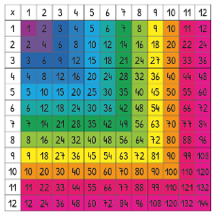
Year 4 Multiplication Tables Check 2026
Presentation for Parents, Carers & Guardians

Slide 2
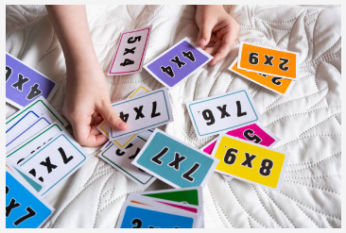
Multiplication Tables Check
As your child is now in Year 4, they will be participating in the multiplication tables check (MTC) in June 2026.
This is a statutory test put in place by Government and must be completed by all eligible children via an on-line assessment tool during the first two weeks in June.

Slide 3
Important Information about the Multiplication Tables Check (MTC)
The purpose of the MTC is to determine whether your child can fluently recall their times tables up to 12 x 12, which is essential for future success in mathematics.
It will also help us to identify if your child may need additional support in this area.
There is no ‘pass’ rate or threshold which means that, unlike the Phonics Screening Check, children will not be expected to re-sit the check.
The Department for Education (DfE) will create a report about the overall results across schools in England, not individual schools.

Slide 4
The National Curriculum
There is an expectation in the National Curriculum that:
Year 3 can, “Recall and use multiplication and division facts for the 3, 4 and 8 multiplication tables.”
Year 4 can, “Recall multiplication and division facts for multiplication tables up to 12 × 12.”
Having a secure grasp of the basics of maths, including the fluent recall of times tables, is crucial for children’s success in moving on to more complex maths.

Slide 5
Why has the Multiplication Tables Check been introduced?
Multiplication facts underpin a lot of maths knowledge:
Division
Fractions
Percentages
Multiplication
Number sequences
Many more!
Expectations from Y1 – 4 in the National Curriculum

Slide 6
When will the check take place?
There will be a 2 week window from Monday 1st June 2026 to Friday 19th June for schools to administer the check.
There is no set day to administer the check and children are not expected to take the check at the same time.
All eligible Year 4 children in England will be required to take the check.

Slide 7
How is the check carried out?
The check is an online assessment.
The children will answer questions by using a keyboard on a laptop or the on-screen number pad on an iPad.
Usually the check will take less than 5 minutes for each child.
The children will have 6 seconds from the time the question appears to input heir answer.
There will be a total of 25 questions with a 3 second pause in between questions.
There will be 3 practice questions before the check begins.

Slide 8
The Check Questions
Each child will be randomly assigned a set of questions
There will only be multiplication questions in the check, not division facts.
The 6, 7, 8, 9 and 12 times tables are more likely to be asked.
Reversal of questions (e.g. 8 x 6 and 6 x 8) will not be asked in the same check.
Children will not see their individual results when they complete the check.

Slide 9
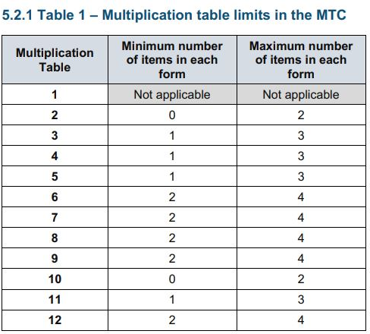
More information about the questions

Slide 10
What if my child cannot access the check?
There are several access arrangements available for the check, which can be used to support pupils with specific needs.
Your child’s teacher will ensure that the access arrangements are appropriate for your child before they take the check in June.
The check has been designed to be inclusive and accessible to as many children as possible, including those with special educational needs or disability (SEND) or English as an additional language (EAL).
However, there may be some circumstances in which it will not be appropriate for a pupil to take the check, even when using suitable access arrangements. If you have any concerns about your child accessing the check, you should discuss this with your child’s school.

Slide 11
Specific Arrangements for the check
Some children will be eligible for specific arrangements:
Colour contrast;
Font size adjustment;
‘Next’ button (alternative to 3-second pause);
An adult to input their answers;
Audio version;
Audible time alert.

Slide 12
Aims
Whole Class - to raise the MTC average attainment score from an Autumn term average of 10.19 and Spring Term of 13.92 beyond the National summer 2025 average of 21 by Summer 2026 37% Pupils achieved 25/25

Slide 13
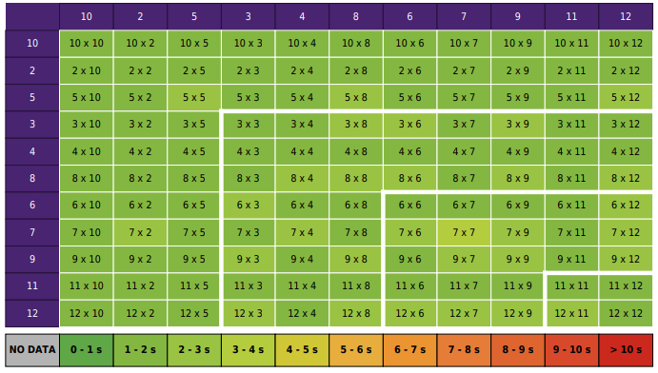
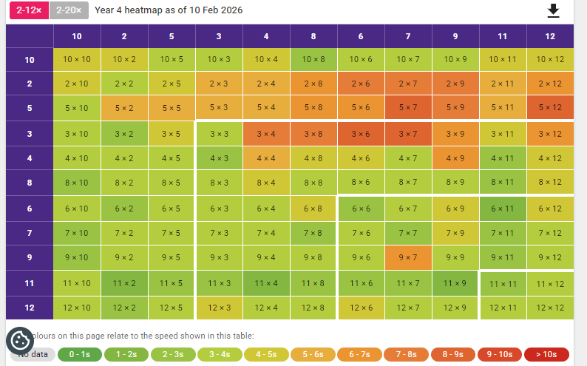
Heatmaps

Slide 14
Ways to support times table knowledge
Count and look for patterns.
Understand that multiplication is repeated addition.
Remember that multiplication is commutative.
Remember that multiplication is the inverse of division.
Recall and utilise number families.
Use different representations to represent multiplication, such as:
Concrete manipulatives suck as multilink cubes or counters.
Create pictorial representations such as arrays.

Slide 15

Counting and looking for patterns.
Example: Counting in 2s
2, 4, 6, 8, 10…
Ensure children have a strong understanding of counting in groups first.
When children are secure with counting, they can then look for patterns.
Notes:
Counting will start before beginning to develop understanding and reasoning but will continue long after, until all times tables can be counted through sequentially at speed.
Counting using manipulatives should start with physical objects (shoes, socks, hands etc) before moving on to counters etc
Whenever starting children counting in a new amount, such as counting in 8s, children should be given the opportunity to see visually what that looks like to reinforce 4 x 8 looks quite big compared to 4 x 6.
Patterns could be 4 x 8 is the same as 4 x 4 doubled.

Slide 16


Repeated addition
Knowing that 2 x 4 is the same as 2 + 2 + 2 + 2
2 + 2 + 2 + 2 = ?
2 x 4 = ?
Notes:
Children need experience of using concrete manipulatives such as counters or multilink cubes and pictorial representations of objects, forming arrays.

Slide 17


Multiplication is commutative
3 x 2 is the same as 2 x 3
Children need to understand that multiplication can be completed in any order to produce the same answer. Sometimes this link needs to be made explicit.
3 lots of 2 = 6
2 lots of 3 = 6
Notes:
Children build on their existing understanding using arrays, turning the arrays around to show that you now have 2 groups of 3 and they will still total 6. This can then be linked to recalling multiplication facts, e.g. if they know their 2 times table as facts but not their 3 times table, they can use 2 x 3 to work out 3 x 2.

Slide 18

Multiplication is the inverse of division
20 ÷ 5 = 4 can be worked out because 5 x 4 = 20
Using pictorial representations (such as arrays) is useful here for children to see the link between multiplication and division.
Notes:
Even though division is not tested in the MTC, it is important that pupils have a strong understanding of the connection between multiplication and division.
Again, the use of arrays is key. Children need experience of pulling arrays apart into groups or sharing. After basic experience has been gained, the children should start to ‘see’ an array structure as 5 groups of 4 equal 20 and 20 can be split into 5 groups of 4.

Slide 19
Number families
4 x 5 = 20, 5 x 4 = 20, 20 ÷ 5 = 4, 20 ÷ 4 = 5
Due to their commutative understanding, children should also be able to see whole number families. For many children this will need to be pointed out and discussed.
20
4
5
Notes:
From here it is only a short jump to understanding that any missing number can be worked out through knowledge of number families, e.g. 4 x [ ] = 20 or [ ] ÷ 4 = 5. There are other methods children can use to work out missing numbers but our goal is to increase working memory in order to increase instant recall from long term memory. Being able to bounce around a number family will achieve that.

Slide 20
Using known facts
4 x 6 = ?
I know 4 x 5 = 20
Therefore, 20 + 4 = 24
By using known facts from ‘easier’ times tables, children should be able to find answers with increasing speed.
+

Slide 21
Daily Practice
In school, we practise daily.
Some children requiring additional practice will be invited to attend booster sessions which will take place over some lunchtimes.
We will send you periodic updates on the progress your child is making with their times tables in the form of ‘heat maps’.
Your child’s score is not published but will be communicated to schools after the MTC and will be included on school reports.

Slide 22
How best to prepare your child for the check
Remind them that the check should last no more than 5 minutes.
If you want to go over times tables, make them fun.
If you have any concerns, talk to your child’s teacher.
If your child has any concerns, encourage them to talk to a trusted adult (for example, yourself, their teacher).
If you’re looking to support your child further with maths at home, there are lots of good websites with free resources.
- https://ttrockstars.com/
- https://www.timestables.co.uk/multiplication-tables-check/
- https://mathsframe.co.uk/en/resources/resource/477/Multiplication-Tables-Check
- https://talkingtimestables.uk/y4_ks2_mtc_practice_tests_multiplication_tables_check.php
Notes:
Games to try:
Climb the stairs counting in multiples
Play time tables games verbally.
Listen and sing along to times tables songs.
Take it in turns to say times tables in funny voices.
Play maths games online.

Slide 23
What can you do to support your child?
Play games with your child to support their recall of times table facts
Ensure children are constantly revisiting their times table facts from previous weeks to ensure they develop fluency in all facts
Support and encourage your child – ask them questions about their progress on TTRS
TTRS Battle of the bands

Slide 24
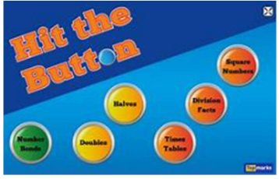

Useful websites
Multiplication Tables Check - 2025 - Timestables.co.uk
https://www.topmarks.co.uk/maths-games/hit-the-button
Multiplication Tables Check – Mathsframe
These websites replicate the check with great accuracy
Times Tables Rockstars is an online programme to support children with securing fluent recall of multiplication and division facts.
Go onto TTRS for 5 minutes a day.

Slide 25

Thank you for taking the time to attend!

