Slide 1
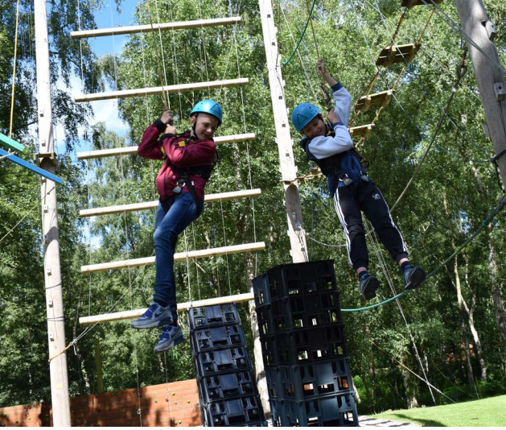
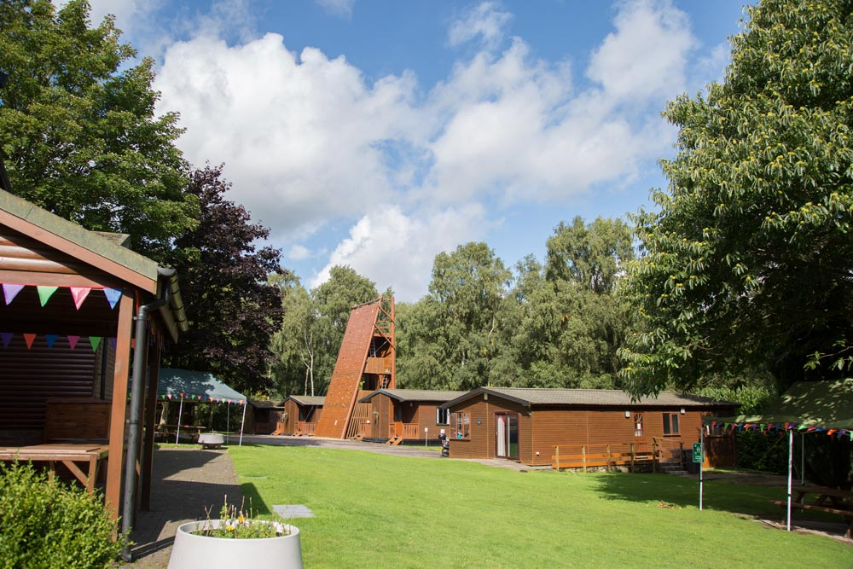
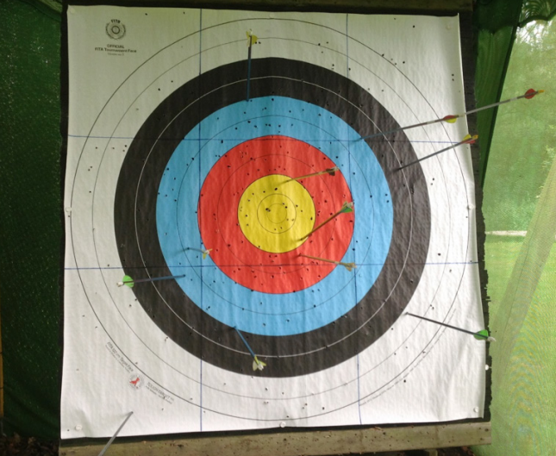
Petty Pool Outdoor Centre
(Venturewood)
Year 3 Residential 2026
Wednesday 25th March – Thursday 26th March 2026

Slide 2

Why Petty Pool?
Wide range of activities for children to experience.
Focus on team building skills
Focus on resilience and independence
Just around the corner!

Slide 3
There are a wide variety of activities available including climbing, crate stack, leap of faith, zip line forest walks, archery, problem solving and team building.
The children will work in 3 groups and will be encouraged to push their boundaries by getting involved in the challenges presented to them.
They will not be forced into participation.
Excellent leaders and the support of their peers is often enough to give less confident children the incentive to have a go. Each group will also have an allocated adult from St. Wilfrid’s.
Miss Kirkham, Mrs Watts and Mrs Jackson

Slide 4
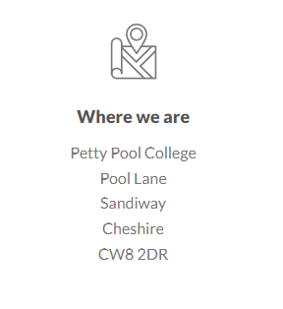
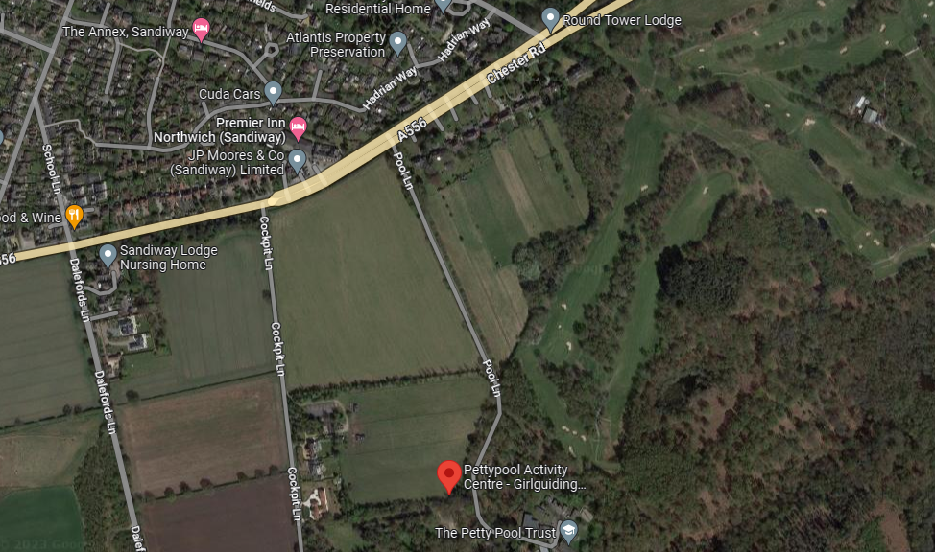
Wednesday 25th March
Drop off at 9:45
Not earlier due to traffic
Packed Lunch *NUT FREE SITE* and refillable water bottle needed for the first day
Blue Cap Restaurant
Notes:
Explain drop off to save on cost
Explain traffic on campus

Slide 5
Thursday 26th March
Pick up 14:00
Blue Cap Restaurant
Notes:
Explain drop off to save on cost

Slide 6
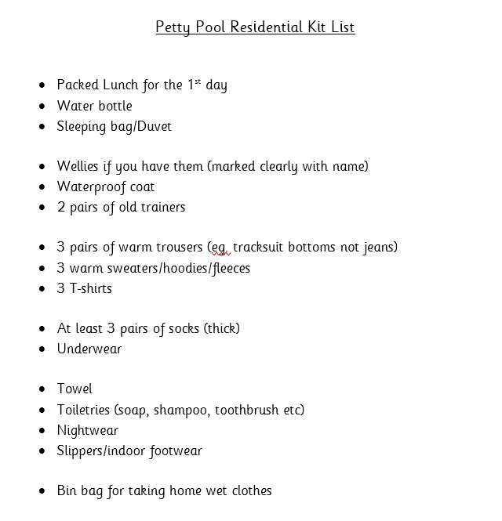
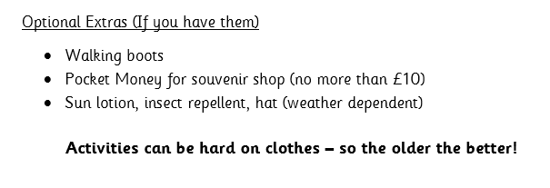
Each child can only bring one bag or suitcase.
The children have to carry their own bags around the centre so a case with wheels or a carry strap is preferable.

Slide 7
Children are not allowed to bring mobile phones, cameras or electronic games and equipment (including watches) on the trip.
Children may wish to bring a teddy or a book to read at night before going to sleep – their own responsibility to look after.

Slide 8
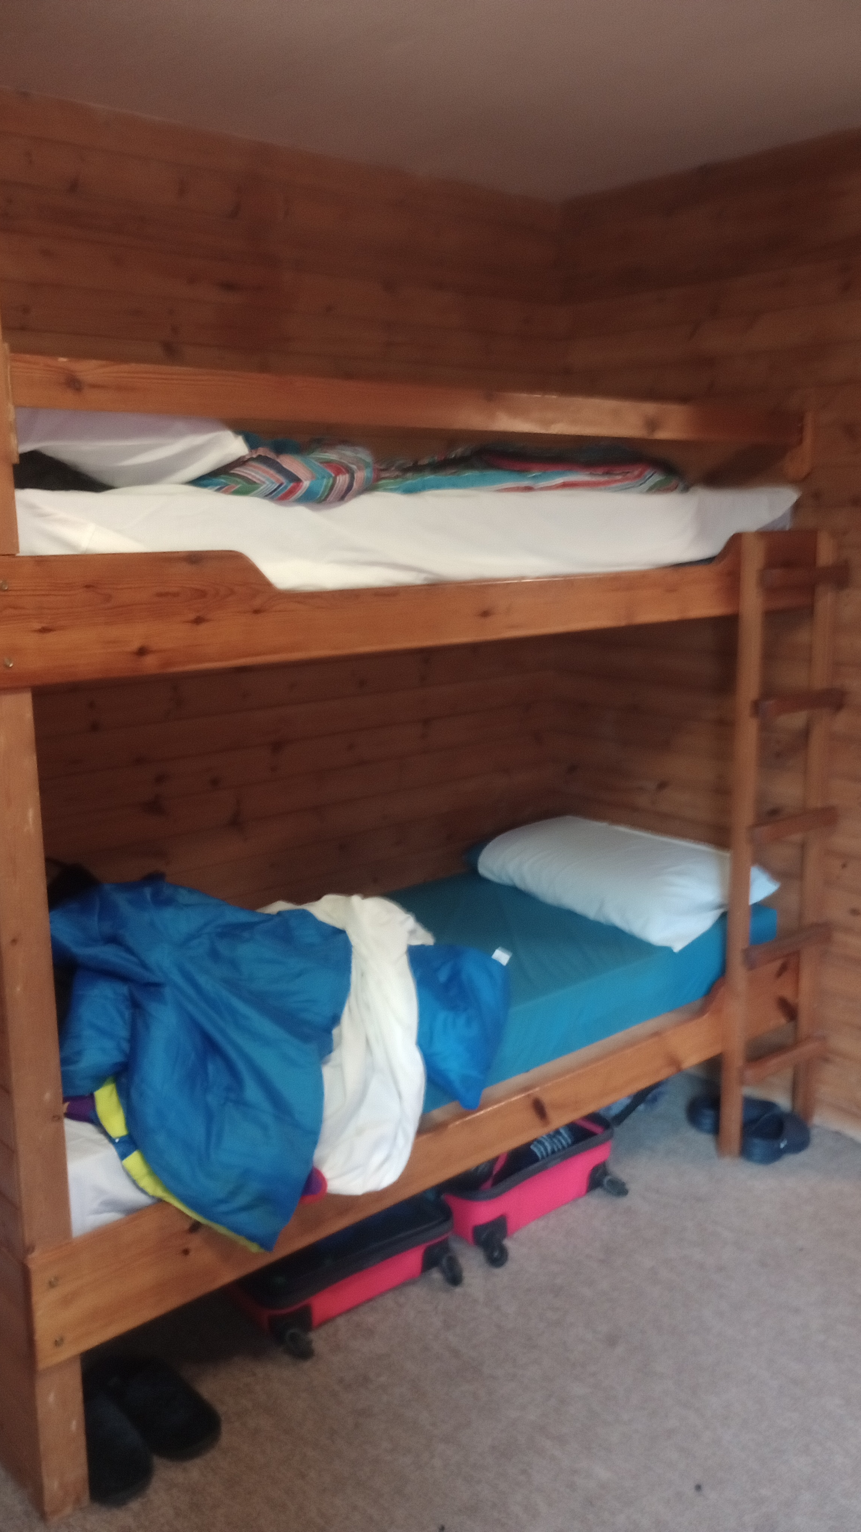
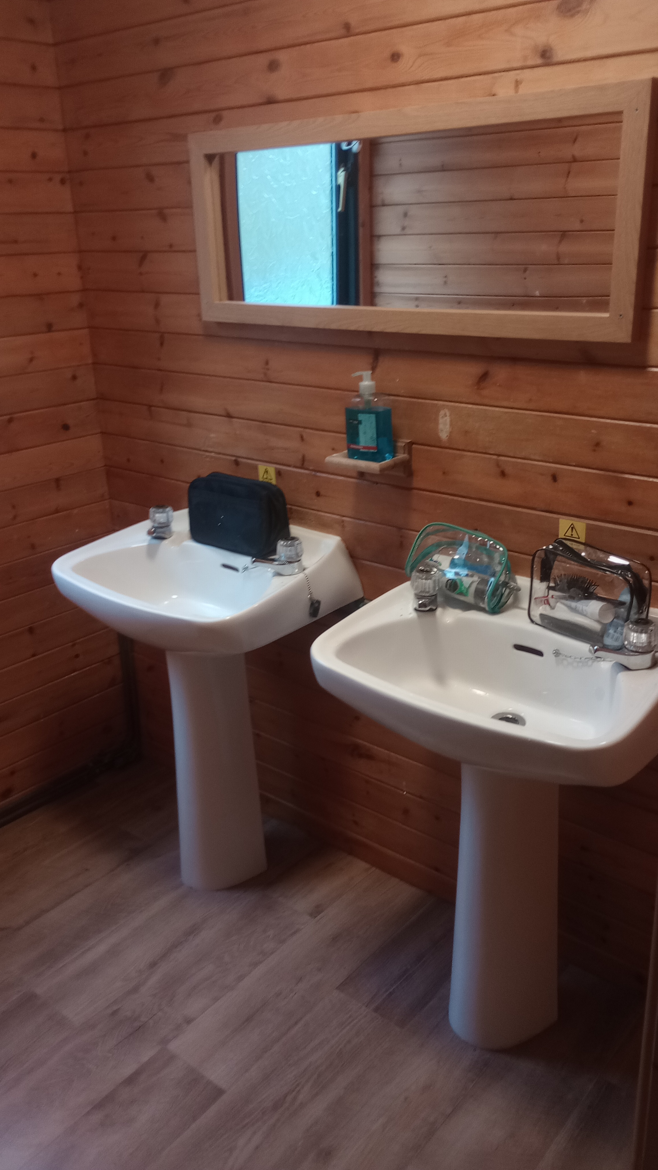
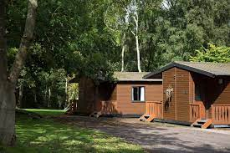
SLEEPING ARRANGEMENTS
Log cabins
Sleeps 4
En-suite bathroom
Very spacious and comfortable
24h Duty Officer
Secure grounds
Children will be asked to write a list of people they’d like to spend time with.
They will be with at least one of these children in their bedroom
Notes:
At night there is a member of staff from the centre on duty as well as the teaching staff and our volunteers.
The children can secure their bedroom doors from the inside and are able to open the doors easily should there be an emergency.
Only centre staff and adults accompanying the group can access the rooms should they need to.

Slide 9
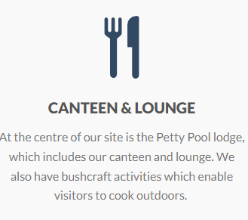
Meals are served in a cafeteria style.
Excellent daily meals. Don’t worry about fussy eaters! They will not go hungry.
Children are also given the opportunity to help with making their own packed lunch for day 2.
Notes:
Examples – pasta, fish and chips, burgers
Hot breakfast options

Slide 10

There is a gift shop at the centre so the children may wish to bring some spending money.
We suggest an amount between £5 and £10 which should be in change rather than notes.
In a named purse/wallet

Slide 11
FORM C – School’s medical form has been sent out.
Please complete and return.
Medication
Any medication should be handed to Miss Kirkham on the day of arrival please make sure that it is labelled with the child’s name and with clear instructions.
These will be distributed as appropriate each day. Members of staff will keep a record of any medication that’s distributed.
If your child has an inhaler please make sure it is handed to a member of staff and that it will last for the two days
Permission for paracetamol/ibuprofen – This has already been given to the school and the list that has been collated by the office will be used.

