Slide 1

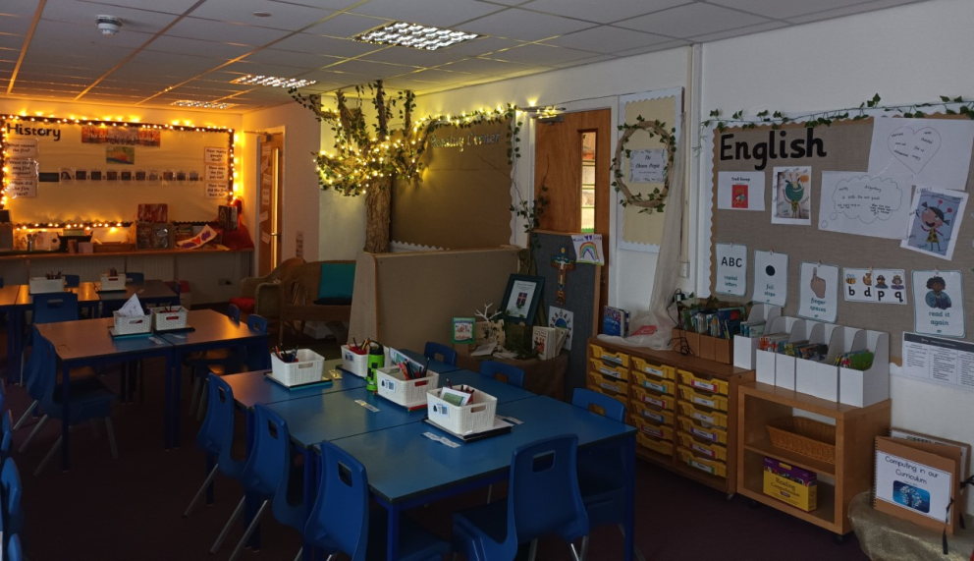
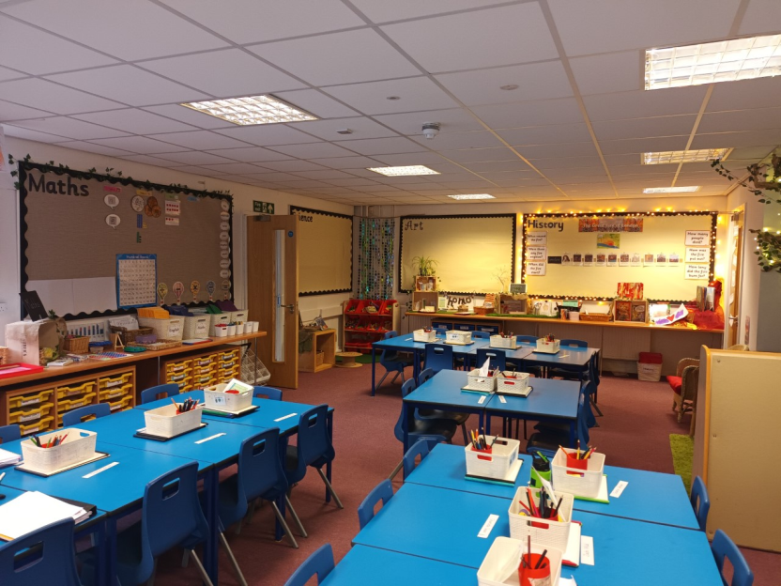
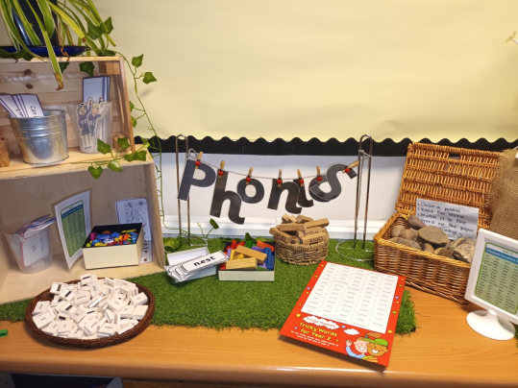
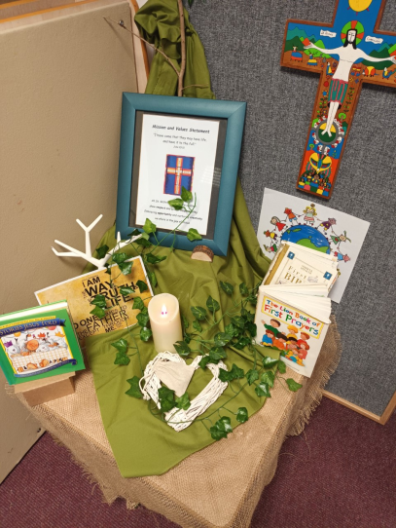
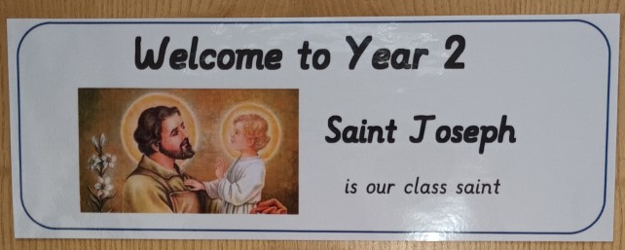
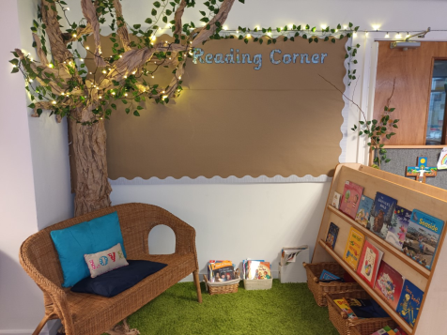

Welcome to Year 2
Love ~ joy ~ responsibility ~ creativity ~ respect ~ opportunity

Slide 2
It has been so lovely meeting you on the playground at home time.
The children have settled into Year 2 so wonderfully and are already working very hard.
We hope this power point helps you to learn a little bit of information about
Year 2.

Slide 3
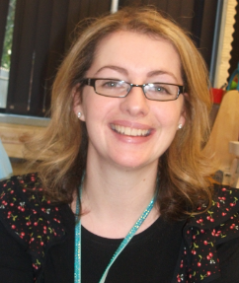
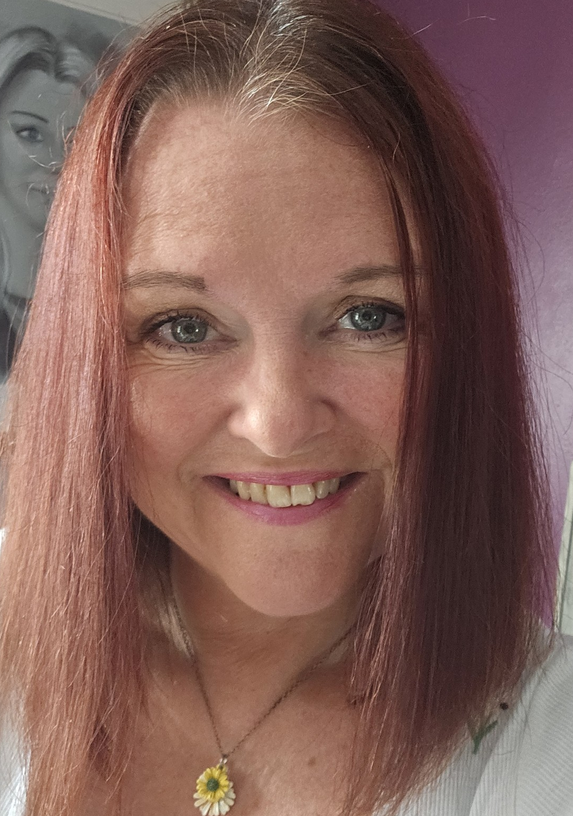
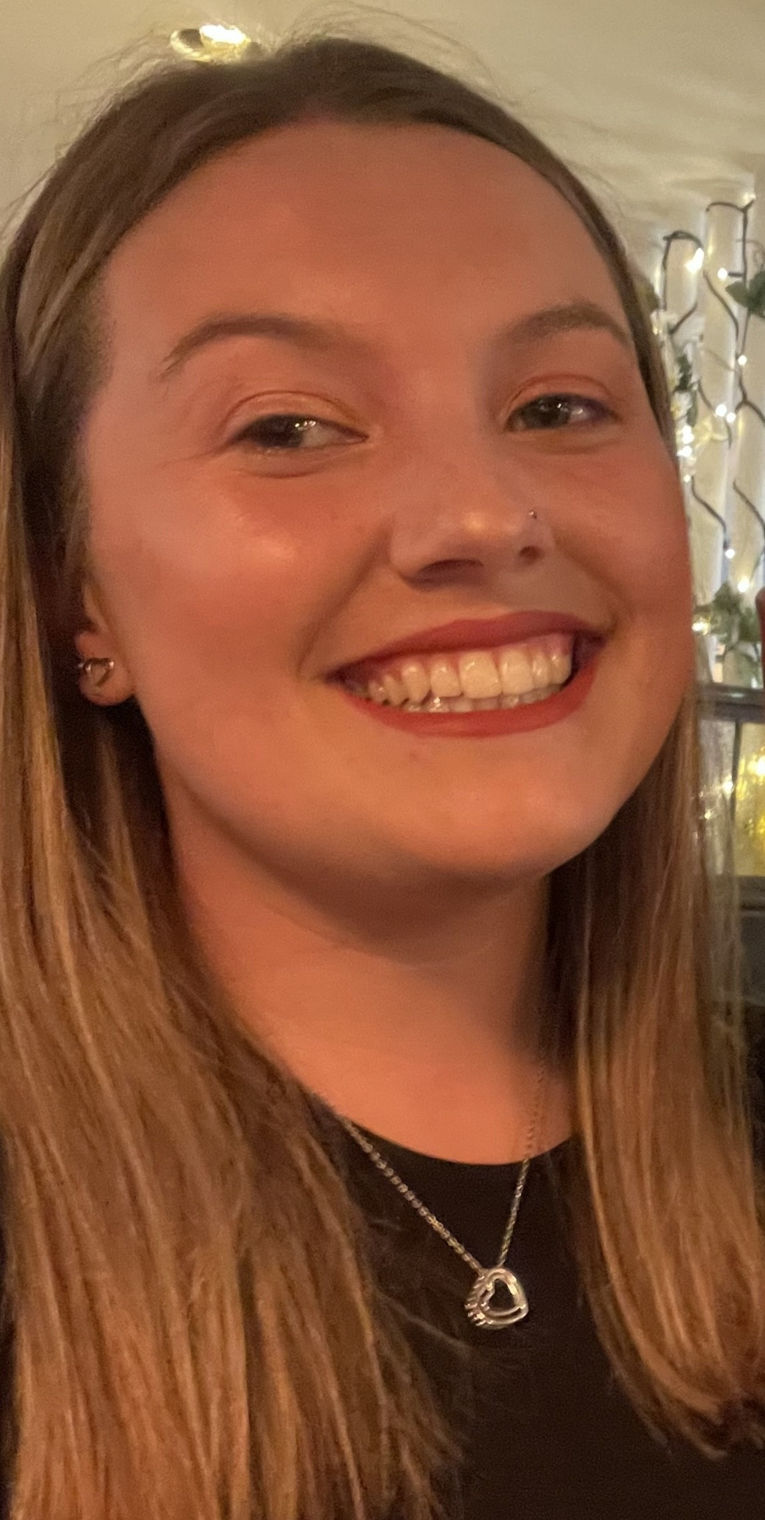
The staff
Mrs Bold
Mon-Weds
Mrs Griffiths
Weds-Fri
Miss Jones
Teaching Assistant

Slide 4
This year is all about…
Building on the independence your child has already developed during their time in the Foundation Stage and Year 1
Help your child to grow, develop and achieve their potential in all areas
Build strong friendships and enjoy their learning

Slide 5
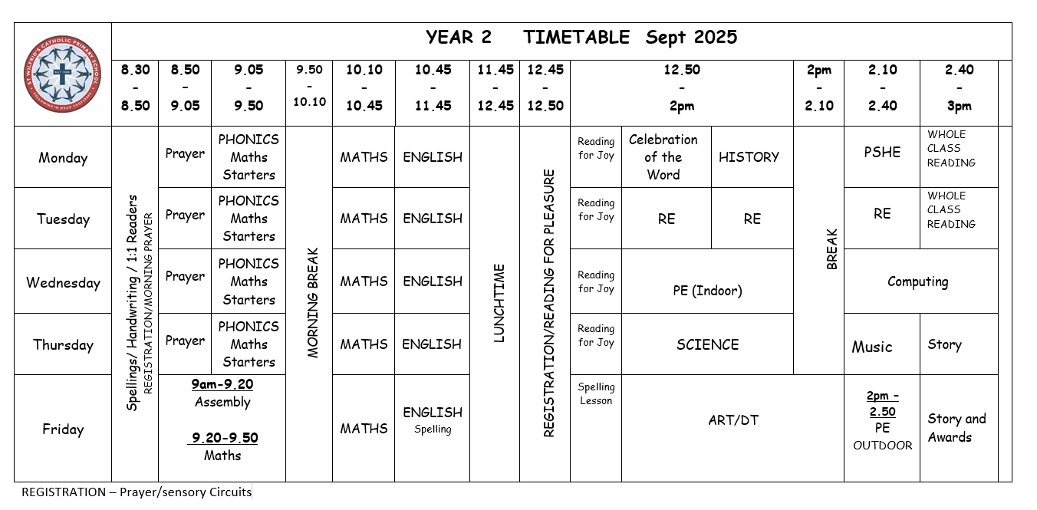
Our Year 2 timetable…..
PE
Wednesday and Friday
First history theme: Great Fire of London

Slide 6
How you can help…..
Being secure in number bonds to 10/20
TIMES TABLES - counting in twos, fives, tens and threes
SPELLINGS – weekly spellings and common exception words
TALKING – asking them about what they have been doing at school
READING – reading with your child at home every day and
asking them questions about the text

Slide 7
Equipment….
PE kit – blue school PE shorts, red T-shirt with logo,
Water bottle
Bag for reading book, reading diary, letters, tissues
No toys or personal belongings are to be brought to school

Slide 8
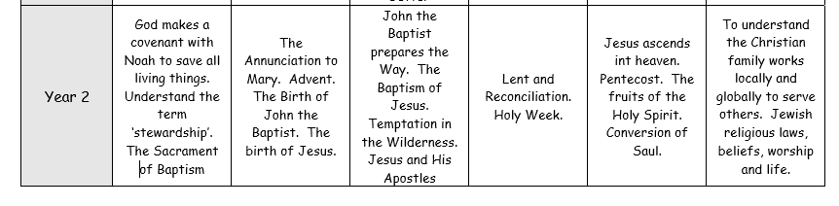
Religious Education
In RE we follow the New RE Directory ‘To Know You More Clearly’ and use the resource prescribed by the diocese; ‘The Vine and the Branches.’
In Year 2 this year we will be learning…
Branch 1 Creation and Covenant | Branch 2 Prophecy and Promise | Branch 3 Galilee to Jerusalem | Branch 4 Desert to Garden | Branch 5 Ends of the Earth | Branch 6 Dialogue and Encounter

Slide 9

Reading at home…
The expectation is that you read with your child read every day. If there is resistance, try to read to them for a period first to build the love of a shared story / book. Please write the date and a comment in their Reading Diary.
Keep reading sessions short (unless your child wants to carry on) and enjoyable.
Read a variety of texts. Be led by what your child wants to read.
Your child will come home with a phonics phased decodable book to read to you. This book will be changed once a week. We ask that these books are read at least four times a week in order to reinforce the vocabulary, phonetic decoding and fluency.
Your child will also be able to bring home a ‘Reading for Joy’ book. This is for you to read, share and enjoy together with your child. This will expose children to a wider range of vocabulary. These books can be changed by your child each week.
Talk about books and don’t forget to let your child see you reading for pleasure

Slide 10
Reading…
Children will read regularly to the teacher and/or teaching assistant. This may be during a guided reading session, as a whole class or individually with an adult.
All children in Y2 will take part in whole class reading sessions throughout the week.
Children will read a variety of genres: poetry, story, information texts.

Slide 11
Writing…
We use the resource Pathways to Write
Children are building on what they already have learnt in Year 1, writing in full sentences, starting with a capital letter, clear finger spaces, full stops and correct letter formation.
Spelling – learning and applying
SPaG – learning rules and applying
Variety of genres
Independent editing of work – spotting mistakes and correcting these, eg, adding in punctuation.

Slide 12
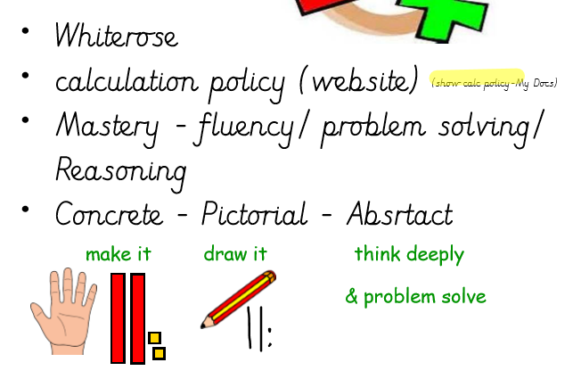
Maths…
We are following the White Rose scheme to plan and prepare lessons.
Calculation Policy – website (under revision)
The maths sessions will use the mastery approach - fluency
- problem solving
- reasoning
Concrete Pictorial Abstract

Slide 13
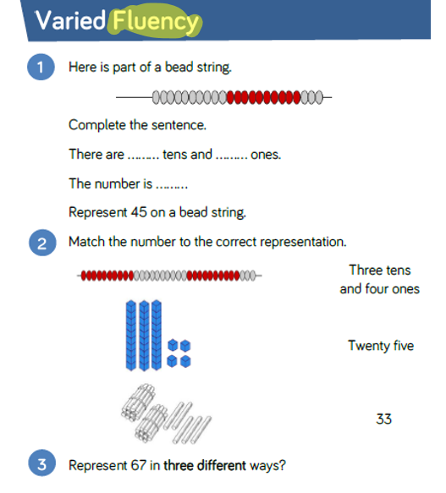
For example

Slide 14
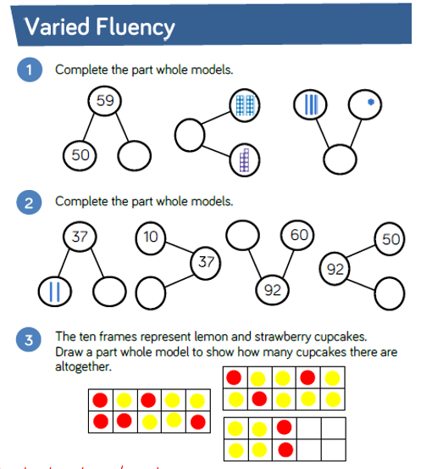

Slide 15
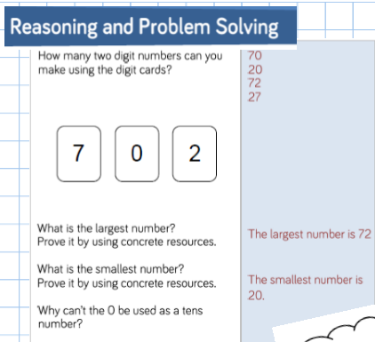

Slide 16
Assessment…
Phonic assessments
Independent writing
NFER (reading comprehension) and NFER (maths) assessments each term
On going teacher assessments
End of Year Assessments- Reading, Maths, Writing
Phonics Screening Check for those children who scored below 32 in Y1. (June)

Slide 17
Assessment continued…
Working towards - yet to be secure in the end of year expectations
ARE (Aged related expectations) Expected / Meeting - secure in the majority of the end of year expectations
Exceeding / Greater Depth - secure in almost all or all the end of year expectations and is able to use and apply their knowledge and skills confidently.

Slide 18
Homework…
For Autumn 1 the homework will be as follows…
Daily Reading
Spelling sheet to be practiced at home
*** Homework is to be done WITH your child, they will need support ***

Slide 19
Thank you for taking the time to learn all about Year 2. Please email any questions to admin@st-wilfrids.cheshire.sch.uk and we will get back to you as soon as possible.

