Slide 1
St Wilfrid’s Catholic Primary School
Reception information
about Reading and Phonics

Slide 2
Aims of the Power point
To provide knowledge of how early reading and writing is taught at school.
To explain how phonics is taught at St Wilfrid’s Catholic Primary School.
To provide you with information on how we would like you to support your child at home.
To discuss the end of year expectations for Reading and Writing.

Slide 3

Everything starts with reading

Slide 4

Being able to read is the most important skill children will learn during their early years.

Slide 5
In Reception we are laying the foundations for future learning. Through our phonics sessions we focus on 5 skills.
5 Basic Skills
1. Learning phonemes (letter sounds)
2. Letter formation
3. Blending for reading
4. Segmenting- identifying sounds in words for spelling
5. Recognising harder to read words by sight

Slide 6
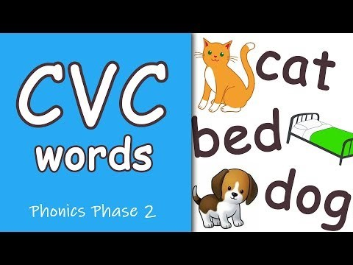
An example video of blending.

Slide 7
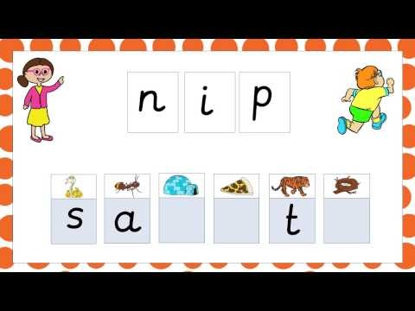
An example video of segmenting.

Slide 8
What is phonics?
Phonics is the link between letters and the sounds they make.
Using a highly structured programme working through progressive phases, children are taught:
*The full range of common letter/ sound correspondences.
*To hear separate sounds within words.
*To blend sounds together.

Slide 9
Key definitions
Phoneme- The smallest unit of sound in a word.
Grapheme- What we write to represent a phoneme (sound in a word) for some phonemes this could be more than one letter.
e.g. t ai igh
Digraphs- A digraph is a single sound, or phoneme, which is represented by two letters e.g. ai, oa.
A trigraph is a phoneme which consists of three letters e.g. igh, ear, air.

Slide 10
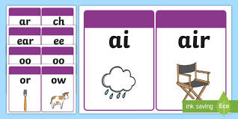
Digraphs
(two letters that make one sound)

Slide 11
1. Learning the phonemes (letter sounds)
We begin at Phase 2. The phonemes are taught in the following order.
Letter progression (one set per week)
Set 1: s a t p
Set 2: i n m d
Set 3: g o c k
Set 4: ck e u r
Set 5: ss, h b f, ff l, ll

Slide 12
Phase 2
The purpose of this phase is to teach at least 19 letters, and move children on from oral blending and segmentation to blending and segmenting with letters.
By the end of the phase many children should be able to read some VC and CVC words and to spell them either using magnetic letters or by writing the letters on paper or on whiteboards.
During the phase they will be introduced to reading simple captions. They will also learn to read some harder to read words words: the, of, no, is

Slide 13
Phase 3
Set 6: j v w x*
Set 7: y z, zz qu*
Consonant digraphs
ch sh th ng nk
Vowel digraphs
ai ee igh oa oo ar or ur oi ear
air ure er

Slide 14
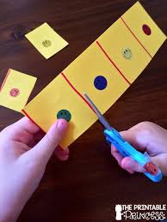
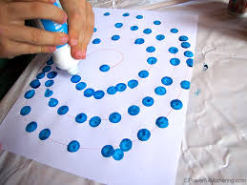
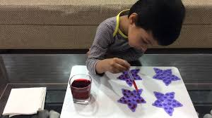
2. Letter formation
As we teach each phoneme we will teach the correct letter formation. We use lots of visual resources and kinaesthetic activities. We will be introducing a physical session where we will practise letter formation and set up lots of activities to develop fine and gross motor skills.

Slide 15


Tripod grip
Establishing the correct pencil grip is essential.

Slide 16
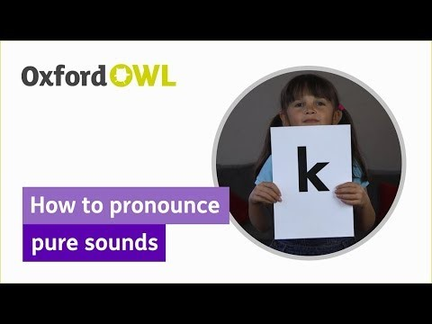
Blending
Oral Blending
Over the next few weeks we will be doing lots of oral blending activities and games.
Blending for reading

Slide 17

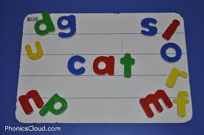
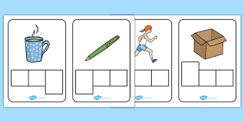
4. Segmentation for spelling

Slide 18
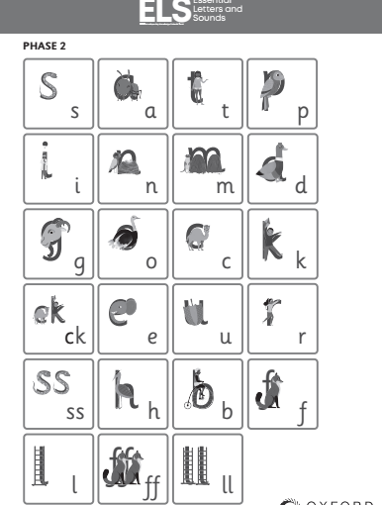
Phonemes in phase 2

Slide 19
Reading Books
We will be sending home reading books this week as we begin our phonics teaching.
Your child will have a book with no words, please encourage them to tell the story in their own words using the pictures. This develops imagination, story language and story structure.
When your child has a book with words, please encourage them to decode cvc (consonant, vowel, consonant) words. If they find this difficult they can look at the initial sound and use the pictures to help them. Your child will begin to sight read the difficult words.

Slide 20
Reading in the Reception class
At St Wilfrid’s we have phonically decodable books that the children will read in school. We will send home the books for them to read at home to increase their fluency.
They are banded into different colours and the children progress through the colours. Children are expected to read the book 4 times before we change it.

Slide 21
Top Tips for reading success
Calm, comfy spot
Shouldn’t be a stressful experience
Shouldn’t be rushed
Don’t always need to read the whole book in one go (reading fatigue- share the book read alternate pages to develop stamina. Focus on a few pages and talk about the characters, setting and plot in a lot of detail
Important to re-read the same book to develop confidence
Try to develop comprehension skills
Read a range of texts

Slide 22
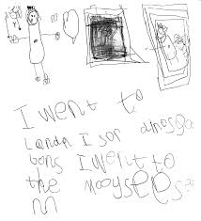
Independent writing
To be able to write independently children need to know;
The 44 letter sounds
How to hear the sounds in words
One way of writing the letters for the sounds
What they want to say
They also need to be able to form each letter accurately .

Slide 23
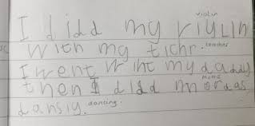
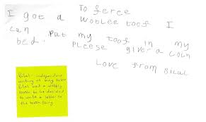

Slide 24
How we promote the development of early writing at St Wilfrid’s
Daily Phonics sessions
Daily physical sessions, play dough gym
Encouraging children to engage in emergent writing
Role play areas
Writing display board
* Please encourage your child to practise writing their name at home.

Slide 25
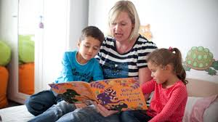
How you can help your child at home
Regularly listen to your child read at home and make a comment in their reading record.
Ask your child questions about what they have read.
Help your child to make the words that are sent home each Friday using the phoneme cards. (Beginning Friday 22nd September)
Regularly read stories to your child so they develop a wide vocabulary.

Slide 26
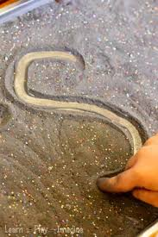
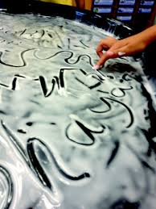
Ideas for reluctant writers

Slide 27
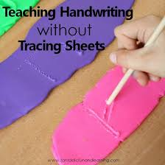
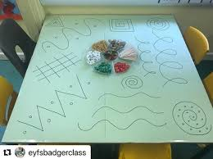
Ideas for reluctant writers

